Slide 1
Advancing PDMP-EHR Integration
Deliverable 1: Kick-Off Meeting
Thursday, October 25, 2018
Submitted by Accenture Federal Services

Slide 2
Agenda
Discussion Topic | Allotted Time
Meeting Purpose | 5 min
Introductions & Project Team | 10 min
Project Purpose | 2 min
Technical Approach Timeline Tasks and Deliverables | 20 min
Project Communication Plan | 3 min
Reporting Requirements | 3 min
Risks and Assumptions | 5 min
Questions/Discussion | 10 min
Next Steps and Action Items | 2 min

Slide 3
Meeting Purpose
Kick-off the Advancing PDMP-EHR Integration project
Ensure agreement on:
  Project objectives
  Common understanding of roles and responsibilities
  Timelines across tasks
Introduce project team members
Discuss outreach to technical demo sites

Slide 4




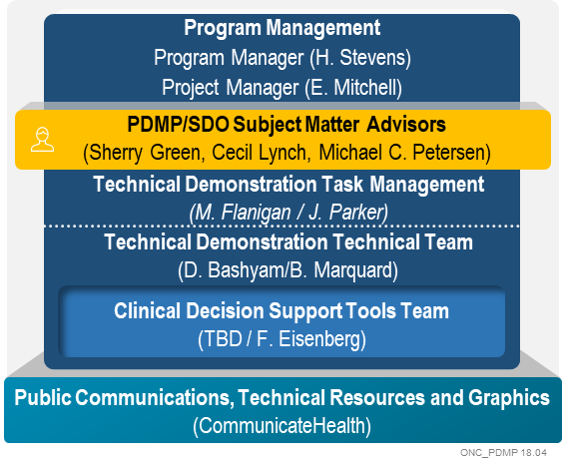
Introductions & Project Team
ONC
Margeaux Akazawa
Mera Choi
Caroline Coy
CDC
Jan Losby
Wes Sargent

Slide 5
Project Purpose
Problem Description:
PDMPs continue to be among the most promising state-level intervention to improve opioid prescribing, inform clinical practice, and protect patients at risk.
However, challenges to PDMP and EHR integration remain and PDMP interoperability has not been widely achieved. Specific recommendations have been made for federal action to improve the interoperability of EHRs and PDMPs and to make PDMP data more easily accessible.
The purpose of this work is to expand upon previous and leverage input from current federal efforts to advance and scale PDMP integration with health IT systems. This includes:
testing and refining standards-based approaches to enable effective integration into clinical workflows,
exploring emerging technical solutions to enhance access and use of PDMP data
providing technical resources to a variety of stakeholders to advance and scale the interoperability of health IT systems and PDMPs,
incorporating policy considerations as relevant, to inform the implementation and success of integration approaches
Source: Advancing PDMP- EHR Integration RFP –Section 2.3 Purpose

Slide 6
Technical Approach
While working to complete the various contract tasks and deliverables, our team will strive for:
Frequent internal communications and collaboration
Close tracking of timeline, deliverable status, budget, and risks
Apply expertise from past ONC and PDMP projects, building on and advancing existing work efforts
Focus on stakeholder needs
High-quality deliverables

Slide 7
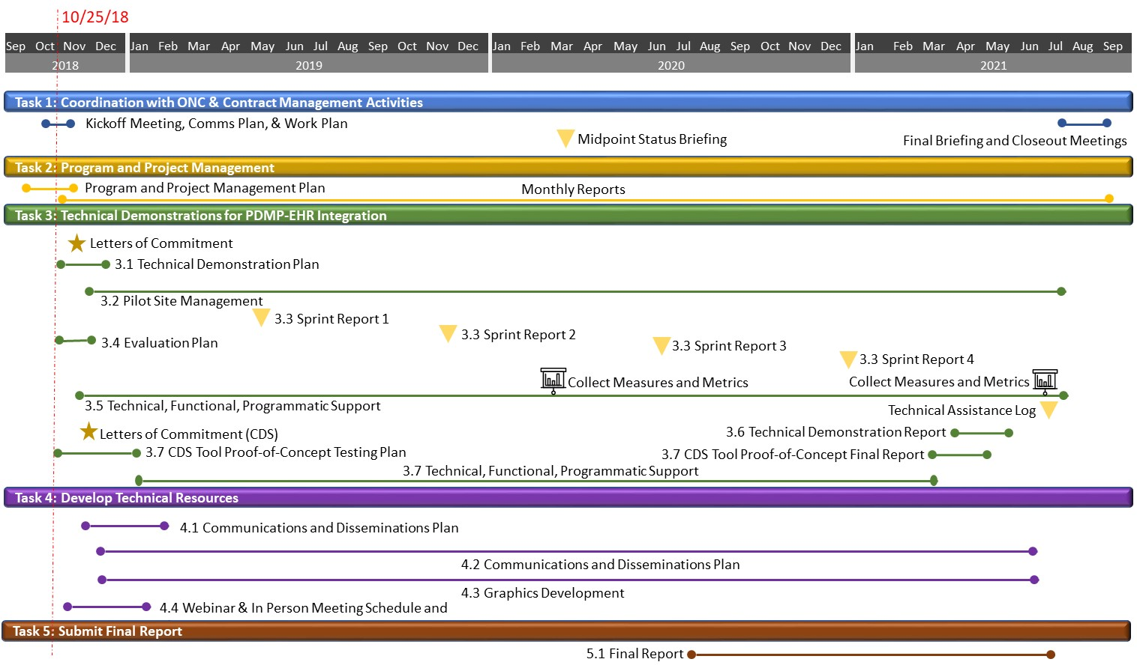
Timeline and Deliverable Tracker

Slide 8
Key Contractual Dates
Contract Award: 9/26/2018
POP: 9/15/2018 - 9/14/2021
Kick-off Meeting: 10/25/2018
Upcoming deliverables:
  Kick-off meeting minutes/final materials (1.1)
  Weekly Status Report/Meeting: 10/29/18 and 10/30/18 (Proposed)
  Monthly Status Report: 11/15/18
  Project Approach and Work Plan (1.2) and Program and Project Management Plan (2.1A)
  Letters of Commitment (3.1A and 3.7A)
  Draft & Final Evaluation Plan (3.4 A & B)

Slide 9
Task 1: Coordination with ONC & Contract Management Activities
Activities
Initiate project activities
Facilitate project kick-off meeting, recurring status meetings
Develop schedule, deliverables, milestones
Ensure ongoing project communications
Support development of agendas, visual aids, presentation materials and meeting minutes
Ensure effective closeout of project
Deliverables
Kick-off Meeting (1.1)
Project Approach and Work Plan (1.2)
Weekly Progress Reports (1.3)
Briefings (1.4)
Closeout Meeting (1.5)

Slide 10
Task 2: Coordination with ONC & Contract Management Activities
Activities
Manage budget, risks, scope, communication, and schedules
Provide monthly report of activities, issues, and budget
Define control processes and performance metrics
Deliverables
Program and Project Management Plan (2.1A)
Monthly Progress Reports (2.1B)
Program and project management activities (2.1C)

Slide 11
Task 3: Technical Demonstrations for PDMP and Health IT Systems Integration
Activities
Pre-selection and planning
Retrieve commitments and conduct kick-off site meetings
Outline goals and scope for each site and sprints
Manage sprints
Document workflows, standards, solutions
Update tech specs; work with SDOs
Define CDS work and manage Proof of Concept (POC)
Deliverables
Letters of Commitment (3.1/3.7)
Tech Demo Plan & Kick-off (3.1)
Weekly Tech Demo Reports (3.2)
Sprint Reports (3.3)
Evaluation Plan (3.4)
Metrics and Data Collection and Reporting (3.4)
Tech Assistance Log/Summary (3.5)
Final Tech Demo Report (3.6)
CDS POC testing Plan and Report (3.7)

Slide 12
Task 4: Develop Technical Resources
Activities
Abstract findings from Technical Demonstration Sprints
Develop and execute public communications and disseminate collateral
Create communications plan
Support graphics development
Support webinar and in-person meetings
Deliverables
Public Communications and Dissemination Plan (4.1)
Technical Resources and Content development (4.2)
Graphics Development (4.3)
Webinar Series Plan and Schedule (4.4)
In-Person Meeting Plan and Support (4.4)
Meeting Evaluation (4.4)

Slide 13
Task 5: Final Report
Activities
Analysis of Sprint reports, site coordination, and communications activities, including feedback from COR
Address questions from stakeholders and next steps/guidance
Presentation of project and expansion areas to ONC and CDC leadership and staff
Deliverables
Final Report (5.1)

Slide 14
Project Communication Plan
PM and Team will ensure transparent, continuous, and timely communications across project stakeholders through internal project team meetings & emails as well as status meetings with ONC, CDC, and Demonstration sites as relevant
Primary contract correspondence between Project Manager and COR
ONC
COR: Margeaux Akazawa
CDC
Ongoing communications for cohesion across full project team and stakeholders
Demonstration Sites
Confluence Site has been created for sharing meeting materials, updates, schedule, minutes, and other materials for deliverables
  Plan to use for internal team file sharing while drafting reports and deliverables
  Formal deliverables will be provided by the PM to the COR via email and made available to team members on the Confluence site
Notes:
https://oncprojectracking.healthit.gov/wiki/display/TechLabSC/Advancing+PDMP-EHR+Integration+Project+Home

Slide 15
Reporting Requirements
Proposed Schedule for reporting requirements
Submit routine weekly status reports each Monday to Margeaux (24 hours prior to meeting)
Weekly status meetings each Tuesdays with Margeaux; biweekly with CDC
  Routinely track status of deliverables via Deliverable Tracker (.xls) as part of status discussion
Monthly Status Reports to Margeaux
  Due 15th of each month, starting in November
Briefings:
  Briefings to be developed as needed throughout contract
  Are there any specific briefings we should begin planning for?

Slide 16
Risks and Assumptions
Potential Risks | Management/Mitigation of Risks
Lacking EHR Vendor Support for Integration | Examine proposed technical demonstration sites to understand organizations that have strategies around EHR vendor support to enable PDMP-EHR integration. (e.g. APIs and compatible interfaces)
Complexity due to Variability in Demo Site Status, Schedules | Develop and execute a detailed work plan to manage six simultaneous/four sequential six-month development sprints across the Technical Demonstration sites. Work with ONC/CDC and the sites to provide transparent and accurate reporting of progress. Scope and expectations for integration and interstate data sharing should be clearly defined.
PDMP/EHR Business Use Agreement Readiness | Verify established business use agreements are in place for the Technical Demonstration site before selection into the program.
Technical Capabilities of ecosystem | Systems will have reliance in intermediaries for EHR and PDMP connections. Successful integration for our demo sites require technology to be in place. Work with sites to understand what technology and data use agreements are in place from the beginning and plan demonstrations accordingly.
Project timelines | Ensure ongoing communications on status of deliverables and progress. Validate acceptance criteria with COR in advance of due dates to ensure compliance and reduce need for rework. Plan schedule to accommodate review process as needed.
Project budget | Establish reasonable budgets with demonstration sites up front and closely manage costs throughout project lifecycle.
Assumptions:
Letter of commitment is a soft agreement, not a formal contractual commitment. Finalizing contracts will extend past the date specified for letters of commitment.

Slide 17
Questions and Discussion
Discuss States provided as preliminary demo sites (refer to list in appendix)
Team would like to understand any selection criteria applied to date. Possible considerations:
  EHR vendor balance across the sites
  PDMP vendor balance across the sites
  Availability of technical resources for the sites
  Current status and maturity of selected sites
  Ability to share data with other states
Discuss expectations for current and to-be capabilities for these sites (e.g. how do we define “integration,” and how broad of an interpretation can be applied for variations in site capabilities?)
Outreach approach
  Are there specific recommended contacts from each state that the CDC has been working with?
Administrative:
HHS Badges

Slide 18
Next Steps and Action Items
Next Steps:
  Compile Kickoff notes and resubmit with final Kickoff deck
  Schedule working session to further discuss demo sites (if needed)
  Outreach to demo sites
  Begin posting work products to the Confluence site
Begin/continue work on Upcoming Deliverables:
Weekly Status report due 10/29; Monthly report due 11/15
Project Approach and Workplan
Evaluation Plan
Letters of Commitment
Upcoming Meetings:
Weekly status meeting on 10/30 (tentative)
Annual Meeting Nov 29-30

Slide 19
APPENDIX
Preliminary list of Demo Sites provided by ONC
Project team member contact information
Project team member roster

Slide 20
Preliminary List of Demonstration Sites (provided by ONC)
These states represent a range of high technical capacity/high burden to low capacity.
High Capacity (also High Burden)
Kentucky
West Virginia
Moderate Capacity
Nebraska
California
Low Capacity
New Hampshire
Georgia
Electronic Clinical Decision Support states are:
Illinois
Utah

Slide 21
Project Team Member Contact Info (Core Team Members)
Name | email | Phone number
Emily Mitchell (Primary Point of Contact) | Emily.d.Mitchell@accenturefederal.com | Cell: 415-377-9388
Heather Stevens | Heather.m.stevens@accenturefederal.com | Office: 571-858-2076
Mike Flanigan | mike.flanigan@carradora.com | Cell: 301-641-9437
Jamie Parker | jamie.parker@carradora.com | Office: 240-426-6977
Sherry Green | sgreen586@gmail.com | Cell: 505-692-0457

Slide 22
Accenture Project Team Member Roster
Name | Role | Tasks/Responsibilities
Heather Stevens | Program Manager | Responsible for contract and project start-up, implementation and enforcement of program processes and policies, provide oversight and serve as escalation contact.
Emily Mitchell | Project Manager/Project Director | Primary Accenture contact for ONC COR. Accountability for all tasks and deliverables. Ensure tasks are executed on time and on budget and that communication between project teams occurs effectively.
Mike Flanigan | Technical Demonstration Task Manager | Task Manager for the technical demonstration sites and proof of concept site testing (Task 3).
Jamie Parker | Technical Demonstration Task Manager | Task Manager for the technical demonstration sites and proof of concept site testing (Task 3).
Sherry Green | PDMP Subject Matter Advisor | Key Health SME supporting PDMP site selection, planning, and oversight of sprint execution.
Dragon Bashyam | Technical Demonstration Technical Team Co-Lead | Inform and lead development of the demonstration sprints and proof of concept testing.
Brett Marquard | Technical Demonstration Technical Team Co-Lead | Inform and lead development of the demonstration sprints and proof of concept testing.
Stacy Robison | Plain Language and Graphics | Oversee and help identify resources for plain language messaging, content development and graphics development.
Floyd Eisenberg | CDS Subject Matter Advisor and Tools Support | Provide knowledge of CDS tools and experience working with CDS to support proof of concept testing (Task 3.7).
Cecil Lynch | SDO Subject Matter Advisor | Provide clinical expertise as a physician as well as informatics and standards to inform the work of the technical demonstrations.
Michael Petersen | PDMP/Opioids Subject Matter Advisor | Provide clinical expertise, relationships and experience as Accenture Epidemic Solutions & Health Innovation Lead to support project goals.
Angelique Cortez | Technical Demonstration Team Advisor | Serve as a supporting task manager, leveraging past experience with ONC & with EHR implementation and health care delivery systems.
Alex Lowitt | Technical Demonstration Team Advisor | Serve as a supporting task manager, leveraging past ONC PDMP experience.

