Slide 1
The Patient Choice Technical Project
Phase 2: Basic Choice for Research Consent Use Case Working Session
April 7th, 2017

Slide 2
Call Logistics
If you are not speaking, please keep your phone on mute
Do not put your phone on hold – if you need to take a call, hang up and dial in again when finished with your other call
This meeting is being recorded
Feel free to use the “Chat” feature for questions, comments or any items you would like the moderator or participants to know

Slide 3
Agenda
Topic | Time Allotted
General Announcements | 5 minutes
Review Dataset Considerations | 50 minutes
Next Steps/Questions | 5 minutes

Slide 4
General Announcements
The next Patient Choice Technical Project Use Case Development meeting will be on Friday, April 14th, 2017 at 11am ET

Slide 5
Proposed Use Case & Functional
Requirements Development Timeline
Week | Target Date | Working Session Tasks | Review and Provide Comments via Confluence (due Thursdays @ 12 pm ET)
18 | 3/3 | Review: Finalized Activity Diagrams, Finalized Base Flows Introduce: Sequence Diagrams | Review: Sequence Diagrams
19 | 3/10 | Review: Finalized Sequence Diagrams Introduce: Functional Requirements | Review: Functional Requirements, Dataset Considerations, and Risks & Issues
20 | 3/17 | Review: Finalized Functional Requirements, Finalized Sequence Diagrams Introduce: High-level Business Issues & Obstacles | Review: High Business Issues & Obstacles
21 | 3/24 | Introduce: Dataset Considerations Review: High Business Issues & Obstacles | Review Dataset Considerations, Scenario 4 Base Flows and Functional Requirements
22 | 3/31 | Cancelled | Cancelled
23 | 4/7 | Review: Dataset Considerations | Review Dataset Considerations

Slide 6
Use Case:
Working Session

Slide 7
Common Rule Informed Consent: Elements (45 CFR 46.116)
Required elements | Additional elements
1 Description of Study | 1 Statement regarding unforeseeable risks
2 Patient risks or discomfort | 2 Situations warranting termination
3 Patient benefits | 3 Additional costs
4 Alternative procedures or treatments | 4 Procedures for patient termination
5 Scope of confidentiality | 5 Disclosure of new findings
6 Compensation or further treatment for sustained injuries | 6 Approximate number of participants
7 Point of contact | 7 Use for commercial profit (biospecimens)
8 Statement regarding voluntary participation | 8 Disclosure of clinically relevant research results
9 For identifiable private information or identifiable biospecimens, a statement indicating use in secondary research | 9 Whether research may include whole genome sequencing (biospecimens)
Notes:
Updated to include Required elements #9 [*why isn’t this a legal requirement under broad consent*]
Updated to include Additional elements #7, 8, 9.

Slide 8
Common Rule Broad Consent: Elements (45 CFR 46.116)
Required elements | Additional elements
1 Patient risks or discomfort | 1 Use for commercial profit
2 Patient benefits | 2 Whether research may include whole genome sequencing
3 Scope of confidentiality
4 Statement regarding voluntary participation
5 General description of research uses
6 Description of type of information, whether sharing is permitted, and types of institutions that may use info
7 Period of time info may be stored and maintained and used for research
8 Statement re: details of research
9 Statement re: research results
10 Point of contact re: storage and use
Notes:
Elements of broad consent for the storage, maintenance, and secondary research use of identifiable private information or identifiable biospecimens.
Items in blue font are unique to broad consent; items in black font are borrowed from informed consent.

Slide 9
HIPAA Patient Authorization: Elements (45 CFR 164.508)
Core elements | Required statements
1 Description of data used or disclosed | 1 Patient’s right of revocation
2 Persons authorized to disclose | 1a Procedure and exceptions, or
3 Others that may be contacted for disclosure | 1b Whether noted in Notice of Privacy Practices
4 Statement of the purpose of disclosure | 2 Conditioning of services on authorization
5 Expiration date or event | 2b Inability to do so, or
6 Signature and date | 2c Consequences where able to do so
 | 3 Potential for re-disclosure

Slide 10
Privacy Act of 1974 (45 CFR 5b)
Purpose: Prohibits the disclosure of a record about an individual from a system of records absent the written consent of the individual; applies to federal agencies
The consent shall specify:
1 Those to whom the record may be disclosed
2 Which record(s) may be disclosed
3 Time frame of disclosure
Notes:
Is this in any of our user stories? Maybe #4?

Slide 11
Common Rule Informed Consent: Detailed Elements (1)
45 CFR 46.116—Basic Elements
(1) A statement that the study involves research, an explanation of the purposes of the research and the expected duration of the subject's participation, a description of the procedures to be followed, and identification of any procedures which are experimental
(2) A description of any reasonably foreseeable risks or discomforts to the subject
(3) A description of any benefits to the subject or to others that may reasonably be expected from the research
(4) A disclosure of appropriate alternative procedures or courses of treatment, if any, that might be advantageous to the subject
(5) A statement describing the extent, if any, to which confidentiality of records identifying the subject will be maintained

Slide 12
Common Rule Informed Consent: Detailed Elements (2)
45 CFR 46.116—Basic Elements, cont.
(6) For research involving more than minimal risk, an explanation as to whether any compensation and an explanation as to whether any medical treatments are available if injury occurs and, if so, what they consist of, or where further information may be obtained
(7) An explanation of whom to contact for answers to pertinent questions about the research and research subjects' rights, and whom to contact in the event of a research-related injury to the subject
(8) A statement that participation is voluntary, refusal to participate will involve no penalty or loss of benefits to which the subject is otherwise entitled, and the subject may discontinue participation at any time without penalty or loss of benefits to which the subject is otherwise entitled

Slide 13
Common Rule Informed Consent: Detailed Elements (3)
45 CFR 46.116—Basic Elements, cont.
(9) One of the following statements about any research that involves the collection of identifiable private information or identifiable biospecimens: A statement that identifiers might be removed from the identifiable private information or identifiable biospecimens and that, after such removal, the information or biospecimens could be used for future research studies or distributed to another investigator for future research studies without additional informed consent from the subject or the legally authorized representative, if this might be a possibility; or A statement that the subject’s information or biospecimens collected as part of the research, even if identifiers are removed, will not be used or distributed for future research studies

Slide 14
Common Rule Informed Consent: Detailed Elements (4)
45 CFR 46.116—Additional Elements
(1) A statement that the particular treatment or procedure may involve risks to the subject (or to the embryo or fetus, if the subject is or may become pregnant) that are currently unforeseeable
(2) Anticipated circumstances under which the subject's participation may be terminated by the investigator without regard to the subject's or the legally authorized representative’s consent
(3) Any additional costs to the subject that may result from participation in the research
(4) The consequences of a subject's decision to withdraw from the research and procedures for orderly termination of participation by the subject
(5) A statement that significant new findings developed during the course of the research that may relate to the subject's willingness to continue participation will be provided to the subject
(6) The approximate number of subjects involved in the study

Slide 15
Common Rule Informed Consent: Detailed Elements (5)
45 CFR 46.116—Additional Elements
(7) A statement that the subject’s biospecimens (even if identifiers are removed) may be used for commercial profit and whether the subject will or will not share in this commercial profit
(8) A statement regarding whether clinically relevant research results, including individual research results, will be disclosed to subjects, and if so, under what conditions
(9) For research involving biospecimens, whether the research will (if known) or might include whole genome sequencing (i.e., sequencing of a human germline or somatic specimen with the intent to generate the genome or exome sequence of that specimen.)

Slide 16
Common Rule Broad Consent: Detailed Elements (1)
45 CFR 46.116—Required and Additional Elements
(1) The information required in paragraphs (b)(2), (b)(3), (b)(5), and (b)(8) and when appropriate, (c)(7) and (9) of this section
(2) A general description of the types of research that may be conducted with the identifiable private information or identifiable biospecimens. This description must include sufficient information such that a reasonable person would expect that the broad consent would permit the types of research conducted
(3) A description of the identifiable private information or identifiable biospecimens that might be used in research, whether sharing of identifiable private information or identifiable biospecimens might occur, and the types of institutions or researchers that might conduct research with the identifiable private information or identifiable biospecimens
(4) A description of the period of time that the identifiable private information or identifiable biospecimens may be stored and maintained (which period of time could be indefinite), and a description of the period of time that the identifiable private information or identifiable biospecimens may be used for research purposes (which period of time could be indefinite)
Notes:
Additional elements for a broad consent are listed under #1 as (c)(7) and (9).

Slide 17
Common Rule Broad Consent: Detailed Elements (2)
45 CFR 46.116—Required and Additional Elements
(5) Unless the subject or legally authorized representative will be provided details about specific research studies, a statement that they will not be informed of the details of any specific research studies that might be conducted using the subject’s identifiable private information or identifiable biospecimens, including the purposes of the research, and that they might have chosen not to consent to some of those specific research studies
(6) Unless it is known that clinically relevant research results, including individual research results, will be disclosed to the subject in all circumstances, a statement that such results may not be disclosed to the subject
(7) An explanation of whom to contact for answers to questions about the subject’s rights and about storage and use of the subject’s identifiable private information or identifiable biospecimens, and whom to contact in the event of a research-related harm

Slide 18
HIPAA Patient Authorization: Detailed Elements (1)
45 CFR 164.508—Core Elements
(1) A description of the information to be used or disclosed that identifies the information in a specific and meaningful fashion
(2) The name or other specific identification of the person(s), or class of persons, authorized to make the requested use or disclosure
(3) The name or other specific identification of the person(s), or class of persons, to whom the covered entity may make the requested use or disclosure
(4) A description of each purpose of the requested use or disclosure. The statement “at the request of the individual” is a sufficient description of the purpose when an individual initiates the authorization and does not, or elects not to, provide a statement of the purpose.
(5) An expiration date or an expiration event that relates to the individual or the purpose of the use or disclosure. The statement “end of the research study,” “none,” or similar language is sufficient if the authorization is for a use or disclosure of protected health information for research, including for the creation and maintenance of a research database or research registry.
(6) Signature of the individual and date. If the authorization is signed by a personal representative of the individual, a description of such representative’s authority to act for the individual must also be provided.

Slide 19
HIPAA Patient Authorization: Detailed Elements (2)
45 CFR 164.508—Required Statements
The individual’s right to revoke the authorization in writing, and either: The exceptions to the right to revoke and a description of how the individual may revoke the authorization; or To the extent that the information in subsection (a) is in the Notice of Privacy Practices, a reference to such Notice
(2) The ability or inability to condition treatment, payment, enrollment or eligibility for benefits on the authorization by stating either: The covered entity may not condition treatment, payment, enrollment or eligibility for benefits on whether the individual signs the authorization when the prohibition on conditioning of authorizations in 164.508(b)(4) applies; or The consequences to the individual of a refusal to sign the authorization when, in accordance with 164.508(b)(4), the covered entity can condition treatment, enrollment in the health plan, or eligibility for benefits on failure to obtain such authorization
(3) The potential for information disclosed pursuant to the authorization to be subject to re-disclosure by the recipient and no longer be protected by this subpart

Slide 20
Data Requirement Building Blocks: Encoded Data Desiderata
Appropriate mix of encoded information [using HL7 syntax and semantics] and coded prose objects [used by research community to codify informed consent provisions that are not easily encoded such as risk, alternatives, description of procedures on subjects, and re-contact options.)
Encoded Data Desiderata
Interoperable/standardized
Computably consumable an enforceable
Code as contract unless a prose object enforceable by law – Likely dependent on governance established by a trust framework
Platform independent, specific, and mappable across information and behavioral models
Transport independence to extent possible

Slide 21
Encoded Data Desiderata Cont.
Informed consent provisions typically used and recognized by the research community as statements of Common Rule/HIPAA research authorization data requirements
  Voluntary nature of participation
  Risks
  Alternatives
  Study procedures
  Re-contacting for clinically actionable information, further use of data in current or secondary studies
Support broad, dynamic, and basic/granular informed consent
Could be used for IRB review, secondary research, and requests to access secondary research bio/data repositories
Supports “informed consent derivatives” – i.e., consent metadata where a subset of the legally binding informed consent information is conveyed.

Slide 22
Encoded Data Desiderata Cont.
Organized into sets of related provisions arranged to permit research entities to select more general or granular provisions for inclusion in informed consent templates
  Leverage 11179 SDC approach to organizing as element definitions for selection as if a code in a registry
Develop informed consent structure to replicate the form structures.
Link FHIR consent forms/form responses to FHIR informed consent via linkID so that every question/provision and research subject response is auto populated in a FHIR informed consent
Informed consent must include all information related to the research study, principal investigator, study plan as it affects the subject, and include a legally binding signature etc.

Slide 23
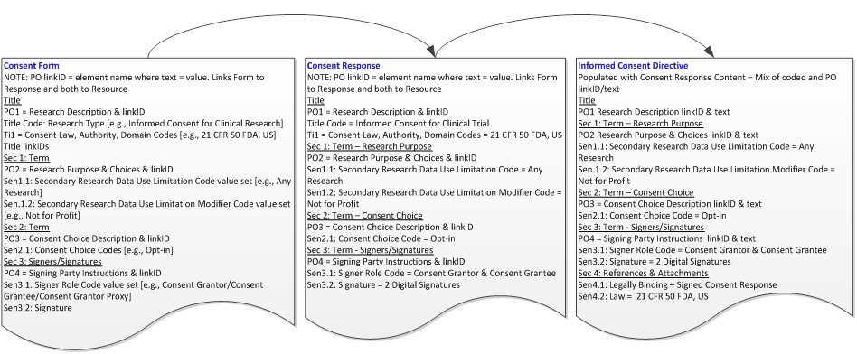
Potential Structured Approach
TI = Title Element
Sec = Section
Sen = Term Provision
PO = Prose Object – Non-Executable

Slide 24
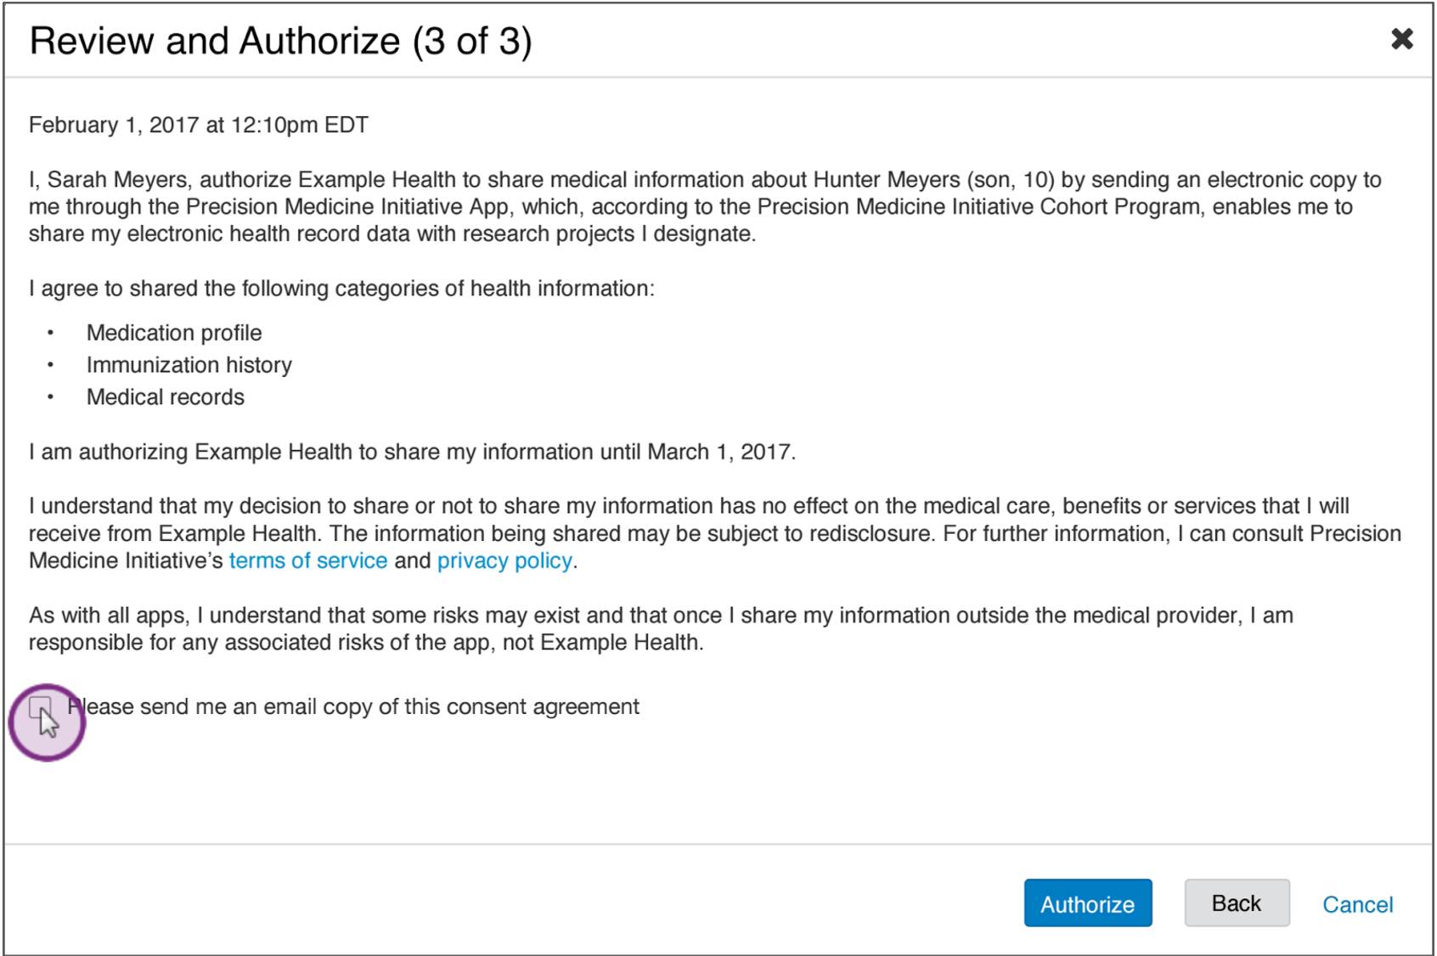
Consent Directive (CD) HIPAA Patient Right of Access (PRA) Example

Slide 25
Consent Directive (CD) HIPAA Patient Right of Access (PRA) Example Cont.
Sync for Science (S4S) PRA Elements | Example
CD Identifier
CD Effective date time | February 1, 2017 12:10 pm EDT
CD Grantor Name | Sarah Mayers
CD Role | Proxy
CD Proxy Relationship | Mother
CD Subject | Hunter Myers
CD Subject DoB | 2007 / 10 years old
CD Type | PRA
CD Asset | Hunter's Medication profile, IZ history, Medical Records
CD Decision | assent/opt-in/authorize
CD Grantee | Example Health
CD Grantee Action | share / disclose to PMI
CD Action Reason | Enable me to share my EHR data with Research Projects I designate
CD Agent | PMI
CD Agent Role | Secondary Recipient of Hunter's Health Information from Example Health
CD Agent Action | PMI Redisclosure
CD Agent Action Reason | Rationale points to link to PMI Terms of Service/Privacy Policy
CD Expiry | March 1, 2017 / one year
CD Prose Object(s)
CD Prose Object - Voluntary Participation | I understand that my decision to share or not share my information has not effect on the medical care, benefits or services that I receive from Example Health
CD Prose Object - Risks | As with all apps, I understand that some risks may exist and that once I share my information outside of the medical provider [subtext = via PRA] I am responsible for any associated risks of the app, not Example Health.
CD Receipt | Please send me an email copy of this consent agreement.
CD Signature | Not clear - perhaps clicking on Authorize Button constitutes a signature?
CD Security Labels | Not addressed

Slide 26
Next Steps
Review and provide feedback to posted materials by the following Thursday at 12pm ET
  http://confluence.siframework.org/display/PATCH/Phase+2%3A+Basic+Choice+for+Research+Consent+Use+Case+Development
Next meeting is Friday, April 14th, 2017 at 11 am ET
Reminder: All Patient Choice Announcements, Schedules, Project Materials, and Use Case will be posted on the Patient Choice Confluence page
  http://confluence.siframework.org/display/PATCH/

Slide 27
Project Contact Information
OCPO-ONC Lead | Rose-Marie Nsahlai | Rose-Marie.Nsahlai@hhs.gov
Project Coordinator | Johnathan Coleman | jc@securityrs.com
Project Manager | Ali Khan | Ali.Khan@esacinc.com
Project Support | Taima Gomez | Taima.Gomez@esacinc.com
Staff SME | Kathleen Connor | klc@securityrs.com
Staff SME | Amber Patel | ayp@securityrs.com
Staff SME | David Staggs | drs@securityrs.com

Slide 28
Thank you for joining!

