Slide 1
Identity Management for Patient-Physician Networks
(Healable)
Zhengpeng Li
Sagar Sawant
March 15, 2017

Slide 2
Healable – A Patient- Physicians Ecosystem
Connects patients with other patients
  Form online Support Groups
  Share health information
Connects patients with doctors
  eConsults using messaging, video chats, audio chats
  Instant Connections or Scheduled appointments
Connects doctors with other doctors
  Peer Consults
  Securely share relevant patient data with other doctors without showing any patient identification.

Slide 3
Patient Networks
Physician Networks
Physician Networks
Patient Networks
Peer Consults
Support Networks
Peer Consults
Support Networks
Self Help Info
Chronic Diseases
Allergies
Cancer
Mental Health
Any non-emergency issues
Skin Diseases
Cardiac Conditions
Patient Data
Internal Medicine
Radiologists
Oncologists
Psychiatrists
Surgeons
Neurologists
Cardiologists
Patient Data
Internal Medicine
Radiologists
Oncologists
Psychiatrists
Surgeons
Neurologists
Cardiologists
eConsults
eConsults

Slide 4
How do eConsults work?
Patient signs up and enters insurance information if patient is insured
Patient searches for a doctor
App shows doctors who are immediately available as well as doctors who are available by appointment
Once patient selects a doctor, the patient will be first asked to fill out a brief patient history, which will be stored in an electronic record and sent to the doctor
The doctor reviews the patient info and then starts a video call with the patient

Slide 5
How BlockChain plays a role in this ecosystem?
BlockChain can be used for identity management of both patients and physicians
For Patients, privacy is vital and would be ensured after authentication
For Physicians, BlockChain would be used for verification of Physician identity after the Physicians credentials have been verified

Slide 6
Physician Sign Up
Physician enters details such as
  Name and Specialty
  Uploads License Information
  Uploads Medical Certificates
  Submits the application
  A public/secret key pair will be generated locally and will only be visible to the Physician.
  Physicians would save the secret key. This secret key will be used to authorize future transactions in the Blockchain.
  The public key will be sent as other information to the App for verification.
Physician Verification
  The App will validates the license information with Licensing Agency and medical certificates with universities (for now this step is expected to be manual)
Blockchain Account Activation
  Once physician credentials have been verified, App activates physician by sending digital currency to the public key (also named as public address).
  The physician can use the secret key for future transactions. All other users can only see the physician’s public key in the Blockchain.

Slide 7
Physician View
Physician Logs In
  User ID
  Password
App Authenticates using Blockchain
Physician gets a connection request from a patient
Reviews patient information
Accepts patient connection request
Starts video consult session
At the end of session, patient pays the Physician by sending digital currency to the public key of the Physician.

Slide 8
Patient View
Patient Logs In
  User ID
  Password
App Authenticates using Blockchain
  A public/secret key pair will be generated locally and only visible to the Patient.
  Patient saves the secret key. This secret key will be used to authorize future transactions in the system.
  The public key will be send as other information to the App for verification.
  Once Patient credentials have been verified, App activates Patient account by sending some digital currency to the public key (also named as public address).
See a list of valid physicians
  These have been authenticated (previously using blockchain)
Requests a connection with a physician
Types in information about condition which will be sent to physician
App confirms appointment

Slide 9
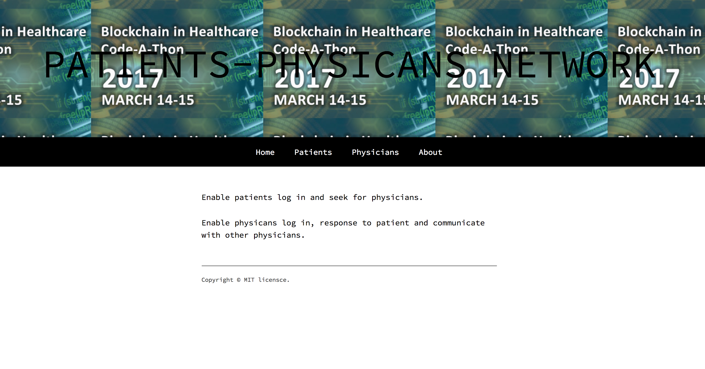
Screenshots of Prototype

Slide 10
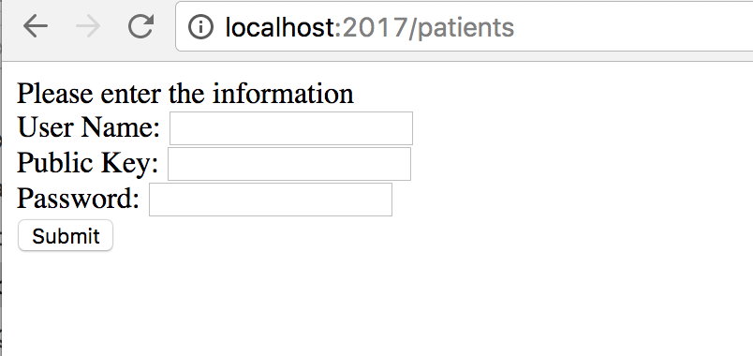
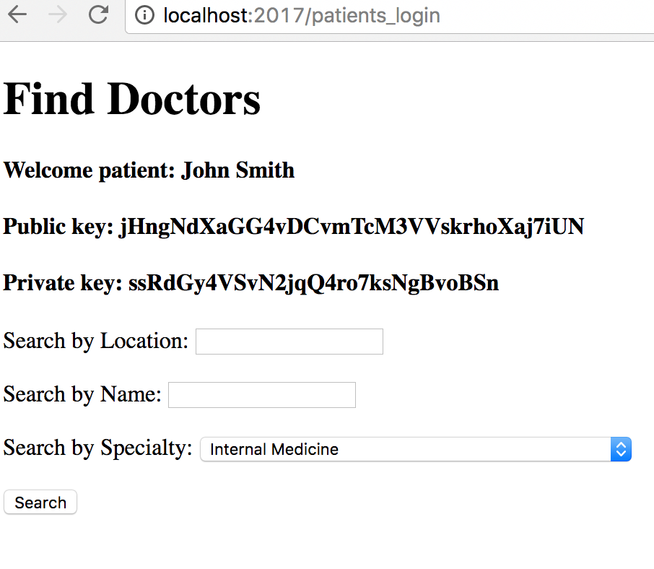

Patient with valid public key can access the doctor information in the Blockchain

Slide 11
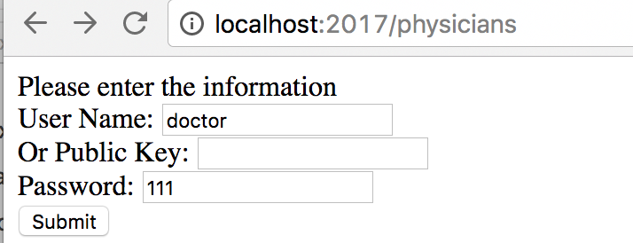
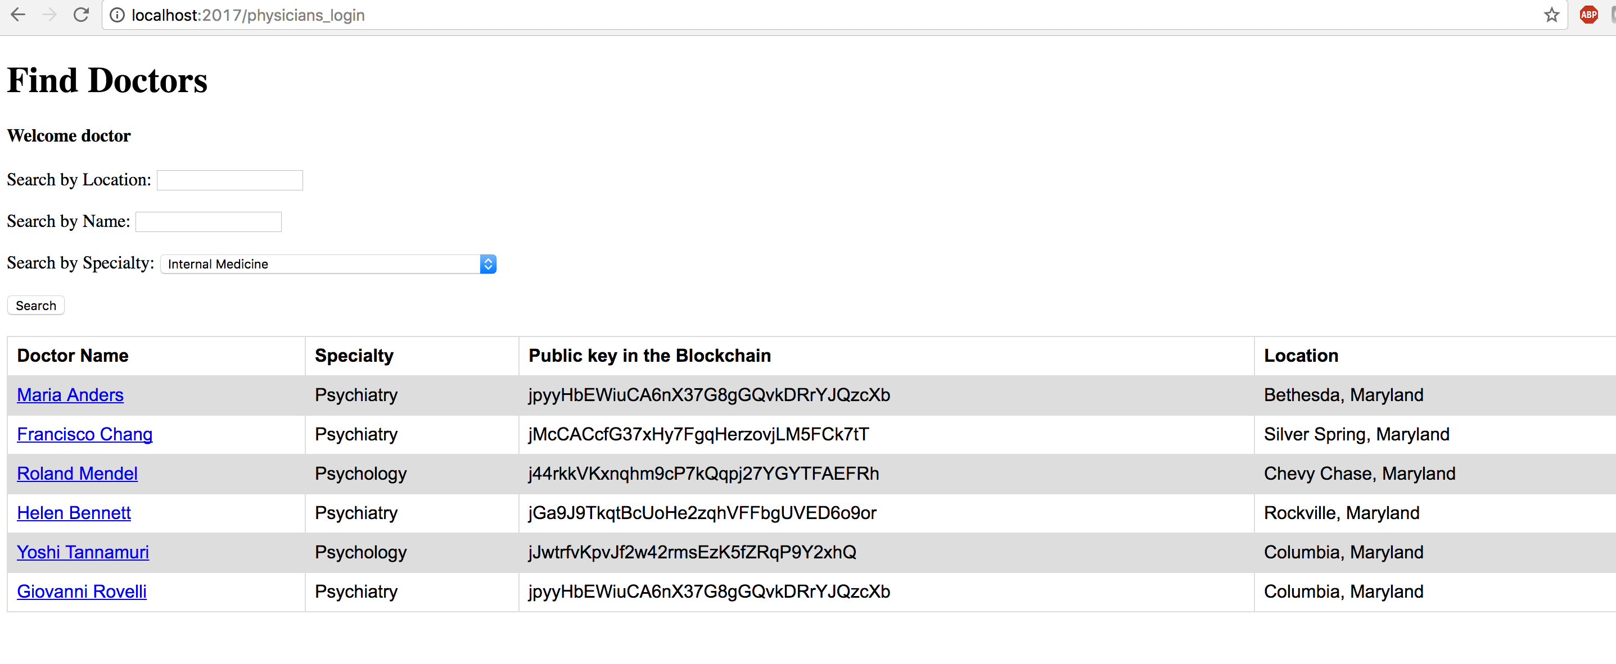
Physicians will have valid public key after they get verification and
then can be searched in the Blockchain.

Slide 12
Blockchain SDK Used for Prototype
Jingtum is a blockchain platform built on Peer-to-peer(P2P) technology.
Use cryptography to digitize assets.
Provided the exchange between digitized assets.
Deploying secure, production-scale services and consumer facing products.
http://www.jingtum.com/
https://www.npmjs.com/package/jingtum-sdk

