Slide 1

Data Provenance Information Interchange Sub-Workgroup
March 26th , 2015

Slide 2



Meeting Etiquette
Please mute your phone when you are not speaking to prevent background noise.
  All meetings are recorded.
Please do not put your phone on hold.
  Hang up and dial back in to prevent hold music.
Please announce your name before speaking
Use the “Chat” feature to ask questions or share comments.
  Send chats to “All Participants” so they can be addressed publicly in the chat, or discussed in the meeting (as appropriate).
Click on the “chat” bubble at the top of the meeting window to send a chat.

Slide 3
Agenda
Topic | Time Allotted
Announcements | 5 minutes
Information Interchange SWG | 40
System Requirements SWG | 40
Next Steps/Wrap Up | 5 minutes

Slide 4
Announcements
Our all hands meeting will be 90 minutes in length (2:00-3:30) which will include two 45 minute working sessions for the Information Interchange and System Requirements Sub Work Groups
  There will no longer be a separate meeting time/day for these two Sub Workgroups it will not be combined into our one weekly all hands call
Meeting during HIMSS week??? Who will be here and who will be at HIMSS?
Introduction to new Provenance SME: Vasa Curcin
  http://wiki.siframework.org/Data+Provenance+References

Slide 5
Information Interchange Sub-Work Group

Slide 6
Agenda
Topic | Time
Review Tasking | 5 minutes
Working Session | 35 minutes

Slide 7
EHR Transactions Task
Force Recommendation
Out of Scope: 3rd Parties (e.g. HIEs third party assemblers etc.)
To address the priority areas recommended by the Task Force, the HITSC recommends:
  The Initiative should begin its focus from the perspective of an EHR, including provenance for information created in the EHR (“source provenance”) and when it is exchanged between two parties. Provenance of the intermediaries is only important if the source data is changed.
    The notion of “who viewed/used/conveyed without modification along the way” is not important for provenance, as long as the information was not changed.
Recommendation follows Scenario 1 of the Use Case: Start Point→ End Point
  Focus on what happens
    Inside the EHR
    When being exchanged between EHRs (assume no change to clinical content during exchange)
Per the task force recommendations: assume that what is already in the EHR is good
  Our analysis should start from this point and this assumption
  The information interchange group can look at the transaction and taking what is available and moving it to another EHR
Notes:
This will give us a starting point for the analysis. Then, the functions of the EHR can include:
§ Creating new data (adding new clinical content)
§ Creating new artifacts (e.g. assembler functions) which are prepared for transmittal
For (b) – Information Interchange – the transaction should be taking what is available from (a) and moving it to another EHR.
These two items will give us the building blocks to later address alternate workflows (PHR, HIE etc.).
If we all agree with this, then system requirements in (a) can still include assembler and composer functions, because presumable an EHR can perform those functions too.
If we take our UML diagram that we had started overlaying system events and provenance events, we can simplify it by removing the additional columns and decision trees, but adding the assembler and composer functions as optional steps in the first HER column.

Slide 8
Scope
Address Communication/Information Interchange requirements:
  The integrity of the provenance data for clinical content should remain intact during transport. For the purposes of this use case, start with the assumption that at the point for information interchange, the “source provenance” is good, complete, trusted
    Coupling sender and receiver to content? Access to payload is not the question is there a dependency on having access to get to that point

Slide 9
Framing Question
For information exchanged between EHRs, can I trust it, and has it been changed?
  Information interchange begins once the exchange artifact is created and it shall not change during transport
Consider that, for clinical care, if trending the data, one may need to know the degree to which the information can be trusted.
Notes:
“has it been changed” – what is it? We will need to know if it is CDA but if we convert CDA to FHIR and sending has clinical content changed – artifact has changed but clinical content has not – Artifact Changed or Clinical Content Changed

Slide 10
Information Interchange SWG
Goal # | Goal | Artifact and Description
1 | Define a set of basic/core requirements for provenance for information interchange between EHRs: Are there any specific technologies or architecture well suited for us to consider in the implementation guide (e.g.RESTul, Exchange, DIRECT and/or those specified in Meaningful use etc.) What transactions need to be specified in the IG? (For example IHE specification ABC…) | Document defining a set of basic/core requirements for provenance for information interchange between EHRs (e.g. REST, Exchange, Direct etc.) and what Transactions needed in the IG
2 | What type of payloads should we focus on when looking at information interchange requirements between EHRs (e.g. C-CDA etc.?) – what do we want to start with – pick a payload | Document, table or list of recommendations for the type of payloads for interchange requirements between EHRs
3 | Identify Candidate Standards to meet the requirements of goals 1 and 2 using existing candidate standards list | Short list of the proposed candidate standards that can achieve requirements of the first goal
4 | Consider the implications of security aspects related to information interchange – Traceability, audit, etc. – what is the impact on the trust decision? (Consider Privacy) | List or document of the implications of security aspects
5 | If applicable, capture policy considerations related to system behavior and request further guidance from the HITPC. | List of questions for HITPC

Slide 11
Information Interchange SWG
Week of | 3/4 | 3/11 | 3/19 | 3/26 | 4/1 |  | 4/9 | 4/16 | 4/23 | 4/30
Launch SWG: Prepare, organize, plan, review existing materials
Define a core set of provenance requirements
Identify payloads that we should focus on
Identify Candidate Standards to meet the need of requirements
Consider implications of security aspects
Capture policy considerations and request further guidance
Legend: Not Started; In progress; Complete

Slide 12
Start Point – End Point Scenario
http://wiki.siframework.org/file/view/DPROV%20Use%20Case%20_%20Final%20Consented%20Use%20Case_10.16.2014.pdf/527056914/DPROV%20Use%20Case%20_%20Final%20Consented%20Use%20Case_10.16.2014.pdf
10A.1 User Story
User Story 1: A patient arrives at the ophthalmologist’s office for her annual eye exam. The ophthalmologist conducts an eye exam and captures all of the data from that visit in his EHR. The ophthalmologist electronically sends the information back to the patient’s PCP (where all data in the report sent was created by the ophthalmologist).
User Story 2: A patient has a PHR that allows them to record their daily dietary intake. The patient accesses the PHR and requests that their dietary intake for the past month be transmitted to their PCP prior to their visit next week. The patients uses a PHR to transmit the dietary record to the PCP. The PCP understands from the document’s provenance that the data was generated by the patient and that it is authentic, reliable, and trustworthy. (this is outside of the EHR to EHR)

Slide 13
Goal 1: Define a set of basic/core requirements for provenance for information interchange between EHRs
Methodology:
  Start with MU Specified Transports
    Focus at higher level of Transport Protocol
      for any of the identified protocols we will do a “deep dive” based on need
  Start at the abstract:
    For example lets determine between the exchange parties what do we need to know?
      Who is the sender?
      Who is the intended recipient?
      What is being sent?
        This helps us determine what needs to be exchanged and vet this against the technologies available

Slide 14
Assumptions:
Black box exchange -EHR to EHR
Information interchange begins once the exchange artifact is created
it shall not change during transport
Transport Content Neutral (the thing doesn’t get changed and is transported intact)
more challenging when information required for content and transport are one in the same and required for both (e.g. message)– does this change the object or is it function as a wrapper –
  Provenance in the exchange artifact(CDA with provenance/ FHIR with Provenance Resource)
  Provenance conveyed in business wrapper/layer (HL7 V.3 Control Act Wrapper)
  Provenance migrates from content to the transport/layer wrapper (FHIR, XD*)
Notes:
we will find ourselves establishing an operational description that includes an element of "authenticity" stratification. Something to the effect of "the Provenance support incorporated in this exchange is intended to assure trustworthiness at a <low, medium, high> level as defined by <some mutually agreed reference>
It seems likely that there will be a "basic Provenance" level as minimum necessary. - OUT OF SCOPE
Notes from 3-19 call
Notice of stratification – risk/stress tolerance? (where do we start) – organizational trust and content trust
Clinical perspective
Records Management perspective
Security and Privacy perspective
Origin and Provenance
Exchange of content standard – SYSTEM REQUIREMENTS
Preserving provenance…would happen inside the EHR (black box)
Does transport layer need to know this
As long as transport treats payload as payload—ASUMPTION
I can look inside but cannot modify
Whether you can see inside is not the question at hand we would be looking at wrapper only to guarantee end to end transport (without modification) – OUT OF SCOPE

Slide 15
Data Elements for Consideration:
Interoperability Roadmap (page 80)
http://www.healthit.gov/sites/default/files/nationwide-interoperability-roadmap-draft-version-1.0.pdf
Patient name
Sex
Date of birth
Race
Ethnicity
Preferred language
Smoking status
Problems
Medications
Medication allergies
Laboratory test(s)
Laboratory value(s)/result(s)
Vital signs
Care plan field(s), including goals and instructions
Procedures
Care team members
Immunizations
Unique device identifier(s) for a patient’s implantable device(s)
Notes/narrative
Notice for Proposed Rule Making (page 148)
https://s3.amazonaws.com/public-inspection.federalregister.gov/2015-06612.pdf
TIN
NPI
Provider type
Patient insurance
Patient age
Patient sex in accordance with the standard specified in § 70.207(n)(1) (HL7Version 3)
Patient race and ethnicity in accordance with the standards specified in §170.207(f)(1) (OMB standard) and, at a minimum, (f)(2) (“Race & Ethnicity –CDC” code system in the PHIN VADS)
Patient problem list data in accordance with, at a minimum, the version of the standard specified in § 170.207(a)(4) (September 2014 Release of the U.S. Editionof SNOMED CT®)
Practice site address.

Slide 16
What do we need to know
What do I need to know | Data Element | Does it map to a DE in the System Requirement SWG? (can be done at a later time)
Who is the sender? | Sender (name, org ID, etc.)
What is being sent (do we need to identify anything about the content)? | Transaction, Transaction Type (CCDA, v2.x message)
Time being sent | Timestamp
Where is this being sent from | Sender Location
Intended Recipient | Receiver

Slide 17
System Requirements Sub Work Group

Slide 18
Agenda
Topic | Time
Review of Wiki Page/Comment Form | 5 minutes
Working Session | 30 minutes

Slide 19
System Requirements SWG
Week of | 2/27 | 03/04 (canceled) | 3/11 | 3/19 | 3/26 | 4/2 | 4/9 | 4/16 | 4/23
Launch SWG: Prepare, organize, plan, review existing materials
Define a core set of provenance requirements
Identify Candidate Standards to meet the need of requirements
Define “change” and the implications for provenance
Consider implications of security aspects
Capture policy considerations and request further guidance
Legend: Not Started; In progress; Completed

Slide 20
Tasking
Goal # | Goal | Artifact and Description
1 | Define a set of basic/core EHR system requirements for provenance for: (NOTE: Build upon Data Elements as defined by the current Use Case) Import (receivers responsibility – trust decision) Create Maintain Export (note this is the minimum set of areas of focus based on the task force recommendations) – Review/examine FULL CHAIN OF TRUST | Minimum set of provenance requirements – Document (may include transaction tables/UML diagrams, DE mapping etc.)
2 | Identify Candidate Standards to meet the requirements of Goal 1 using existing candidate standards list (To be supplied) | Short list of the proposed candidate standards that can achieve requirements of the first goal
3 | Choose a definition of “change” to data (for example, transformation with no intent to change the meaning of the data such as content format, terminology, or feature extraction versus substantive changes such as amend, update, append, etc.) and the implications for provenance. If the content changes, the change should be considered a “provenance event”. –this would be an update event and should be included in item 1 | Provide a definition of “Change” to data
4 | Consider the implications of security aspects related to information interchange – Traceability, audit, etc. – what is the impact on the trust decision? (evidence of where data came from and provenance of the data…explore this) | List or document of the implications of security aspects
5 | If applicable, capture policy considerations related to system behavior and request further guidance from the HITPC. | List of questions for HITPC

Slide 21
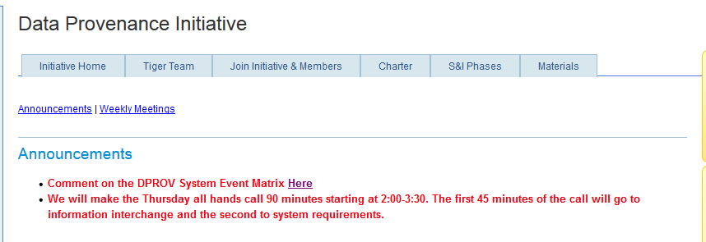
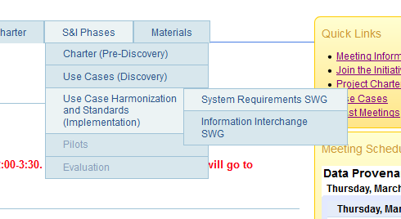
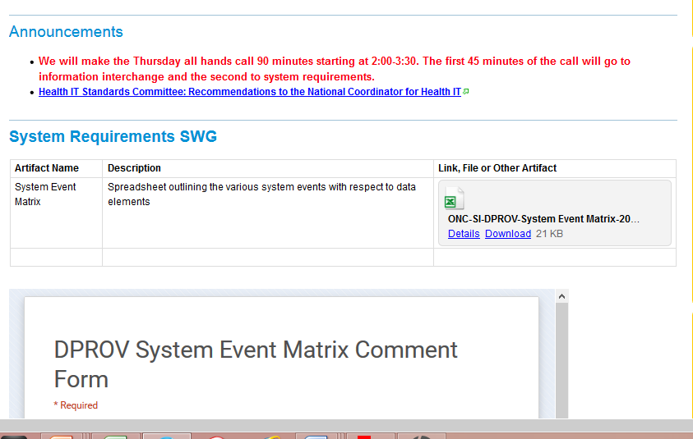
Commenting on Data Elements
From the DPROV wiki homepage
Or From the System Requirements Wiki Page
Download the spreadsheet and complete the comment form

Slide 22
RECAP: Minimum Set of Requirements to Review
Identifying provenance requirements of an EHR system – what are the events we expect them to manage
Import- New Artifact Arrived (decomposing/disassembling content prior to accepting/putting in EHR record and then maintain)
Decompose (include verification by human to make reliability judgment)
Disassemble to incorporate into EHR
Use or View- show all detailed data
Create
Update
Maintain (not necessarily a provenance event as we have already created and updated which are provenance event)
Compose Content (as done in EHR system)
Assemble Composed Content (as done in EHR system)
Export – Artifact ready to go (Transmit perhaps Information Interchange)
Assembling = done by software
Compose = done by human and software
Policy committee – viewing and accounting of disclosers - if no change to clinical data
Create table – Events at top, Provenance data around the left (create a matrix) – use the who what when where why –use DE tables to start this process
Out of Scope: 3rd Parties (e.g. HIEs third party assemblers et)

Slide 23
Assumptions
Chain of Trust ?
  Point to point exchange – A-B
    Once point B has the information the process starts over again
Need minimum definition of “traceability concepts” – cannot be presumed to exist in all existing systems

Slide 24
Data Elements for Consideration:
Interoperability Roadmap (page 80)
http://www.healthit.gov/sites/default/files/nationwide-interoperability-roadmap-draft-version-1.0.pdf
Patient name
Sex
Date of birth
Race
Ethnicity
Preferred language
Smoking status
Problems
Medications
Medication allergies
Laboratory test(s)
Laboratory value(s)/result(s)
Vital signs
Care plan field(s), including goals and instructions
Procedures
Care team members
Immunizations
Unique device identifier(s) for a patient’s implantable device(s)
Notes/narrative
Notice for Proposed Rule Making (page 148)
https://s3.amazonaws.com/public-inspection.federalregister.gov/2015-06612.pdf
TIN
NPI
Provider type
Patient insurance
Patient age
Patient sex in accordance with the standard specified in § 70.207(n)(1) (HL7Version 3)
Patient race and ethnicity in accordance with the standards specified in §170.207(f)(1) (OMB standard) and, at a minimum, (f)(2) (“Race & Ethnicity –CDC” code system in the PHIN VADS)
Patient problem list data in accordance with, at a minimum, the version of the standard specified in § 170.207(a)(4) (September 2014 Release of the U.S. Editionof SNOMED CT®)
Practice site address.

Slide 25
Data Requirements Matrix
http://wiki.siframework.org/Data+Provenance+Sub-Work+Groups

Slide 26
Next Steps
Join us on our next all hands meeting
  April 2nd from 2:00 -3:30 pm ET
http://wiki.siframework.org/Data+Provenance+Initiative

Slide 27
Support Team and Questions
  Please feel free to reach out to any member of the Data Provenance Support Team:
    Initiative Coordinator: Johnathan Coleman: jc@securityrs.com
    OCPO Sponsor: Julie Chua: julie.chua@hhs.gov
    OST Sponsor: Mera Choi: mera.choi@hhs.gov
    Subject Matter Experts: Kathleen Connor: klc@securityrs.com and Bob Yencha: bobyencha@maine.rr.com
    Support Team:
      Project Management: Jamie Parker: jamie.parker@esacinc.com
      Standards Development Support: Perri Smith: perri.smith@accenturefederal.com and Atanu Sen: atanu.sen@accenture.com
      Support: Apurva Dharia: apurva.dharia@esacinc.com, Rebecca Angeles: rebecca.angeles@esacinc.com and Zach May: zachary.may@esacinc.com

Slide 28
System Requirements Appendix

Slide 29
EHR Transactions Task
Force Recommendation
To address the priority areas recommended by the Task Force, the HITSC recommends:
  The Initiative should begin its focus from the perspective of an EHR, including provenance for information created in the EHR (“source provenance”) and when it is exchanged between two parties. Provenance of the intermediaries is only important if the source data is changed.
    The notion of “who viewed/used/conveyed without modification along the way” is not important for provenance, as long as the information was not changed.
Recommendation follows Scenario 1 of the Use Case: Start Point→ End Point
  Focus on what happens
    Inside the EHR
    When being exchanged between EHRs
Per the task force recommendations: assume that what is already in the EHR is good
  Our analysis should start from this point and this assumption
Functions of the EHR can include:
  Creating new data (adding new clinical content)
  Creating new artifacts (e.g. assembler functions) which are prepared for transmittal
  The information interchange group can look at the transaction and taking what is available and moving it to another EHR
Out of Scope: 3rd Parties (e.g. HIEs third party assemblers et)
Notes:
This will give us a starting point for the analysis. Then, the functions of the EHR can include:
§ Creating new data (adding new clinical content)
§ Creating new artifacts (e.g. assembler functions) which are prepared for transmittal
For (b) – Information Interchange – the transaction should be taking what is available from (a) and moving it to another EHR.
These two items will give us the building blocks to later address alternate workflows (PHR, HIE etc).
If we all agree with this, then system requirements in (a) can still include assembler and composer functions, because presumable an EHR can perform those functions too.
If we take our UML diagram that we had started overlaying system events and provenance events, we can simplify it by removing the additional columns and decision trees, but adding the assembler and composer functions as optional steps in the first HER column.

Slide 30
Start Point – End Point Scenario
http://wiki.siframework.org/file/view/DPROV%20Use%20Case%20_%20Final%20Consented%20Use%20Case_10.16.2014.pdf/527056914/DPROV%20Use%20Case%20_%20Final%20Consented%20Use%20Case_10.16.2014.pdf
10A.1 User Story
User Story 1: A patient arrives at the ophthalmologist’s office for her annual eye exam. The ophthalmologist conducts an eye exam and captures all of the data from that visit in his EHR. The ophthalmologist electronically sends the information back to the patient’s PCP (where all data in the report sent was created by the ophthalmologist).
User Story 2: A patient has a PHR that allows them to record their daily dietary intake. The patient accesses the PHR and requests that their dietary intake for the past month be transmitted to their PCP prior to their visit next week. The patients uses a PHR to transmit the dietary record to the PCP. The PCP understands from the document’s provenance that the data was generated by the patient and that it is authentic, reliable, and trustworthy. (this is outside of the EHR to EHR)

Slide 31
Scenarios from Use Case Sequence Diagram
Assembler/Composer

Slide 32
Data Elements in the Use Case
Start Point-
Role | Data Category | Data Element | Comments
Start Point | Who | Sending System
 |  | Sending System Organization
 |  | Author
 |  | Custodian
 |  | Role
 | When | Send Date
 |  | Send Time
 | Where | Address
 |  | State
 |  | Zip
 | Type (What) | Software
 |  | Device
 | Why | Clinical Context
 |  | Purpose
 | Integrity/ Authenticity | Digital Signature
 | Additional | Patient
 |  | Record Target
 |  | Assigned Author
 |  | Informant
 |  | Service Event
 |  | Performer
 |  | Authenticator
 |  | Legal Authenticator
Potential Removal or rename Start Point of Exchange? (see notes below)
http://wiki.siframework.org/file/view/DPROV%20Use%20Case%20_%20Final%20Consented%20Use%20Case_10.16.2014.pdf/527056914/DPROV%20Use%20Case%20_%20Final%20Consented%20Use%20Case_10.16.2014.pdf
Notes from our call today: Since EHR will be the point of origination we may not need a start point. The start point of our use case would be the originator (not focusing on compiler or composer). It was also suggested that we rethink roles because the Start point in an EHR and the start point of the exchange are different. We may need to come up with 2 different names for the “start point” roles

Slide 33
Data Elements in the Use Case:
Transmitter
Transmitter based on diagrams and community call was proposed for removal but might be a good candidate for review in the Information Interchange SWG
Transmitter | Who | Transmitter Organization | This might be looked at by the Information Interchange SWG
 |  | Transmitter System
 | When | Transmission Time Sent
 |  | Transmission Date Sent
 | Where | Transmitter Location
 |  | Transmitter System Location
 | Type (What) | Transmission Device
 |  | Transmission Software
 |  | Transmission Hardware
 |  | Transmission Method
 | Why | Purpose of Transmission
 | Routing | Transmitter Sender Address
 |  | Receiver Address
 | Integrity/ Authenticity | Digital Signature
 | Who | Transmitter Organization
 |  | Transmitter System
 | Additional | Patient
 |  | Record Target

Slide 34
Data Elements in the Use Case
Originator
Originator | Who | Originator Organization
 |  | Originator Author
 |  | Originator Enterer
 |  | Originator Attester
 |  | Originator Verifier
 |  | Originator System
 | When | Originator Time Created
 | Where | Originator Locations
 |  | Originator System Location
 | Type (What) | Originator Event
 | Additional | Patient
 |  | Record Target
 |  | Author
 |  | Assigned Author
 |  | Authoring System
 |  | Authoring Organization
 |  | Informant
 |  | Service Event
 |  | Performer
 |  | Participant
 |  | Custodian
 |  | Authenticator
 |  | Legal Authenticator
Keep and rename to follow diagram to “Initiating System?”)

Slide 35
Data Elements in the Use Case –
Assembler
Assembler proposed for removal based on diagram?
Assembler | Who | Assembler System
 |  | Assembler Organization
 |  | Intended Recipient
 | When | Assembly Date
 |  | Assembly Time
 | Where | Address
 |  | State
 |  | Zip
 | Type (What) | Software
 |  | Device
 | Why | Assembly Purpose
 | Integrity/ Authenticity | Assembly Participants
 |  | Attestation/Nonrepudiation of data
 | Additional | Patient
 |  | Record Target
 |  | Author
 |  | Assigned Author
 |  | Authoring System
 |  | Authoring Organization
 |  | Informant
 |  | Service Event
 |  | Performer
 |  | Participant
 |  | Custodian
 |  | Authenticator
 |  | Legal Authenticator

Slide 36
Data Elements in the Use Case –
Composer
Composer based on diagrams –proposed for removal
Composer | Who | Composer System
 |  | Composer Organization
 | When | Composition Date
 |  | Composition Time
 | Where | Address
 |  | State
 |  | Zip
 | Type (What) | Software
 |  | Device
 | Why | Composing Purpose
 | Integrity/ Authenticity | Composing Participants
 |  | Selector
 | Additional | Patient
 |  | Record Target
 |  | Author
 |  | Assigned Author
 |  | Authoring System
 |  | Authoring Organization
 |  | Informant
 |  | Service Event
 |  | Performer
 |  | Participant
 |  | Custodian
 |  | Authenticator
 |  | Legal Authenticator

