Slide 1

Data Provenance All Hands Community Meeting
February 5, 2015

Slide 2



Meeting Etiquette
Please mute your phone when you are not speaking to prevent background noise.
  All meetings are recorded.
Please do not put your phone on hold.
  Hang up and dial back in to prevent hold music.
Please announce your name before speaking
Use the “Chat” feature to ask questions or share comments.
  Send chats to “All Participants” so they can be addressed publicly in the chat, or discussed in the meeting (as appropriate).
Click on the “chat” bubble at the top of the meeting window to send a chat.

Slide 3
Agenda
Topic | Time Allotted
Announcements Update on Task Force Recommendations | 15 minutes
CDISC Operational Data Model Presentation by Sam Hume | 15 minutes

Slide 4
Announcements
  Task Force Recommendations Update

Slide 5
Updated Candidate Standards
# | Transaction | Content and Structure | Terminology and Code Values - DP | Transport | Security
1 a) | Start Point sends clinical data with provenance information to End Point | *C-CDA *CDA R2 *W3C PROV: PROV-AQ, PROV-CONSTRAINTS, PROV-XML *Personal Health Record System Functional Model *HL7 EHR Records Management and Evidentiary Support (RM-ES) Functional Model, Release 1 *ISO/HL7 EHR System Functional Model Release 2 *HL7 EHR Lifecycle Model (2008) *HL7 Record Lifecycle Event Metadata using FHIR (project underway 2014) *HL7 V.2.x *ISO 21089 Health Informatics: Trusted End-to-End Information Flows *HL7 FHIR DSTU Release 1.1 Provenance Resource *HL7 Implementation Guide for CDA® Release 2: Data Provenance, Release 1 – US Realm *HL7 Implementation Guide for CDA®, Release 2: Consent Directives, Release 1 *HL7 EHR Interoperability Model DSTU (2007) *HL7 Implementation Guide for CDA Release 2: Reference Profile for EHR Interoperability DSTU (2008) * CDISC Operational Data Model | *HL7 V.2/ V.3 Vocabulary & Terminology Standards | *Representation State Transfer (RESTful) *Cross Enterprise Document-Sharing XDS *SOAP | *HL7 Implementation Guide: Data Segmentation for Privacy (DS4P), Release 1 * HL7 Health Care Privacy and Security Classification System, Release 1 (HCS) *HL7 Version 3 Standard: Privacy, Access and Security Services (PASS) *HL7 Version 3 Standard: Privacy, Access and Security Services; Security Labeling Service, Release 1 (SLS) *HL7 Implementation Guide for CDA® Release 2: Digital Signatures and Delegation of Rights, Release 1
2 a) | Start Point sends clinical data to transmitter with provenance information
2 b) | Transmitter send clinical data to end point with provenance information
3 a) | Start Point sends clinical data to assembler/composer with provenance information
3 b) | Assembler/composer compiles clinical data which is sent to end point with provenance information

Slide 6
CDISC Operational Data Model
Sam Hume
February 5th, 2015

Slide 8
The CDISC Operational Data Model and Data Provenance
Sam Hume <shume@cdisc.org>

Slide 9
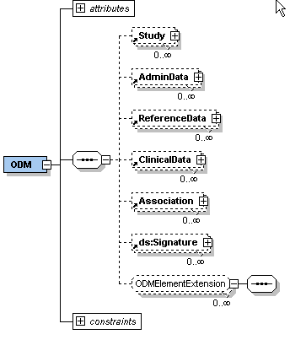
Operational Data Model
Vendor neutral XML Schema provides standard syntax for interchange and archive of general Clinical Trials information
Defines structure, not content
Supports 21 CFR Part 11 compliance and FDA Guidance on Computerized Systems
  Enables exchange of study metadata and data or updates between systems
  Archives electronic data at sites and supports remote monitoring
9
Notes:
This describes the top level schema elements. Mention that Study includes the metadata (which uses an audit trail to represent protocol changes), AdminData refers to users (Investigators and sites), Reference data includes dictionaries, lab normals and non-patient data and associations can link different items of data (like an AE and a con med). ODM is also extensible for vendor-specific features.

Slide 10
ODM Use Cases
Data transmission from 3rd party data providers to sponsors
Clinical data archiving
Automated set up of EDC / CDM systems
Clinical data standards metadata repositories
Electronic Health Record Integration
Submission of SDTM and ADaM metadata and data
Proposed replacement for SAS XPT for submissions
10

Slide 11
ODM Element
attributes
ODM
@ Description
Study
@ FileType
@ Granularity
AdminData
@ Archival
@ FileOID
ReferenceData
@ CreationDateTime
@ PriorFileOID
ClinicalData
@ AsOfDateTime
@ ODMVersion
Association
@ Originator
@ SourceSystem
ds:signature
@ SourceSystemVersion
@ ID

Slide 12
ODM Element
attributes
ODM
@ Description
Study
MetaData
@ FileType
@ Granularity
AdminData
@ Archival
@ FileOID
ReferenceData
@ CreationDateTime
Data & Audit
@ PriorFileOID
ClinicalData
@ AsOfDateTime
@ ODMVersion
Association
@ Originator
@ SourceSystem
ds:signature
@ SourceSystemVersion
@ ID

Slide 13
SubjectData Element
SubjectData
Audit
attributes
Signature
@ SubjectKey
InvestigatorRef
@ TransactionType
SiteRef
Audit
Annotation
Signature
Annotation
StudyEventData
Audit
FormData
Signature
ArchiveLayoutRef
Annotation
Audit
Signature
ItemGroupData
Annotation
ItemData

Slide 14
AuditRecord Element
ItemData
attributes
@ ItemOID
@ TransactionType
AuditRecord
attributes
@ Value
@ EditPoint
@ IsNull
UserRef
@ UsedImputationMethod
LocationRef
DateTimeStamp
ReasonForChange
SourceID
Signature
MeasurementUnitRef
Annotation

Slide 15
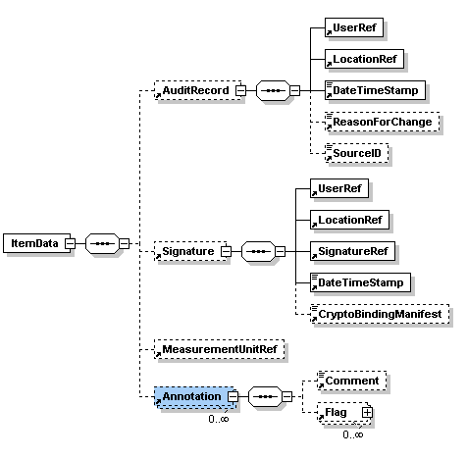
ODM & Audit Trail
Who
Where
Why
What
When
ItemDef
metadata
How
Slide courtesy Dave Iberson-Hurst, Assero

Slide 16
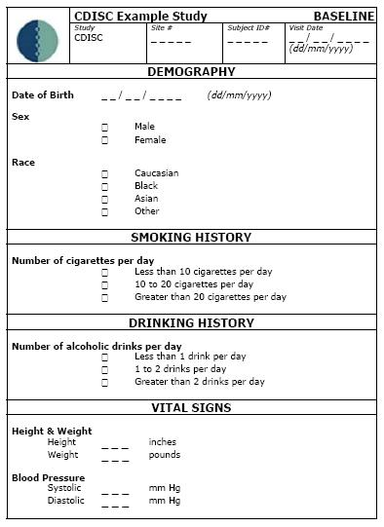
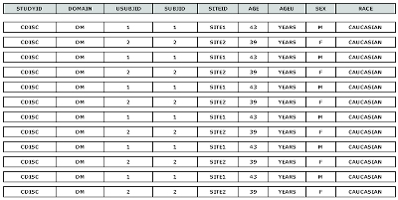
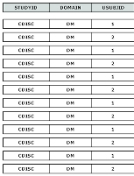
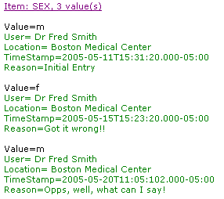
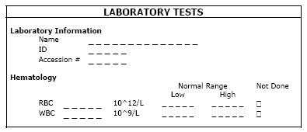
Traceability and the Audit Trail

Slide 17
Signature Element
ItemData
AuditRecord
attributes
Signature
@ ItemOID
@ TransactionType
UserRef
@ Value
LocationRef
@ IsNull
SignatureRef
DateTimeStamp
CryptoBindingManifest
MeasurementUnitRef
Annotation
Signature also includes the Meaning and Legal Reason for the signature

Slide 18









ODM links to EHR: Retrieve Form for Data Capture (RFD)
2. Request
Form
Form
Definition
ODM & XForms
ODM
3. Enter
Data
Offline: Use ODM metadata to create form
4. Submit
Data
Single Entry
Double Use
ODM
EHR
CDM
Sponsor
Site
ODM
5. Archive Data
(eSource!)
Form Archiver

Slide 19
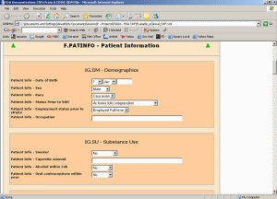
Automated Setup of EDC/eCRF systems
ODM
XML
MetaData
ODM Metadata can be used to configure data collection tools
eCRF systems: Numerous vendors using ODM
eDiary/ePRO systems
  Used ODM for configuration purposes and data transfer
EHR systems
  Medical form standard for a large EHR and clinical research data model repository of 3,320 medical forms (https://medical-data-models.org/)

Slide 20
ODM Summary
ODM is a mature standard
  Nearly 20 years of development
  Used by numerous software and service providers
  Global use (e.g. US, Europe, Japan)
  ODM Certification is available
ODM is remarkably flexible
  Medical forms repository / EHR integration
  Interoperability with HL7 CDA has been demonstrated
  Meets requirements for HHS/ONC Structured Data Capture forms
  Carries complete audit trail (provenance) information (fulfills 21CFR11 requirements)
  Allows for remote monitoring or auditing, including audit trail for traceability from electronic source

Slide 21
Next Steps
Next All Hands meeting is Thursday, February 5, 2015
  http://wiki.siframework.org/Data+Provenance+Initiative

Slide 22
Support Team and Questions
  Please feel free to reach out to any member of the Data Provenance Support Team:
    Initiative Coordinator: Johnathan Coleman: jc@securityrs.com
    OCPO Sponsor: Julie Chua: julie.chua@hhs.gov
    OST Sponsor: Mera Choi: mera.choi@hhs.gov
    Subject Matter Experts: Kathleen Conner: klc@securityrs.com and Bob Yencha: bobyencha@maine.rr.com
    Support Team:
      Project Management: Jamie Parker: jamie.parker@esacinc.com
      Standards Development Support: Perri Smith: perri.smith@accenturefederal.com and Atanu Sen: atanu.sen@accenture.com
      Support: Apurva Dharia: apurva.dharia@esacinc.com, Rebecca Angeles: rebecca.angeles@esacinc.com and Zach May: zachary.may@esacinc.com

