Slide 1

Data Provenance All Hands Community Meeting
January 29, 2015

Slide 2



Meeting Etiquette
Please mute your phone when you are not speaking to prevent background noise.
  All meetings are recorded.
Please do not put your phone on hold.
  Hang up and dial back in to prevent hold music.
Please announce your name before speaking
Use the “Chat” feature to ask questions or share comments.
  Send chats to “All Participants” so they can be addressed publicly in the chat, or discussed in the meeting (as appropriate).
Click on the “chat” bubble at the top of the meeting window to send a chat.

Slide 3
Agenda
Topic | Time Allotted
Announcements | 5 minutes
Review of HL7 Activities | 10 minutes
Review of HITSC Recommendations for DPROV Initiative and Next Steps for the Initiative | 20 minutes
S&I Harmonization Process Review | 15 minutes
Tentative Timeline and Approach | 10 minutes

Slide 4
Announcements
ONC Annual Meeting
  Feb 2-3 in Washington DC at the Washington DC Hilton
    http://healthit.gov/oncmeeting
  DPROV will be presenting in the morning on the 3rd
    We encourage all of you who are at the meeting to come visit us, sit in on the presentation and meet the team and others in the group

Slide 5
HL7 Meeting Summary
Continued ballot reconciliation on comments where “in person” reconciliation was requested
  Several negative majors were withdrawn, reconciled, or deferred for future editions of the standard (expanding scope).
  Participated in joint meetings with EHR, Security, Patient Care, CBCC. Discussed scope of related projects, areas of overlap between WGs.

Slide 6
DATA PROVENANCE TASK FORCE RECOMMENDATIONS

Slide 7
Question #1
High level Recommendation
Do the 3 scenarios in the Use Case, and the Use Case’s identified scope, address key data provenance areas, or is something missing?
        Yes, the scenarios address key provenance areas
        No, some key data provenance areas are missing
RESPONSE:
The Use Case may be over-specified. The Task Force recommends that the Data Provenance Initiative should focus on the following:
        Where did the data come from? (“source provenance”)
        Has it been changed?
        Can I trust it (the data)?

Slide 8
Question #1
Detailed Recommendations
Begin focus from the perspective of an EHR - Provenance of the intermediaries is only important if the source data is changed. Therefore, begin focus from the perspective of an EHR, including provenance for information created in the EHR (“source provenance”) and when it is exchanged between two parties.
  The notion of “who viewed/used/conveyed without modification along the way” is not important for provenance, as long as the information was not changed.

Slide 9
Question #1
Detailed Recommendations (Cont.)
Clearly differentiate between Communication/Information Interchange requirements and System Requirements
  Both are important. For the purposes of this use case-- Start with the assumption that at the point for information interchange, the “source provenance” is good, complete, trusted.
  Address Communication/Information Interchange requirements
    Note: As a basic requirement, converting between different transport protocols should be lossless, i.e., retain integrity, in terms of provenance of the payload/content.
  Address System Requirements for provenance (including “source provenance”) by looking at provenance data at time of import, creation, maintenance, and export.
    Note: Agnostic of transport technologies
    Consider FDA Project, Guidance and Regulations - There are 12 requirements and use cases for the use of EHRs and eSource applications (e.g. patient reported information/eDiaries) requiring provenance described in an eSource Data Interchange Document, FDA Guidance, which includes a definition for “the source” and regulation for Electronic Records.

Slide 10
Question #1
Detailed Recommendations (Cont.)
Consider the definition of “change” to data (for example, amend, update, append, etc.) and the implications for provenance. If the content changes, the change should be considered a “provenance event.”
Consider the implications of security aspects – Traceability, audit, etc. – what is the impact on the trust decision?
If applicable, capture policy considerations and request further guidance from the HITPC. For example,
  Can I trust it and has it been changed? Consider that, for clinical care, if trending the data, one may need to know the degree to which the information can be trusted.
  Defining levels of trust would be a policy issue.

Slide 11
Question #2
High-Level Recommendations
The Use Case is broad and spans a lot of challenges. Where in the Use Case should the Initiative start in terms of evaluating standards to meet Use Case requirements?
RESPONSE:
Given the recommendations above, the TF recommends addressing the Use Case in the following priority order:
  With exchange of data between EHRs
  At the point of origin/data creation in an EHR or HIE
  With the transfer of data from a PCD/PHR to an EHR system
  At the point of data creation in a Patient Controlled Device (PCD) or PHR
The Initiative should clearly differentiate a set of basic/core requirements for provenance.

Slide 12
Question #2
Detailed Recommendations
Determine if “Origination of the Patient Care Event Record Entry” is in scope
  Address “source provenance” data within an EHR
  Consider those provenance events which an EHR would need for:
    import, create, maintain, export
  Define “source” (consider FDA definition below)
    Source Data: All information in original records and certified copies of original records of clinical findings, observations, or other activities (in a clinical investigation) used for the reconstruction and evaluation of the trial. Source data are contained in source documents (original records or certified copies).

Slide 13
Question #2
Detailed Recommendations (Cont.)
Add CDISC ODM to the candidate standards list.
Consider if there are related requirements that may have implications (i.e., regulatory, program specific), for example:
  Medical Record retention
  Data receipts
  esMD (digital signature)

Slide 14
Question #3
Recommendations
Are there any architecture or technology specific issues for the community to consider?
        Content: Refining provenance capabilities for CDA/C-CDA while supporting FHIR?
          RESPONSE: Consider related work in HL7 projects, such as:
            CDA/C-CDA provenance
            FHIR Provence Project
            Privacy on FHIR Projects
        Exchange: Push (e.g. DIRECT), Pull (SOAP and REST-based query responses)?
          RESPONSE: In Information Interchange – The provenance of content should be lossless (retain integrity).

Slide 15
In Anticipation of Formal Approval of Recommendations
DPROV anticipates forming 2 Sub-WGs (that would meet separately, in addition to our weekly all hands call)
  System Requirements SWG (including identification of Content-level Data Elements)
  Information Interchange SWG (including Transport-level Data Elements)
Community members will lead these calls (DPROV support team will coordinate logistics)
Each SWG will be given tasking, including expected deliverables/artifacts, and a proposed timeline
Once we have formal approval on the recommendations we will begin the logistical planning of these sub-work groups

Slide 16
Requirements Definitions
DPROV Harmonization Timeline
Feb.
March
May
June
July
April
Aug.
Sept.
Today
2/9-3/23
System Requirements SWG
2/9-3/23
Information Interchange Requirements SWG
Standards Evaluation
3/23 -5/8
Standards Analysis & Assessment
Solution Planning/
IG Design
5/11-6/12
Solution Planning/IG Design
Harmonized IG
Development
5/4 – 5/22
Create IG Template
5/25 – 6/12
Introduction
Implementation Approach
6/15 – 8/14
8/17 – 9/4
Suggested Enhancements
End-to-End Review
9/7 -9/11
9/14 – 9/18
Update Draft IG
Consensus Review
9/21 – 9/25
16

Slide 17
Agenda
Harmonization Overview
Standards Evaluation
Solution Planning/ IG Design
Harmonized IG Development
17

Slide 18

Standards & Harmonization Process
Use Case Requirements
Candidate Standards
Evaluation and Selection of Standards
Technical Design
Standards & Technical Gap Analysis
After finalizing system, information interchange, and data element requirements, the Harmonization Process provides detailed analysis of candidate standards to determine “fitness for use” in support of Initiative functional requirements.
The resulting technical design, gap analysis and harmonization activities lead to the evaluation and selection of draft standards. These standards are then used to develop the real world implementation guidance via an Implementation Guide or Technical Specification which are then validated through Reference Implementation (RI) and Pilots.
The documented gap mitigation and lessons learned from the RI and Pilot efforts are then incorporated into an SDO-balloted artifact to be proposed as implementation guidance for Recommendation.
Draft Harmonized Profile/Standard
Harmonized Profile/Standard for Recommendation
Validation of Standard
Implementation Guidance for Real-World Implementers
SDO Balloting, RI & Pilots
18

Slide 19
Key Tasks & Work Outputs
Refine Requirements
  Detailed artifact listing system, information interchange, and data element requirements
  Build upon requirements from the Use Case
UCR-Standards Crosswalk
  Evaluation of Candidate Standards List
  Sub-workgroup meetings to evaluate standards
  Mitigate any gaps within existing standards
HITSC Evaluation
  Quantitative analysis of evaluated standards resulting from UCR-Standards Crosswalk
Solution Plan
  Final layered solution of standards across all standards categories and requirements used for implementation guidance
Initiative Deliverable: Implementation Guidance
1. Refine Requirements
2 & 3. Evaluate Standards
4. Plan for Solution and Final standards
5. Produce IG
19

Slide 20
Agenda
UCR Mapping
Standards Evaluation
Solution Plan
IG Development
Harmonization Overview
Standards Evaluation
Solution Planning/ IG Design
Harmonized IG Development
20

Slide 21
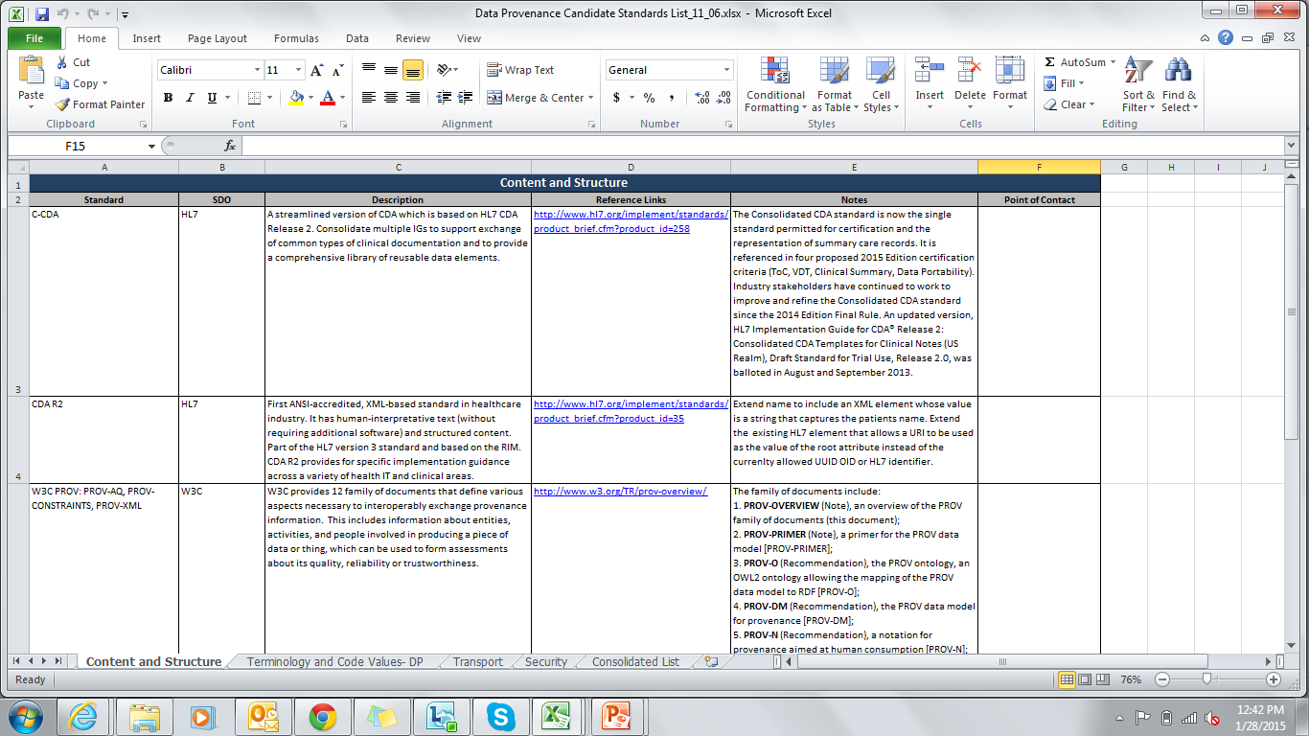
Candidate Standards List
UCR Mapping
Standards Evaluation
Solution Plan
IG Development
S&I Support Staff gathers list of initial standards within the Candidate Standards List and the community further narrows down the standards
Standard
One worksheet per Standards Category (4 total)
Standard
Standards Development Organization
Description
Reference Links
Notes
Note: Example Candidate Standards template from Data Provenance initiative
**All standards listed include the standards mentioned in the Data Provenance as well as other additional, relevant standards
21

Slide 22
UCR-Standards Crosswalk
UCR Mapping
Standards Evaluation
Solution Plan
IG Development
Each Standard from the Candidate Standards List must be mapped to each of the Use Case Requirements in the UCR-Standards Crosswalk
Community input is recorded from the initiative community members and additional working sessions are held in order to mitigate standards gaps
  Standards that did not pass the HITSC Evaluation may be added back into consideration at this point in the Harmonization Process
Use Case: Requirements
Candidate Standards
Community members
UCR-Standards Crosswalk Document
Actions
Record Community input
Hold additional Working Sessions
Results
Mitigate Standards Gaps
List of standards for Solution Planning
UCR-Standards Mapping Documents
Support Team
22

Slide 23
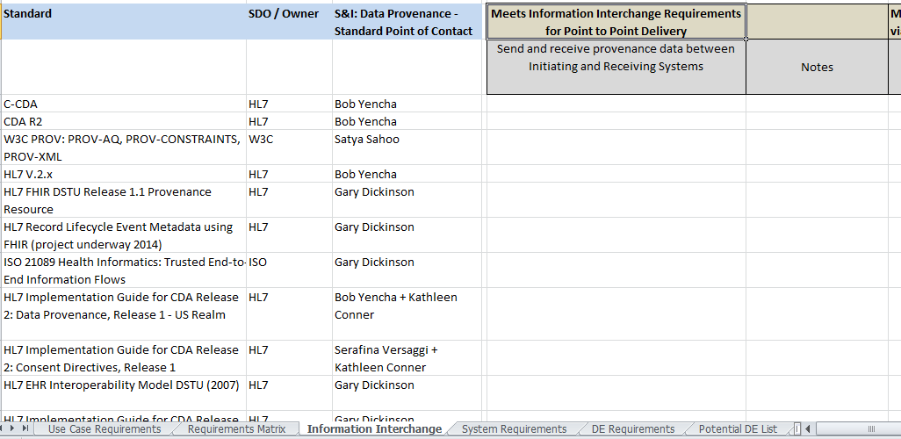
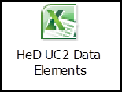
UCR-Standards Mapping
UCR Mapping
Standards Evaluation
Solution Plan
IG Development
Requirements
Comments
Standards
Note: Draft UCR Crosswalk template for the Data Provenance initiative
Cross-mapping of each standard with Use Case Requirements
Gap mitigation occurs here
  Can add and remove standards back in for consideration in order to mitigate any gaps found
23

Slide 24
HITSC Evaluation Process
After the standards are mapped to the Use Case Requirements in the UCR-Standards Mapping, any conflicting standards resulting from the UCR-Standards Mapping are then evaluated in the HITSC Evaluation
The HITSC Evaluation spreadsheet is used to evaluate the conflicting standards (mapped to the Use Case Requirements) against the HITSC criteria
  Three categories of criteria
    Maturity of Specification
    Adoptability of Standard
    S&I Framework Specific (including Meaningful Use criteria)
S&I Community members fill out the evaluation individually offline
  S&I support staff reconciles results into one master copy
Working sessions are held to review discrepancies and come to one consensus
24

Slide 25
HITSC Criteria Overview
UCR Mapping
Standards Evaluation
Solution Plan
IG Development
Adoptability Criteria
Ease of Implementation and Deployment | Availability of Off-the-Shelf Infrastructure to Support Implementation Specification Maturity Quality and Clarity of Specifications Ease of Use of Specification Degree to which Specification uses Familiar Terms to Describe “Real-World” Concepts Expected Total Costs of Implementation Appropriate Optionality Availability of Off-the-Shelf Infrastructure to Support Implementation Standard as Success Factor Conformance Criteria and Tests Availability of Reference Implementations Separation of Concerns Runtime Decoupling
Intellectual Property | Openness Affordability Freedom from Patent Impediments Licensing Permissiveness Copyright Centralization
Ease of Operations | Comparison of Targeted Scale of Deployment to Actual Scale Deployed Number of Operational Issues Identified in Deployment Degree of Peer-Coordination of Technical Experts Needed Operational Scalability (i.e. operational impact of adding a single node) Fit to Purpose
Maturity Criteria
Maturity of Specification | Breadth of Support Stability Adoption of Selection
Maturity of Underlying Technology Components | Breadth of Support Stability Adoption of Technology Platform Support Maturity of the Technology within its Life Cycle
Market Adoption | Installed Health Care User Base Installed User Base Outside Health Care Interoperable Implementations Future Projections and Anticipated Support Investment in User Training
S&I Criteria
Regulatory | Meaningful Use HIPAA Other Regulation
Usage within S&I Framework | Usage within S&I Framework
Note: HITSC Evaluation contains definitions for each criterion; Criteria can be deemed not applicable for the initiative and applicable criteria can be added
25

Slide 26
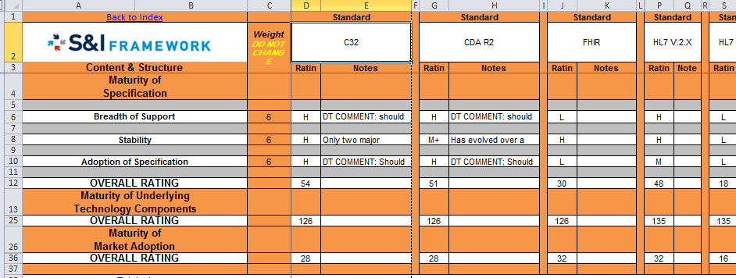
HITSC Evaluation
UCR Mapping
Standards Evaluation
Solution Plan
IG Development
Note: Example HISTC Analysis template from PDMP & HITI initiative
Using formula-driven tools, each standard is given a rating of High, Medium, or Low against the criteria and a weight to determine the overall rating of the standard. All ratings are then compared within each category and if the rating is above a certain point determined by SMEs, the standards are then leveraged in the next stage of Harmonization
26
Notes:
SDC was also able to leverage the ratings for some standards – this means that future S&I initiatives don’t have to “re-rate” the same standards

Slide 27
Agenda
UCR Mapping
Standards Evaluation
Solution Plan
IG Development
Harmonization Overview
Standards Evaluation
Solution Planning/ IG Design
Harmonized IG Development
27

Slide 28
Solution Planning/ IG Design
UCR Mapping
Standards Evaluation
Solution Plan
IG Development
The list of standards that result from the UCR-Standards Mapping are then used in the final Solution Plan
Community Input is recorded from initiative community members as well as collaboration with SWGs
Formal Consensus Process is coordinated
List of Standards for Solution Planning
Community members
Actions
Solution Plan
Record Community input
Collaborate with SWG’s
Coordinate Formal Consensus Process
Results
Finish Solution Plan for use in IG
Solution Plan Documents
Support Team
28

Slide 29
Agenda
UCR Mapping
Standards Evaluation
Solution Plan
IG Development
Harmonization Overview
Standards Evaluation
Solution Planning/ IG Development
Harmonized IG Development
29

Slide 30
IG Development Process
UCR Mapping
Standards Evaluation
Solution Plan
IG Development
Finalized Standards from Solution Plan
Creation of Schemas
Input from Community members
Actions
Incorporate Community input
Hold additional Working Sessions
Implementation Guide
SupportTeam
30

Slide 31
IG Development Template
Standards Evaluation
UCR Mapping
Solution Plan
IG Development
To develop the IG template we use:
..and eventually iterative feedback from the initiative communities to understand what is best included in an IG document
Previous S&I IGs
SME Input
Other IG examples
SDO Examples
HITSP Outline
31
Notes:
Rename “IG” once SDO is determined

Slide 32
IG Contents
Standards Evaluation
UCR Mapping
Solution Plan
IG Development
Example IG Table of Contents created by the Structured Data Capture Initiative
Purpose: To provide implementation details to all implementers so that their system can be compliant to SDC Initiative. SDC will focus first on the SOAP/SAML IG for a quick-win and work on the REST/OAuth IG in parallel where applicable
1.0 INTRODUCTION
1.1 Purpose
1.2 Approach
1.3 Intended Audience
1.4 Organization of This Guide
1.4.1 Conformance Verbs (Keywords)
1.4.2 Cardinality
1.4.3 Definition of Actors
2.0 IMPLEMENTATION APPROACH
2.1 Solution Plan
2.2 Pre-conditions
2.3 Common Data Element (CDE) Definition
2.3.1 Overview
2.3.2 Element Definition
2.3.3 Element Storage
2.3.4 Version Control
2.4 Structure and Overview of MFI Form Model Definition
2.3.1 Detail provided for each metaclass and attribute
2.3.2 Basic Types and Enumerations
2.3.3 Primary Metaclasses in MFI for Form registration
2.5 Transaction Definition
2.4.1 Transport and Security Mechanism
2.4.2 Service Implementation
2.4.3 Authentication Mechanism
2.4.4 XML-based Template
2.6 Auto-population Definition
2.5.1 Overview
3.0 SUGGESTED ENHANCEMENTS
4.0 APPENDICES
Appendix A: Definition of Acronyms and Key Terms
Appendix B: Conformance Statements List
Appendix C: Templates List
Appendix D: Specifications References
32

Slide 33
Conclusion
Having performed this process on several initiatives the Harmonization process has proven to be successful in refining and narrowing down a broad list of standards to be implemented and ultimately piloted
The methodology is executed in the following stages:
This process can and will be extended to new S&I initiatives with the use of existing templates
UCR Mapping
Standards Evaluation
Solution Plan
IG Development
33

Slide 34
Next Steps
Stop by and say “Hi” at the ONC Annual Meeting
Next All Hands meeting is Thursday, February 5, 2015
  http://wiki.siframework.org/Data+Provenance+Initiative

Slide 35
Support Team and Questions
  Please feel free to reach out to any member of the Data Provenance Support Team:
    Initiative Coordinator: Johnathan Coleman: jc@securityrs.com
    OCPO Sponsor: Julie Chua: julie.chua@hhs.gov
    OST Sponsor: Mera Choi: mera.choi@hhs.gov
    Subject Matter Experts: Kathleen Conner: klc@securityrs.com and Bob Yencha: bobyencha@maine.rr.com
    Support Team:
      Project Management: Jamie Parker: jamie.parker@esacinc.com
      Standards Development Support: Perri Smith: perri.smith@accenturefederal.com and Atanu Sen: atanu.sen@accenture.com
      Support: Apurva Dharia: apurva.dharia@esacinc.com, Rebecca Angeles: rebecca.angeles@esacinc.com and Zach May: zachary.may@esacinc.com

