Slide 1

Data Provenance Community Meeting
October 23, 2014

Slide 2



Meeting Etiquette
Please mute your phone when you are not speaking to prevent background noise.
  All meetings are recorded.
Please do not put your phone on hold.
  Hang up and dial back in to prevent hold music.
Please announce your name before speaking
Use the “Chat” feature to ask questions or share comments.
  Send chats to “All Participants” so they can be addressed publicly in the chat, or discussed in the meeting (as appropriate).
Click on the “chat” bubble at the top of the meeting window to send a chat.

Slide 3
Agenda
Topic | Time Allotted
General Announcements | 4 minutes
Harmonization and Candidate Standards Introduction | 45 minutes
Next Steps/Questions | 1 minutes

Slide 4
General Announcements
  Next meeting:
    All Hands: Thursday, October 23rd, 2014 – 2:30-3:30 pm ET
    http://wiki.siframework.org/Data+Provenance+Initiative
  All meeting materials (including this presentation) can be found on the Past Meetings page:
    http://wiki.siframework.org/Data+Provenance+Past+Meetings

Slide 5
S&I Framework Phases outlined for Data Provenance
Phase | Planned Activities
Pre-Discovery | Development of Initiative Synopsis Development of Initiative Charter Definition of Goals & Initiative Outcomes
Discovery | Creation/Validation of Use Cases, User Stories & Functional Requirements Identification of interoperability gaps, barriers, obstacles and costs Review of Candidate Standards
Implementation | Creation of aligned specification Documentation of relevant specifications and reference implementations such as guides, design documents, etc. Development of testing tools and reference implementation tools
Pilot | Validation of aligned specifications, testing tools, and reference implementation tools Revision of documentation and tools
Evaluation | Measurement of initiative success against goals and outcomes Identification of best practices and lessons learned from pilots for wider scale deployment Identification of hard and soft policy tools that could be considered for wider scale deployments
We are Here

Slide 6
Harmonization Process Overview
Data Provenance
S&I Framework
October 23rd, 2014
6

Slide 7
Agenda
Harmonization Overview
Standards Evaluation
Solution Planning
IG Development
7

Slide 8

Standards & Harmonization Process
Use Case Requirements
Candidate Standards
Evaluation and Selection of Standards
Technical Design
Standards & Technical Gap Analysis
The Harmonization Process provides detailed analysis of candidate standards to determine “fitness for use” in support of Initiative functional requirements.
The resulting technical design, gap analysis and harmonization activities lead to the evaluation and selection of draft standards. These standards are then used to develop the real world implementation guidance via an Implementation Guide or Technical Specification which are then validated through Reference Implementation (RI) and Pilots.
The documented gap mitigation and lessons learned from the RI and Pilot efforts are then incorporated into an SDO-balloted artifact to be proposed as implementation guidance for Recommendation.
Draft Harmonized Profile/Standard
Harmonized Profile/Standard for Recommendation
Validation of Standard
Implementation Guidance for Real-World Implementers
SDO Balloting, RI & Pilots
8

Slide 9
Standardization Development & Harmonization: Workflow
Evaluate Standards
Plan for Solution and Final standards
Develop Implementation Guide
Potential SDO Balloting
Validate candidate standards list
Map UCR to candidate standards
Analyze mapped standards per HITSC criteria to narrow down any conflicting standards resulting from the UCR-Standards mapping
Perform technical feasibility of analysis
Review with community
Use Case Requirements Crosswalk
Develop gap mitigation plan
Perform current state workflow analyses
Draft Solution diagram/matrices
Validate solution plan
Confirm data model approach
Modify/harmonize existing standard(s) to produce final standards
Achieve community consensus or agreement
Final standards
Using final standards, develop Implementation Guide document
Document IG Conformance Statements in RTM
Develop Examples to inform implementers
Validate examples
Achieve community consensus or agreement
Implementation Guide
Survey SDO or standards organization options
Select balloting approach
Align timeline with ballot cycles
Submit documents informing SDO of intent to ballot
Submit content to SDO
Conduct balloting cycle & reconciliation per SDO guidelines
Balloted standards
Outputs
9

Slide 10
Key Tasks & Work Outputs
UCR-Standards Crosswalk
  Evaluation of Candidate Standards List
  Sub-workgroup meetings to evaluate Content & Structure, Vocabulary & Code set Standards
  Mitigate any gaps within existing standards
HITSC Evaluation
  Quantitative analysis of evaluated standards resulting from UCR-Standards Crosswalk
Solution Plan
  Final layered solution of standards across all standards categories and requirements used for implementation guidance
Initiative Deliverable: Implementation Guidance
10

Slide 11
Standards Development Support
“Building Blocks”
The role of SDS within S&I is complementary to future Harmonization activities by convening SDOs and educating the community on standards and organizational processes
Successfully implement developed standards
Result
Extend, modify, or develop a standard and develop implementation guidance
Align initiative with SDO balloting or development priorities
Initiative Progress
Action
Support standards analysis against requirements
Confirm Gaps
Work with WG and SDOs to create plan and recommendations to address gaps
Contribution
Implement Communication Plan for SDO engagement
Scan the standards & implementation environment
Develop a “Candidate Standards” list
Foundation
11

Slide 12
Agenda
UCR Mapping
Standards Evaluation
Solution Plan
IG Development
Harmonization Overview
Standards Evaluation
Solution Planning
IG Development
12

Slide 13
Candidate Standards List
UCR Mapping
Standards Evaluation
Solution Plan
IG Development
S&I Support Staff gathers list of initial standards within the Candidate Standards List and the community further narrows down the standards
PDMP & HIT Integration Candidate Standards
Standard | SDO | Description | Reference Links | Notes
C32 | HITSP | HL7 | The Summary Documents Using HL7 Continuity of Care Document (CCD) Component describes the document content summarizing a consumer's medical status for the purpose of information exchange. The content may include administrative (e.g., registration, demographics, insurance, etc.) and clinical (problem list, medication list, allergies, test results, etc) information. This Component defines content in order to promote interoperability between participating systems such as Personal Health Record Systems (PHRs), Electronic Health Record Systems (EHRs), Practice Management Applications and others. |  | Describes the document content (e.g., demographics, problem, medication list, test results, etc.) for the purpose of exchange. Type of CDA. Supports MU Stage 1. Designed to provide a clinical summary of patient information.
CDA R2 | HL7 | First ANSI-accredited, XML-based standard in healthcare industry. It has human-interpretative text (without requiring additional software) and structured content. Part of the HL7 version 3 standard and based on the RIM. CDA R2 provides for specific implementation guidance across a variety of health IT and clinical areas. | http://www.hl7.org/implement/standards/product_brief.cfm?product_id=35 | There are 26 CDA R2-related implementation guides spanning across a variety of clinical areas.
HL7 V.2.X | HL7 | Defines a series of electronic messages to support administrative, logistical, financial as well as clinical processes. Messaging standard that supports human readable, non-XML electronic messages based on segments (lines) and one-character delimiters. | http://www.hl7.org/implement/standards/product_brief.cfm?product_id=148 | An HL7 V2.x Message Profile is a precise and unambiguous specification of a standard HL7 message that has been analyzed for use within a particular set of requirements. It is a particular style or usage of a standard HL7 message, driven by use case analysis and interaction modeling.
Standard
One worksheet per Standards Category (4 total)
Standard
Standards Development Organization
Description
Reference Links
Notes
Note: Example Candidate Standards template from PDMP & HITI initiative
**All standards listed include the standards mentioned in the PDMP & HITI Charter as well as other additional, relevant standards
13

Slide 14
UCR-Standards Crosswalk
UCR Mapping
Standards Evaluation
Solution Plan
IG Development
Each Standard from the Candidate Standards List must be mapped to each of the Use Case Requirements in the UCR-Standards Crosswalk
Community input is recorded from the initiative community members and additional working sessions are held in order to mitigate standards gaps
  Standards that did not pass the HITSC Evaluation may be added back into consideration at this point in the Harmonization Process
Use Case: Requirements
Candidate Standards
Community members
UCR-Standards Crosswalk Document
Actions
Record Community input
Hold additional Working Sessions
Results
Mitigate Standards Gaps
List of standards for Solution Planning
UCR-Standards Mapping Documents
Support Team
14

Slide 15
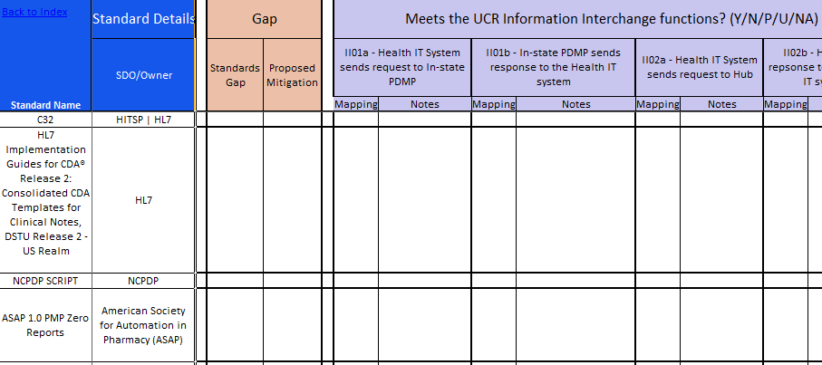
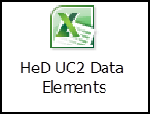
UCR-Standards Mapping
UCR Mapping
Standards Evaluation
Solution Plan
IG Development
Comments
Requirements
Standards
Note: Example UCR Crosswalk template from PDMP & HITI initiative
Cross-mapping of each standard with Use Case Requirements
Gap mitigation occurs here
  Can add and remove standards back in for consideration in order to mitigate any gaps found
15

Slide 16
HITSC Evaluation Process
After the standards are mapped to the Use Case Requirements in the UCR-Standards Mapping, any conflicting standards resulting from the UCR-Standards Mapping are then evaluated in the HITSC Evaluation
The HITSC Evaluation spreadsheet is used to evaluate the conflicting standards (mapped to the Use Case Requirements) against the HITSC criteria
  Three categories of criteria
    Maturity of Specification
    Adoptability of Standard
    S&I Framework Specific (including Meaningful Use criteria)
S&I Community members fill out the evaluation individually offline
  S&I support staff reconciles results into one master copy
Working sessions are held to review discrepancies and come to one consensus
16

Slide 17
HITSC Criteria Overview
UCR Mapping
Standards Evaluation
Solution Plan
IG Development
Adoptability Criteria
Ease of Implementation and Deployment | Availability of Off-the-Shelf Infrastructure to Support Implementation Specification Maturity Quality and Clarity of Specifications Ease of Use of Specification Degree to which Specification uses Familiar Terms to Describe “Real-World” Concepts Expected Total Costs of Implementation Appropriate Optionality Availability of Off-the-Shelf Infrastructure to Support Implementation Standard as Success Factor Conformance Criteria and Tests Availability of Reference Implementations Separation of Concerns Runtime Decoupling
Intellectual Property | Openness Affordability Freedom from Patent Impediments Licensing Permissiveness Copyright Centralization
Ease of Operations | Comparison of Targeted Scale of Deployment to Actual Scale Deployed Number of Operational Issues Identified in Deployment Degree of Peer-Coordination of Technical Experts Needed Operational Scalability (i.e. operational impact of adding a single node) Fit to Purpose
Maturity Criteria
Maturity of Specification | Breadth of Support Stability Adoption of Selection
Maturity of Underlying Technology Components | Breadth of Support Stability Adoption of Technology Platform Support Maturity of the Technology within its Life Cycle
Market Adoption | Installed Health Care User Base Installed User Base Outside Health Care Interoperable Implementations Future Projections and Anticipated Support Investment in User Training
S&I Criteria
Regulatory | Meaningful Use HIPAA Other Regulation
Usage within S&I Framework | Usage within S&I Framework
Note: HITSC Evaluation contains definitions for each criterion; Criteria can be deemed not applicable for the initiative and applicable criteria can be added
17

Slide 18
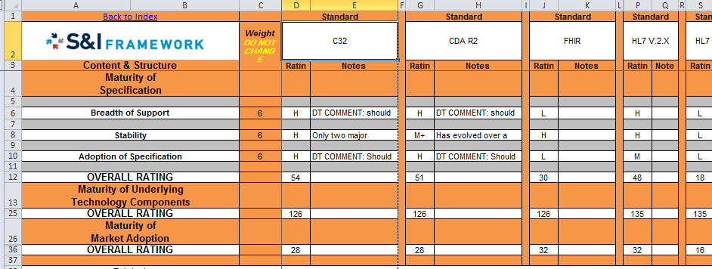
HITSC Evaluation
UCR Mapping
Standards Evaluation
Solution Plan
IG Development
Note: Example HISTC Analysis template from PDMP & HITI initiative
Using formula-driven tools, each standard is given a rating of High, Medium, or Low against the criteria and a weight to determine the overall rating of the standard. All ratings are then compared within each category and if the rating is above a certain point determined by SMEs, the standards are then leveraged in the next stage of Harmonization
18
Notes:
SDC was also able to leverage the ratings for some standards – this means that future S&I initiatives don’t have to “re-rate” the same standards

Slide 19
Agenda
UCR Mapping
Standards Evaluation
Solution Plan
IG Development
Harmonization Overview
Standards Evaluation
Solution Planning
IG Development
19

Slide 20
Solution Planning
UCR Mapping
Standards Evaluation
Solution Plan
IG Development
The list of standards that result from the UCR-Standards Mapping are then used in the final Solution Plan
Community Input is recorded from initiative community members as well as collaboration with SWGs
Formal Consensus Process is coordinated
  This could last from 2 to 6 weeks
List of Standards for Solution Planning
Community members
Actions
Solution Plan
Record Community input
Collaborate with SWG’s
Coordinate Formal Consensus Process
Results
Finish Solution Plan for use in IG
Solution Plan Documents
Support Team
20
Notes:
HeD’s process was slightly different because their community was more active.
SDC’s required more materials presented to them.

Slide 21
Structured Data Capture
 |  | Transport & Security |  |  | Content & Structure
# | Transaction | Transport | Authentication | Security/ Encryption | Service | Authorization /Consent | Organizer/ Container | Item Payloads | Reference Information Model
II01 | EHR System - Send Form/template request to Form/Template Repository | SOAP REST Direct (SMIME) | SAML | TLS Direct (SMIME) HTTPS | RFD XD* IHE DEX | XUA | N/A |  | To be considered over the longer term: FHIM CIMI CDASH
II02 | EHR System - Send Form/Template Request to Form/Template Repository with relevant patient data | SOAP REST Direct (SMIME) | SAML | TLS Direct (SMIME) HTTPS XD* | RFD XD* | XUA BPPC | ODM (partial) ICSR (partial) HL7 V3 - Patient Administration Domain | CDA R2 CCDA Common Formats (partial)
II03 | Form/Template Repository - Sends blank form/template | SOAP REST Direct (SMIME) | SAML | TLS Direct (SMIME) HTTPS XD* (partial) | RFD XD* (partial) IHE DEX | XUA | CDA R2 (partial) CDA Questionnaire Form IG IHE DEX XHTML ODM (partial) | CDA R2 (partial) CDA Questionnaire Form IG X-Forms XHTML Common Formats (partial) CDS Knowledge Sharing IG
II04 | Form/Template Repository - Sends form/template with populated patient data *consider dependency on how population occurs | SOAP REST Direct (SMIME) | SAML | TLS Direct (SMIME) HTTPS XD* (partial) | RFD XD* (partial) IHE DEX | XUA BPPC | CDA R2 (partial) CDA Questionnaire Form IG IHE DEX XHTML | CDA R2 (partial) CDA Questionnaire Form IG X-Forms XHTML CDS Knowledge Sharing IG
II05 | EHR System - Sends completed form/template structured data | SOAP REST Direct (SMIME) | SAML | TLS Direct (SMIME) HTTPS XD* (partial) | RFD XD* (partial) | XUA BPPC | CDA Questionnaire Response IG | CDA Questionnaire Response IG CDA R2 (partial) CCDA (partial) X-Forms (partial) CDS Knowledge Sharing IG (partial)
S04 | Form/Template Repository - (Conditional) Auto-population of retrieved form / template with EHR-sent patient data | N/A |  |  | IHE DEX | XUA BPPC | ISO 11179 (partial) ODM | CDS Knowledge Sharing IG
S05 | EHR System - (Conditional) Auto-population of displayed form / template with EHR-derived patient data | N/A |  |  | IHE DEX | N/A | ISO 11179 (partial) ODM | CDS Knowledge Sharing IG
S08 | EHR System - Store structured data from form/template in standard format | N/A |  |  | RFD |  | X-Forms XHTML
Identify Sub-Categories of Standards
2
1
Requirements are pulled from UCR Crosswalk
**Example Solution Plan leveraged from SDC S&I Initiative
21
Notes:
Replace table with PDMP standards/transactions for community

Slide 22
Structured Data Capture
 |  | Transport & Security |  |  | Content & Structure
# | Transaction | Transport | Authentication | Security/ Encryption | Service | Authorization /Consent | Organizer/ Container | Item Payloads | Reference Information Model
II01 | EHR System - Send Form/template request to Form/Template Repository | SOAP REST Direct (SMIME) | SAML | TLS Direct (SMIME) HTTPS | RFD XD* IHE DEX | XUA | N/A |  | To be considered over the longer term: FHIM CIMI CDASH
II02 | EHR System - Send Form/Template Request to Form/Template Repository with relevant patient data | SOAP REST Direct (SMIME) | SAML | TLS Direct (SMIME) HTTPS XD* | RFD XD* | XUA BPPC | ODM (partial) ICSR (partial) HL7 V3 - Patient Administration Domain | CDA R2 CCDA Common Formats (partial)
II03 | Form/Template Repository - Sends blank form/template | SOAP REST Direct (SMIME) | SAML | TLS Direct (SMIME) HTTPS XD* (partial) | RFD XD* (partial) IHE DEX | XUA | CDA R2 (partial) CDA Questionnaire Form IG IHE DEX XHTML ODM (partial) | CDA R2 (partial) CDA Questionnaire Form IG X-Forms XHTML Common Formats (partial) CDS Knowledge Sharing IG
II04 | Form/Template Repository - Sends form/template with populated patient data *consider dependency on how population occurs | SOAP REST Direct (SMIME) | SAML | TLS Direct (SMIME) HTTPS XD* (partial) | RFD XD* (partial) IHE DEX | XUA BPPC | CDA R2 (partial) CDA Questionnaire Form IG IHE DEX XHTML | CDA R2 (partial) CDA Questionnaire Form IG X-Forms XHTML CDS Knowledge Sharing IG
II05 | EHR System - Sends completed form/template structured data | SOAP REST Direct (SMIME) | SAML | TLS Direct (SMIME) HTTPS XD* (partial) | RFD XD* (partial) | XUA BPPC | CDA Questionnaire Response IG | CDA Questionnaire Response IG CDA R2 (partial) CCDA (partial) X-Forms (partial) CDS Knowledge Sharing IG (partial)
S04 | Form/Template Repository - (Conditional) Auto-population of retrieved form / template with EHR-sent patient data | N/A |  |  | IHE DEX | XUA BPPC | ISO 11179 (partial) ODM | CDS Knowledge Sharing IG
S05 | EHR System - (Conditional) Auto-population of displayed form / template with EHR-derived patient data | N/A |  |  | IHE DEX | N/A | ISO 11179 (partial) ODM | CDS Knowledge Sharing IG
S08 | EHR System - Store structured data from form/template in standard format | N/A |  |  | RFD |  | X-Forms XHTML
3
Standards are mapped to their respective Sub-Categories
4
Non-Applicable Areas are identified
22

Slide 23
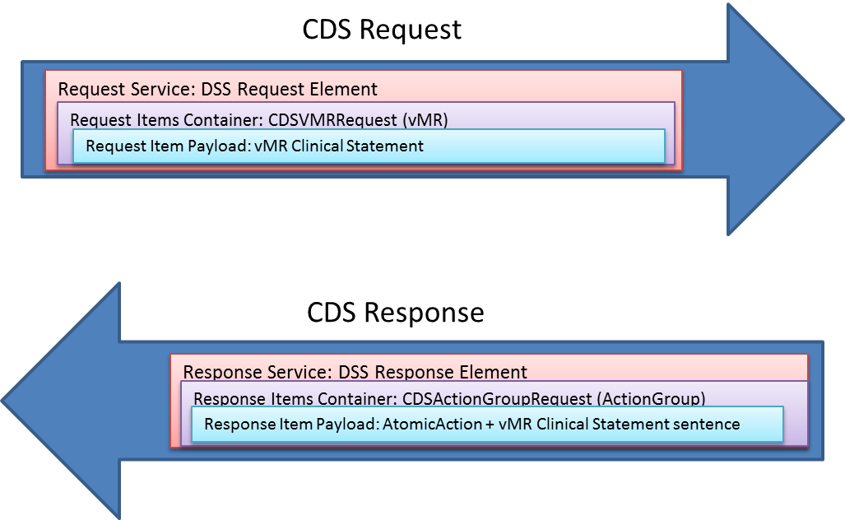
Solution Planning
UCR Mapping
Standards Evaluation
Solution Plan
IG Development
Example Solution Plan created by the Health eDecisions Initiative
Legend
Service
Items Container
Item Payload
23

Slide 24
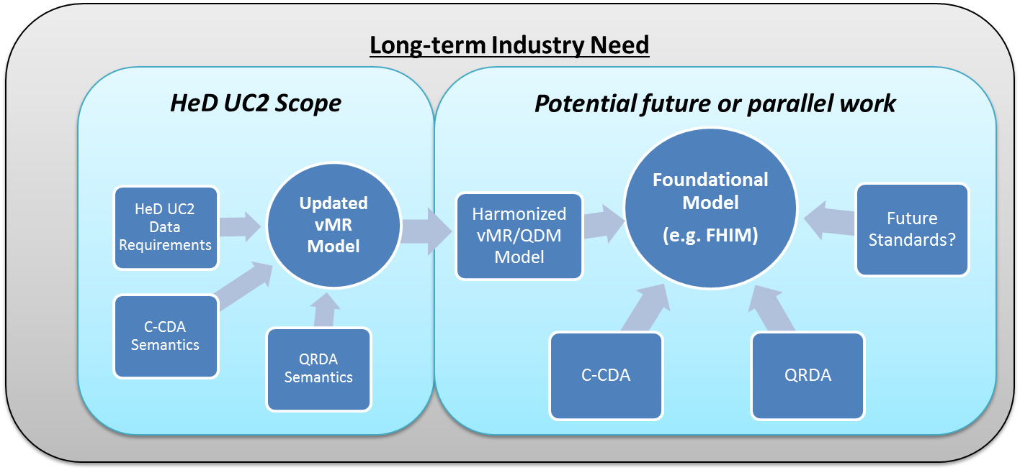
Solution Planning
Standards Evaluation
UCR Mapping
Solution Plan
IG Development
Example from Health eDecisions Initiative
The ultimate goal as a part of the solution plan is to move towards a foundational model, allowing for mapping to additional payload formats in the future
Propose to support multiple payload standards while still promoting interoperability over the longer term, aligning the harmonized semantics of the payload to a foundational model
24

Slide 25
Agenda
UCR Mapping
Standards Evaluation
Solution Plan
IG Development
Harmonization Overview
Standards Evaluation
Solution Planning
IG Development
25

Slide 26
IG Development Process
UCR Mapping
Standards Evaluation
Solution Plan
IG Development
Finalized Standards from Solution Plan
Creation of Schemas
Input from Community members
Actions
Incorporate Community input
Hold additional Working Sessions
Implementation Guide
SupportTeam
26

Slide 27
IG Development Template
Standards Evaluation
UCR Mapping
Solution Plan
IG Development
To develop the IG template we use:
..and eventually iterative feedback from the initiative communities to understand what is best included in an IG document
Previous S&I IGs
SME Input
Other IG examples
HL7 Examples
HITSP Outline
27
Notes:
Rename “IG” once SDO is determined

Slide 28
IG Contents
Standards Evaluation
UCR Mapping
Solution Plan
IG Development
Example IG Table of Contents created by the Structured Data Capture Initiative
Purpose: To provide implementation details to all implementers so that their system can be compliant to SDC Initiative. SDC will focus first on the SOAP/SAML IG for a quick-win and work on the REST/OAuth IG in parallel where applicable
1.0 INTRODUCTION
1.1 Purpose
1.2 Approach
1.3 Intended Audience
1.4 Organization of This Guide
1.4.1 Conformance Verbs (Keywords)
1.4.2 Cardinality
1.4.3 Definition of Actors
2.0 IMPLEMENTATION APPROACH
2.1 Solution Plan
2.2 Pre-conditions
2.3 Common Data Element (CDE) Definition
2.3.1 Overview
2.3.2 Element Definition
2.3.3 Element Storage
2.3.4 Version Control
2.4 Structure and Overview of MFI Form Model Definition
2.3.1 Detail provided for each metaclass and attribute
2.3.2 Basic Types and Enumerations
2.3.3 Primary Metaclasses in MFI for Form registration
2.5 Transaction Definition
2.4.1 Transport and Security Mechanism
2.4.2 Service Implementation
2.4.3 Authentication Mechanism
2.4.4 XML-based Template
2.6 Auto-population Definition
2.5.1 Overview
3.0 SUGGESTED ENHANCEMENTS
4.0 APPENDICES
Appendix A: Definition of Acronyms and Key Terms
Appendix B: Conformance Statements List
Appendix C: Templates List
Appendix D: Specifications References
28

Slide 29
Conclusion
Having performed this process on the Health eDecisions and Structured Data Capture initiatives, the Harmonization process has proven to be successful in refining and narrowing down a broad list of standards to be implemented and ultimately piloted
The methodology is executed in the following stages:
This process can and will be extended to new S&I initiatives with the use of existing templates
UCR Mapping
Standards Evaluation
Solution Plan
IG Development
29
Notes:
Change this to be PDMP-specific?

Slide 30
DPROV Harmonization Timeline
Oct.
Nov.
Dec.
Jan.
Feb.
March
Today
Standards Evaluation
10/23: DPROV Harm Launch
10/23 – 12/12
Standards Analysis & Assessment
Solution Planning
12/1 - 1/9
Solution Planning
Create IG Template
12/15 - 1/5
Introduction
1/8 - 1/22
IG Development
1/12 - 2/12
Implementation Approach
Suggested Enhancements
2/12 - 2/19
End-to-End Review
2/19 – 3/5
30

Slide 31
Support Team and Questions
  Please feel free to reach out to any member of the Data Provenance Support Team:
    Initiative Coordinator: Johnathan Coleman: jc@securityrs.com
    OCPO Sponsor: Julie Chua: julie.chua@hhs.gov
    OST Sponsor: Mera Choi: mera.choi@hhs.gov
    Subject Matter Experts: Kathleen Conner: klc@securityrs.com and Bob Yencha: bobyencha@maine.rr.com
    Support Team:
      Project Management: Jamie Parker: jamie.parker@esacinc.com
      Use Case Development: Ahsin Azim: ahsin.azim@accenturefederal.com
      Harmonization: Alex Lowitt: alexander.s.lowitt@accenturefederal.com
      Standards Development Support: Amanda Nash: amanda.j.nash@accenturefederal.com
      Support: Lynette Elliott: lynette.elliott@esacinc.com and Apurva Dharia: apurva.dharia@esacinc.com

