Slide 1
electronic Long-Term Services & Supports (eLTSS) Initiative
All-Hands Workgroup Meeting
January 19, 2017

Slide 2



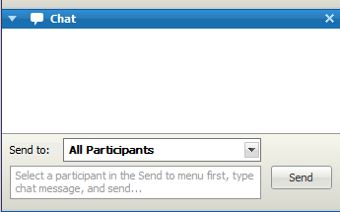
Meeting Etiquette
Remember: If you are not speaking, please keep your phone on mute
Do not put your phone on hold. If you need to take a call, hang up and dial in again when finished with your other call
  Hold = Elevator Music = frustrated speakers and participants
This meeting is being recorded
  Another reason to keep your phone on mute when not speaking
Use the “Chat” feature for questions, comments and items you would like the moderator or other participants to know.
  Send comments to All Panelists so they can be addressed publically in the chat, or discussed in the meeting (as appropriate).
From S&I Framework to Participants:
Hi everyone: remember to keep your phone on mute ☺
All Panelists

Slide 3
Agenda
Topic | Presenter | Timeframe
Welcome and Announcements | Lynette Elliott | 10 mins
RTM Strategies and Timelines | Jamie Parker | 20 mins
Round 2 Pilot Status Updates (TEFT teams) | Jamie Parker | 30 mins

Slide 4
Announcements
AHRQ Funding Opportunity Announcement: “Patient Reported Outcomes Using Health IT” now available
  What: AHRQ has issued a Funding Opportunity Announcement (FOA) for grant applications to conduct research that demonstrates how health information technology (IT) can improve patient-centered health outcomes and quality of care in primary care and other ambulatory settings. Applications should focus on the scale and spread of health IT-enabled practice models that use patient-reported outcome measures.
  When: Applications will be accepted on a rolling basis with the first due date of January 25, 2017
    (subject to NIH Standard Due Dates: https://grants.nih.gov/grants/guide/pa-files/PA-17-077.html )
  For full announcement, requirements and application instructions: https://grants.nih.gov/grants/guide/pa-files/PA-17-077.html

Slide 5
Announcements, cont’d...
ONC’s 2016 Report to Congress on Health IT Progress: Examining the HITECH Era and the Future of Health IT
  What: The President's FY 2017 Budget included four legislative proposals for ONC, which aim to further the advancement of nationwide interoperability, reliability, and transparency of health IT. ONC requested additional authorities to combat information blocking, enhance transparency, establish rules of the road for the electronic exchange of health information, and establish a Health IT Safety Collaborative. This annual report was submitted to Congress describing actions taken, barriers to adoption and recommendations for achieving full implementation of a nationwide system.
  When: Submitted and published November 2016
  To review the report: http://dashboard.healthit.gov/report-to-congress/2016-report-congress-examining-hitech-era-future-health-information-technology.php

Slide 6
Announcements, cont’d...
ONC initiatives have a new online home!
  S&I Framework Wiki has moved to a new Confluence platform within the ONC Tech Lab’s Standards Coordination area.
  ONC Tech Lab provides a central location for ONC resources.
Confluence offers better features allowing community members to easily access content.
The new eLTSS wiki space is here:
  https://oncprojectracking.healthit.gov/wiki/display/TechLabSC/eLTSS+Home
For ease of access, make sure you bookmark the new wiki in your browser and delete any S&I Framework bookmarks.
Please contact confluencesupport@esacinc.com for questions or comments.

Slide 7
eLTSS Initiative Roadmap
Q3 ‘14
Q4 ‘14
Q1 ‘15
Q2 ‘15
Q3 ‘15
Q4 ‘15
Q4 ‘16
Q4 ‘17
Initiative Kick Off: 11/06/14
Pre-Planning
Call for Participation
Conduct Environmental Scan
Success Criteria
Stakeholder Engagement
Phase 4: Pilots & Testing
Pilot site readiness
Implementation of solution
Test User Stories and Scenarios
Monitor Progress & Outcomes
Utilize Requirements Traceability Matrix
Develop, review, and finalize the Use Case and Functional Requirements
Phase 2: Use Case Development
& Functional Requirements
Launch initiative
Review and Finalize Charter
Review initial Candidate Standards
Finalize Candidate Standards
Standards Gap Analysis
Technical & Standards Design
Develop Requirements Traceability Matrix
Phase 5: Evaluation
Evaluate outcomes against Success Metrics and Criteria
Phase 1: Pre-Discovery
Phase 3: Pilot Guide Development
Timelines for Consideration: Two Pilot Phases, SDO Ballot Cycles

Slide 8
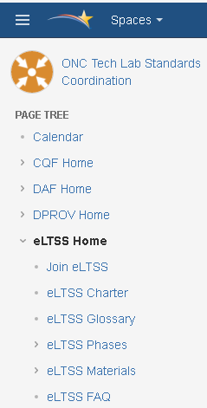
Reminder: Join the eLTSS Initiative
To join the electronic Long Term Services and Supports (eLTSS) Initiative, go here: https://oncprojectracking.healthit.gov/wiki/display/TechLabSC/Join+eLTSS
Registered Members are included on all initiative communications, updates and announcements.
You may join as an Interested Party or Committed Member (descriptions of each are on the wiki).
Thank you! Your commitment and participation are critical to the success of this initiative.

Slide 9

Key Inputs to Person-Centered Plan:
Person-Centered Profile
WHAT IS IMPORTANT TO ROBERT
Having a straw to hold
Using my iPad apps
Out and about
Swimming
Music
Healthy food
Looking sharp
Drinking water
Eating out
Church
Family
Recreation, sports
Volunteer, Job
PEOPLE WHO HELP ROBERT BEST
Tell me when I do well
Cheerful and outgoing
Assist me to do things for myself
Help me do what I like to do
Use positive language (not “don't...”)
Tell me the plan
Keep my house clean and neat
Communicate and keep my mom in the loop
Minimize waiting for things to happen
Know I may have a seizure
Identify fun activities
Professional
Stay with me
Think ahead
Safe driver
Engage me
Are on time
SUPPORTS ROBERT NEEDS TO BE HAPPY, HEALTHY, AND SAFE
Medication on time
Careful in parking lots
Help in bathroom
Seat belt on
Wear ID bracelet
Use bathroom a lot
Call Mom if problem or question(s) 410.733.9539
Deep breaths if agitated
Safe seizures
Suntan lotion
Food cut up
Teeth clean
No balcony use
Nurse Lara: 443.677.7130
WHAT PEOPLE LIKE
AND ADMIRE ABOUT ROBERT
Say what I want, decisive
Good memory
Like everyone
Handsome and polite
High energy, adventurous
Love my family
Deep thinker
Nice dresser
Mellow
Funny
Like to "chill"

Slide 10
RTM Strategies and
Pilot Timelines

Slide 11
Round 2 Pilot Status Updates

Slide 12
Colorado Medicaid - Weekly Update
Findings by provider(s) Montrose County SEP
  What information did your provider give you? Basic agreement on elements. Understands the process for developing a plan. Wants speed and ease of agreement.
  Do the eLTSS Core Elements reflect the providers needs? Yes. Wants to add plan funding source and service unit quantity interval.
  What is missing. Nothing at this point. Like secure email exchange.
  What non- element issues impact the use of these core elements? Consumability. Spreadsheet is good option but ultimately an embedded PDF works best.
Progress against your Timeline(s)
  Based on your proposed timeline where are you and anything at “risk” Nothing at risk today.
Risks
  Are there any issues causing risk to the work or timeline (i.e. software upgrades, vendor priorities etc.)

Slide 13
CT TEFT Update
Progress against your Timeline(s)
  Initial Mapping complete
  Vendor selected
Risks
  None at this time

Slide 14
GA Weekly Update
Findings by provider(s)
  We are summarizing findings. A few example findings to-date:
    On financial information – important to include ”liability/cost share” information – e.g. an amount the beneficiary is responsible for
    Info about home environment – e.g. pets
Progress against your Timeline(s)
  We have held engagements with two providers. We are summarizing results and conducting additional outreach to schedule an engagement with a third provider.
  We are preparing for our session at a provider association conference (GACCP)
Risks
  Including other stakeholder perspectives. We have focused on providers, but would like to include feedback from beneficiaries/advocates.

Slide 15
Kentucky eLTSS Pilot 2 Update
Findings by provider(s)
  Current Kentucky timeline to evaluate findings by provider is March 2017 and close out pilot by April 2017 deadline
  Working with our vendor, Deloitte to coordinate with the cabinet’s future plan to evaluate the LTSS Service plan with stakeholders in first quarter 2017 and update MWMA in Spring 2017.
    The MWMA system training sessions are underway
  Five service providers currently using the LTSS system MWMA contacted to participate in pilot
Progress against your Timeline(s)
  Draft document comparing current data items to the core data set completed
  Creation of an online response survey created in REDCap Survey Tool
  Piloting of Use case 1 and 2 underway (January 1st –February 28th)
  Determine metrics
Risk
  No risk or issue to current timeline

Slide 16
DHMH Maryland Weekly Update
Findings by provider(s) <Local Health Department Nurse Monitor & Personal Assistance Agency. Obtaining Supports Planner findings by 1-20-17>
  Our providers filled out a survey we created based on the RTM provided
  The core eLTSS elements do reflect the providers’ needs
  Elements missing:
    A few indicated usefulness of elements not found on MD’s printed plan but listed in the core elements, including: SP phone number, emergency back up plan text, & emergency contact’s phone number
  Fields having incorrect or incomplete information
Progress against your Timeline
  We have identified providers to work with, performed initial outreach, scheduled providers to complete survey, & have 4 completed surveys
  We are currently transferring the data into the RTM & plan to be finished by 1-25-17
Risks
  Supports planner completion of survey

Slide 17
Minnesota Weekly Update
Findings by provider(s)
  What information did your provider give you?
    Reaction to 450+ proposed data elements; told us what they had in their systems and what would be of interest to them; also told us what they’d like to receive from other Collaborative providers; also provided reaction to the Harmonized Data Set/Core Elements.
  Do the eLTSS Core Elements reflect the providers needs
    They certainly would value getting the Core Elements from the State; the Core Elements are not sufficient as an interoperability data exchange standard between providers delivering LTSS services for a beneficiary
  What is missing
    Currently piloting to develop that list, but the list includes things like ADLs/iADLs, meds, etc.
  What non- element issues impact the use of these core elements?
    These Core Elements are not available to providers electronically from the State at this time.
Progress against your Timeline(s)
  Based on your proposed timeline where are you and anything at “risk”
    We are close to launching secure exchange of our OTC eLTSS Data Sheet, so we’re feeling pretty good about where we’re at.
Risks
  Are there any issues causing risk to the work or timeline (i.e. software upgrades, vendor priorities etc.)
    We have some technical work to do for a couple of providers to get the data out of their EHRs

Slide 18
Pilot Working Session
Reminder: We have fewer than 48 working days to complete Round 2 Pilots.
  2-3 more formal Office Hours
We encourage you all to schedule one-off meetings as necessary.
  Strategy would include walking through the RTM with us the first 2-3 times as you work with providers
Rough Timeline:
  Feb 10: 1-2 providers interviewed and RTM completed (meeting scheduled with pilot team to review RTM progress and questions)
    Work on the exchange with the providers
  March 3rd: Final providers interviewed and RTM completed
    Work on exchange with providers
  March 17th: Draft RTMs submitted for review and questions
  March 31st: Completion of Round 2 pilots and start of Pilot Report Outs
Question for the pilots:
  How will you be exchanging the agreed upon data set once the providers sign off of and identify additional elements? (i.e. via fax, over the internet, with a PHR, through a case worker)
  What will you be exchanging (i.e. a mocked up plan, your current plan with hand written edits/additions, a comma delimited spreadsheet as a data dump from your system)
18

Slide 19
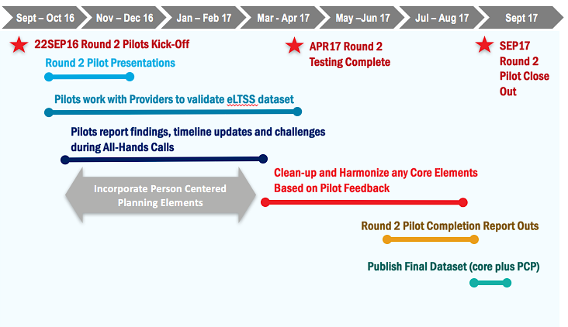
Round 2 Pilots Timeline

Slide 20
Tentative Meeting Schedule
Date | Topic | Presenter
January 26th | Office Hours with TEFT Grantees | 12:30 – 1:00 ET – GA 1:00 – 1:30 ET – KY 1:30 – 2:00 ET – MN
February 2nd | eLTSS All Hands Community Call | Pilot Status Updates
February 9th | Office Hours with TEFT Grantees | 12:30 – 1:00 ET – 1:00 – 1:30 ET – 1:30 – 2:00 ET – CO
February 16th | eLTSS All Hands Community Call | Pilot Status Updates
February 23rd | Office Hours with TEFT Grantees | 12:30 – 1:00 ET – CT 1:00 – 1:30 ET – 1:30 – 2:00 ET –
Notes:
Additional meetings scheduled as requested by non-TEFT pilots

Slide 21
FACA Meetings (Federal Advisory Committees)
Upcoming FACA Meetings
  2017 Interoperability Standards Advisory Task Force – January 23, and 30
  Consumer Task Force – January 23
  Public Health Task Force – January 25, February 8 and 13
  Collaboration of the Health IT Policy and Standards Committees – February 7
Public attendance is encouraged
https://www.healthit.gov/facas/calendar/2017/1

Slide 22
eLTSS Initiative: Project Team Leads
ONC Leadership
  Caroline Coy (caroline.coy@hhs.gov)
  Elizabeth Palena-Hall (elizabeth.palenahall@hhs.gov)
CMS Leadership
  Kerry Lida (Kerry.Lida@cms.hhs.gov)
Community Leadership
  Mary Sowers (msowers@nasddds.org)
  Terry O’Malley (tomalley@mgh.harvard.edu)
Federal Leadership
  Shawn Terrell (shawnterrell@acl.hhs.gov)
  Caroline Ryan (caroline.ryan@acl.hhs.gov)
  Marisa Scala-Foley (marisa.scala-foley@acl.hhs.gov)
Initiative Coordinator
  Evelyn Gallego-Haag (evelyn.gallego@emiadvisors.net)
Project Management
  Lynette Elliott (lynette.elliott@esacinc.com)
Use Case & Functional Requirements Development
  Becky Angeles (becky.angeles@esacinc.com)
Pilots Management
  Jamie Parker (jamie.parker@esacinc.com)
Standards and Technologies Identification
  Angelique Cortez (Angelique.j.cortez@accenturefederal.com)

