Slide 1

electronic Long-Term Services & Supports (eLTSS) Initiative
All-Hands Workgroup Meeting
December 10, 2015

Slide 2



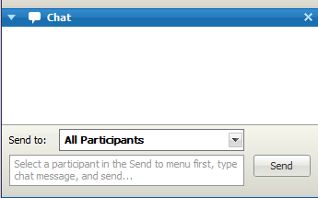
Meeting Etiquette
Remember: If you are not speaking, please keep your phone on mute
Do not put your phone on hold. If you need to take a call, hang up and dial in again when finished with your other call
  Hold = Elevator Music = frustrated speakers and participants
This meeting is being recorded
  Another reason to keep your phone on mute when not speaking
Use the “Chat” feature for questions, comments and items you would like the moderator or other participants to know.
  Send comments to All Panelists so they can be addressed publically in the chat, or discussed in the meeting (as appropriate).
From S&I Framework to Participants:
Hi everyone: remember to keep your phone on mute ☺
All Panelists

Slide 3
Agenda
Topic | Presenter | Timeframe
Welcome Announcements eLTSS Roadmap | Lynette Elliott | 10 mins
eLTSS Pilot Guidance: Requirements Traceability Matrix Walk Through | Jamie Parker | 50 mins

Slide 4
Announcements
CMS Updates its 2016 Quality Strategy
  What: The Centers for Medicare and Medicaid Services (CMS) are sharing an updated version of its 2014 Quality Strategy. The main purposes of the 2016 CMS Quality Strategy update are to achieve the broad aims of the NQS and to apply the Administration’s strategy around person-centered care. This document guides the various components of CMS, including Medicaid, Medicare and the Center for Consumer Information and Insurance Oversight, as they work together toward the common goal of health system transformation.
  Review the 2016 Quality Strategy: https://www.cms.gov/Medicare/Quality-Initiatives-Patient-Assessment-Instruments/QualityInitiativesGenInfo/CMS-Quality-Strategy.html

Slide 5
Announcements, cont’d...
Call for Participation: Help HL7 Help You Reduce C-CDA Implementation Inconsistencies
  What: HL7 invites C-CDA users to complete a survey that will help clarify the inconsistencies and pain points encountered when sending and/or receiving CCDs, Discharge Summaries and/or Referral Notes. Collection of data on these three document types will continue for several months. Results will be shared via webinar once results are compiled. Respondents should have direct experience sending and/or receiving the document types noted above.
  When: Interested parties should respond by December 15, 2015 ~ survey takes approximately 10-20 minutes to complete
  Survey link: https://www.surveymonkey.com/r/C-CDA21Content

Slide 6
Announcements, cont’d…
Free Webinar: “Fundamentals of eCQM Development”
  What: Angela Flanagan will present a one-hour webinar on the Fundamentals of eCQM Development hosted by Lantana Consulting Group. This webinar introduces the basics of eCQM development, focusing on fundamentals like the Blueprint and Quality Data Model, as well as tools used in eCQM development, such as Value Set Authoring Center (VSAC), Measure Authoring Tool (MAT), and Bonnie testing tool. This overview can be a starting point for program and business analysts, architects, and managers assessing the viability and level of effort involved.
  When: December 16, 2015 at 12:00pm ET
  To register: http://bit.ly/1OW3Zcy (no cost to attend)

Slide 7
Announcements, cont’d…
NATE and the California Association of Health Information Exchanges (CAHIE) Call for Participation: New National Forum for Provider Trust Community
What: NATE and the California Association of Health Information Exchanges (CAHIE) recently announced that CAHIE is assuming administration of the NATE Provider-to-Provider Trust Bundle for Direct messaging among providers. We are now looking for participants to serve on a new national forum to help establish a voluntary governance process to manage and govern the new national trust community.
When: Interested parties should respond as soon as possible
For information: http://www.ca-hie.org/news/call-for-participants-national-forum

Slide 8
Announcements, cont’d…
CMS needs your comments on discharge planning proposed rule on patient preferences
  What: The proposed rule emphasizes the importance of the patient’s goals and preferences during the discharge planning process. CMS advises that in planning transitions providers should consult with Aging and Disability Resource Centers, Area Agencies on Aging, and Centers for Independent Living, or SAMHSA’s treatment locator. These improvements should ensure that patients and their caregivers can work with organizations that provide community supports and help promote their personal goals upon discharge from the hospital or post-acute care setting.
  When: CMS will accept comments until January 4, 2016
  Submit comments: http://www.regulations.gov
  Proposed Rule – Revisions to Discharge Planning Requirements (CMS-3317-P): https://www.federalregister.gov/articles/2015/11/03/2015-27840/medicare-and-medicaid-programs-revisions-to-requirements-for-discharge-planning-for-hospitals
  CMS Press Release: https://www.cms.gov/Newsroom/MediaReleaseDatabase/Press-releases/2015-Press-releases-items/2015-10-29.html

Slide 9
Announcements, cont’d…
HL7 C-CDA Implementation-A-Thon
  What: HL7 is hosting the first C-CDA Implementation-A-Thon to identify issues and potential trouble spots. With an end goal to make implementations as easy as possible, the information gathered during the Implementation-A-Thon will be used to uncover inconsistencies in the C-CDA standard. Best practices for C-CDA implementations will subsequently be developed for use across the healthcare continuum.
  When: January 7-8, 2016
  Where: University of Central Florida, Executive Development Center Orlando, FL
  For information: http://www.hl7.org/events/implementationathon201601/index_7.cfm

Slide 10
Announcements, cont’d…
Precision Medicine (PM) for the Underserved: Announcing a Challenge on "Advancing Health Equity through Precision Medicine Tools”
  What: The President’s Precision Medicine Initiative seeks to revolutionize how we improve health and treat disease by taking into account individual differences in people’s genes, environments, and lifestyles. This new private-public initiative was introduced to fund digital health tool innovations that:
    Address the Precision Medicine needs of underserved and medically underserved people and communities
    Facilitate participation of people from underserved and medically underserved groups and communities in the PM cohert
    Promote use of open health platforms as a way of expanding the breadth, depth and interoperability of digital health tools and associated data to support the PM Initiative
  When: Concept submission deadline January 8, 2016
  Prizes: 1st Place $15k ~ 2nd Place $10K ~ 3rd Place $5K
  For more information: http://nhitunderserved.org/pmichallenge.html

Slide 11
eLTSS Initiative Timeline
DEC 14
JAN
FEB
MAR
APR
MAY
JUN
JUL
AUG
SEP
OCT
NOV
DEC 15
JAN 16
Kick Off
11/06/14
Use Case &
Functional
Requirements
Pilot Guide Development
Phase 1 Pilots &
Testing …
Pre-Discovery
Evaluation...
eLTSS All-Hands Work Group
Use Case
1. eLTSS Use Case
Pilot Guide Development
Candidate Standards & Technologies
Three-tiered implementation Approach
Functional Requirements Matrix
Pilot Execution
Content
Work Stream
eLTSS Plan Content SWG
  eLTSS Plan Domains & Data Elements

Slide 12
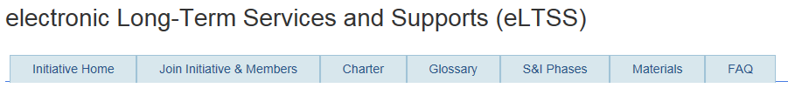
Reminder:
Join the eLTSS Initiative
To join the electronic Long Term Services and Supports (eLTSS) Initiative, go here: http://wiki.siframework.org/eLTSS+Join+the+Initiative.
Registered Members are included on all initiative communications, updates and announcements.
  You may join as an Interested Party or a Committed Member. (More information about these options on the Join page.)
Thank you! Your commitment and participation are critical to the success of the eLTSS initiative.

Slide 13
Goals for the eLTSS Initiative
Identify key assessment domains and associated data elements to include in an electronic Long-term Services & Supports (eLTSS) plan
Create a structured, longitudinal, person-centered eLTSS plan that can be exchanged electronically across and between community-based information systems, clinical care systems and personal health record systems.

Slide 14
eLTSS Artifacts
Final published Project Charter: http://wiki.siframework.org/electronic+Long-Term+Services+and+Supports+%28eLTSS%29+Charter
eLTSS Glossary: http://wiki.siframework.org/eLTSS+Glossary
  The eLTSS Glossary is a working document containing eLTSS-relevant terms, abbreviations and definitions as defined by stakeholders
Final published Use Case: http://wiki.siframework.org/electronic+Long-Term+Services+and+Supports+%28eLTSS%29+Use+Case
Pilot Artifacts
  Pilot Starter Kit: http://wiki.siframework.org/electronic+Long-Term+Services+and+Supports+%28eLTSS%29+Pilots#Pilot Starter Kit
    The Pilot Starter Kit includes the Pilot Guide (consisting of a ReadMe overview, Functional Requirements Matrix/FRM and Tiered Approach), the Requirements Traceability Matrix (RTM), and Pilot Plan Templates
  Pilot Resource Materials: http://wiki.siframework.org/electronic+Long-Term+Services+and+Supports+%28eLTSS%29+Pilots#Pilot Resource Materials
    Pilot Resource Materials include overview documentation, design process documentation, and the Domain Harmonization Matrix

Slide 15
eLTSS Pilot Guidance:
Requirements Traceability Matrix (RTM) Walk Through

Slide 16
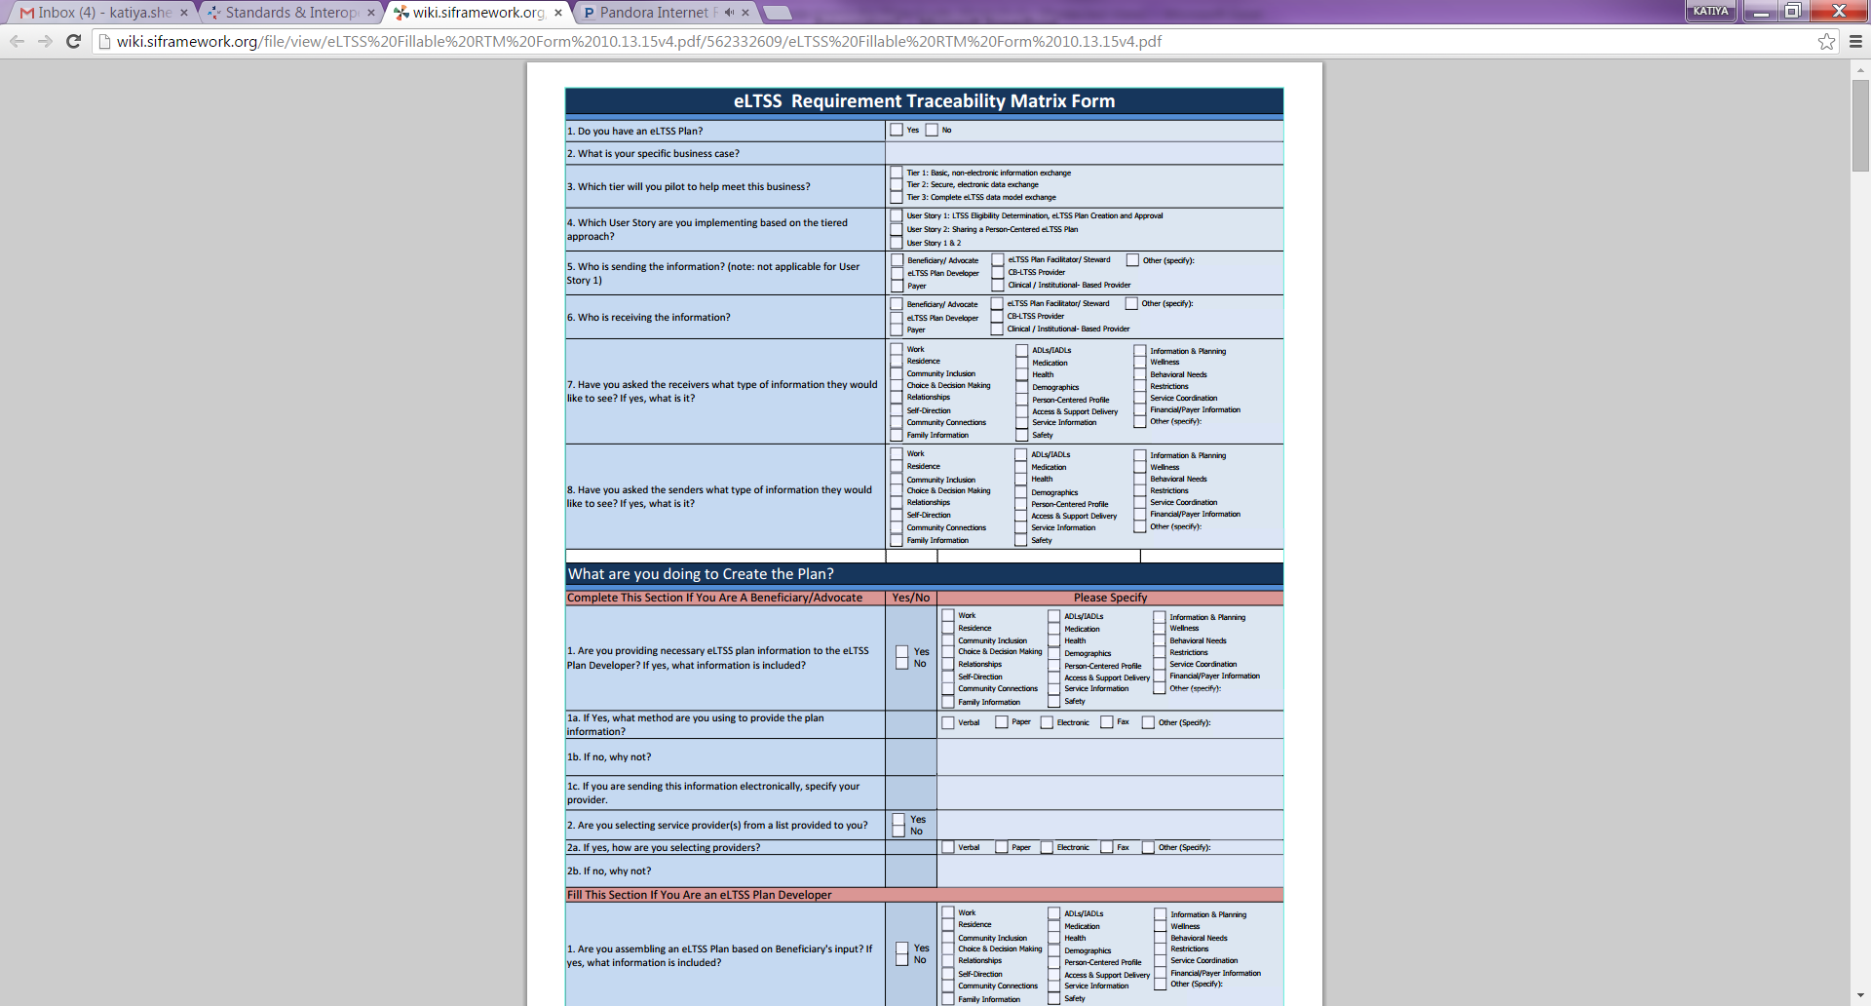
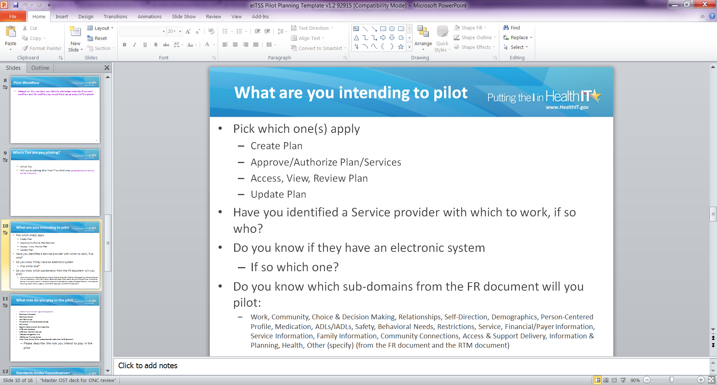
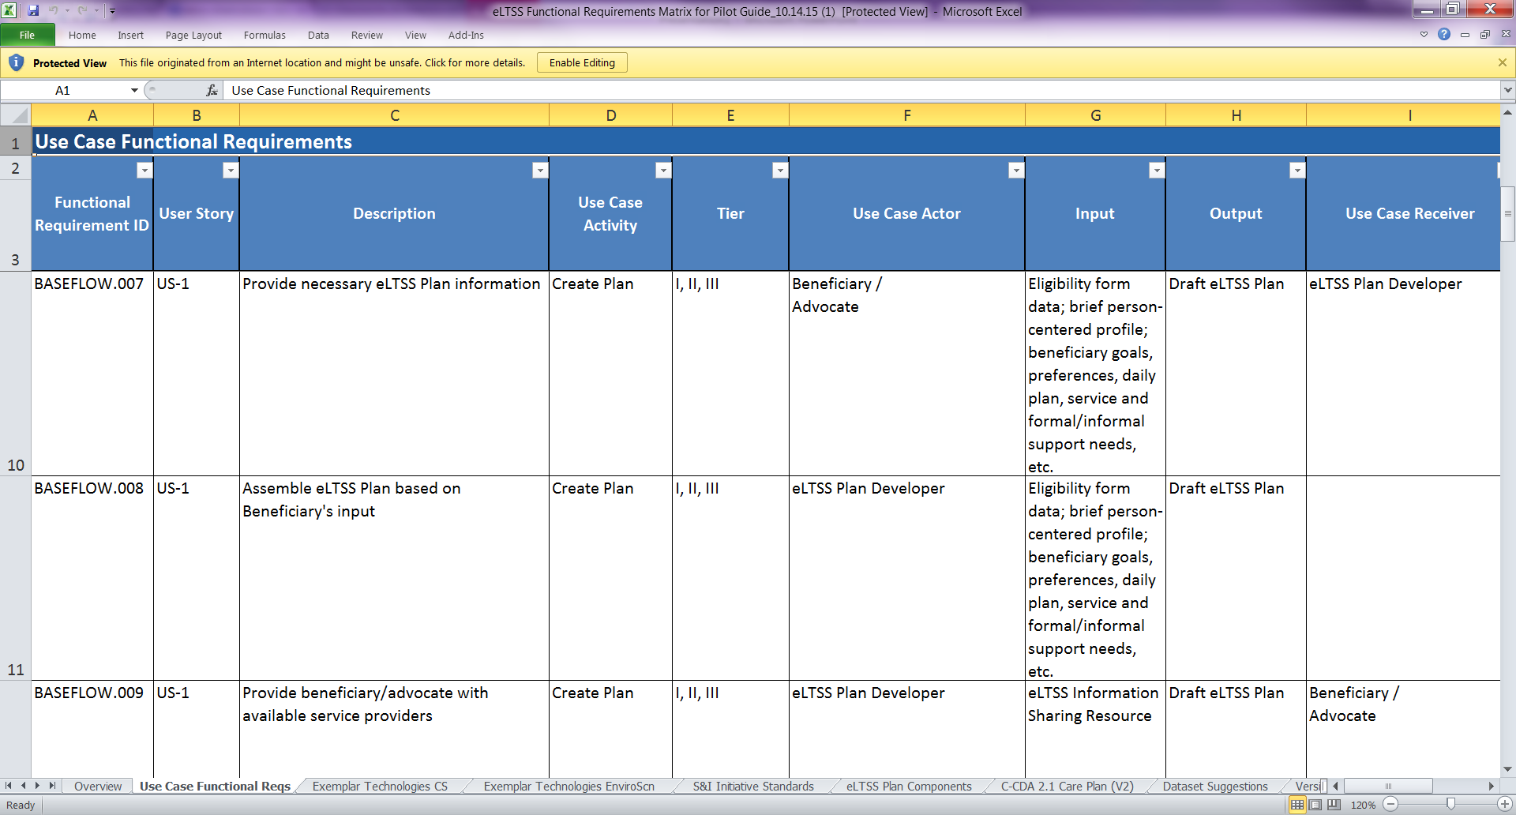

Mapping the RTM back to eLTSS Source Materials
Requirement Traceability matrix
A checklist version of the FRM. Using this as a step by step guide will allow you to effectively complete the eLTSS pilot
Pilot Planning Presentation Highlights the goals and activities found in the RTM and FRM and helps organizations plan their pilot work
Functional Requirement Matrix
A tool to help identify the functions and activities that will be piloted and tested
You can find the answer to this question by looking at these 3 documents.
Let’s start with this question here.
Use Case
Foundation for identifying & specifying the standards required to support data exchanges
All the eLTSS artifacts are connected and can be used to complete the RTM

Slide 17
Participating TEFT Grantees
Pilot Activities
Non TEFT | Tier | User Story | Activity
 |  |  | Create Plan | Access, View, Review | Approve/Authorize Plan/Services | Update Plan
Arizona | 1 | 2 |  | ✓
Colorado | 1 | 1 | ✓
Connecticut | 1 | 2 | ✓
Georgia | 1 | TBD | TBD | TBD | TBD | TBD
Kentucky | 2 | 1, 2 | ✓ | ✓ | ✓ | ✓
Maryland | 1 | 2 |  | ✓
Minnesota | 1 | 2 |  | ✓ |  | ✓

Slide 18
Participating Non TEFT Organizations
Pilot Activities
Non TEFT | Tier | User Story | Activity
 |  |  | Create Plan | Access, View, Review | Approve/Authorize Plan/Services | Update Plan
A|D Vault | 1, 2, 3 | 1, 2 | ✓ | ✓ | ✓ | ✓
Care at Hand | 1, 2, 3 | 2 | ✓ | ✓ | ✓ | ✓
eCaring | 1, 2 | 2 | ✓ | ✓ |  | ✓
FEi Systems | 2, 3 | 1 | ✓ | ✓ | ✓ | ✓
Janie Appleseed | 1 | 1, 2 | ✓ | ✓ | ✓ | ✓
Kno2 | 1,2, 3 | 1, 2 |  | ✓ | ✓ | ✓
Meals on Wheels | 1, 2, 3 | 1, 2 | ✓ | ✓ | ✓ | ✓
National Disability Institute | 2,3 | 2 |  | ✓ |  | ✓
Peer Place | 2, 3 | 1, 2 | ✓ | ✓ | ✓ | ✓
Therap Services | 3 | 1, 2 | ✓ | ✓ | ✓ | ✓

Slide 19
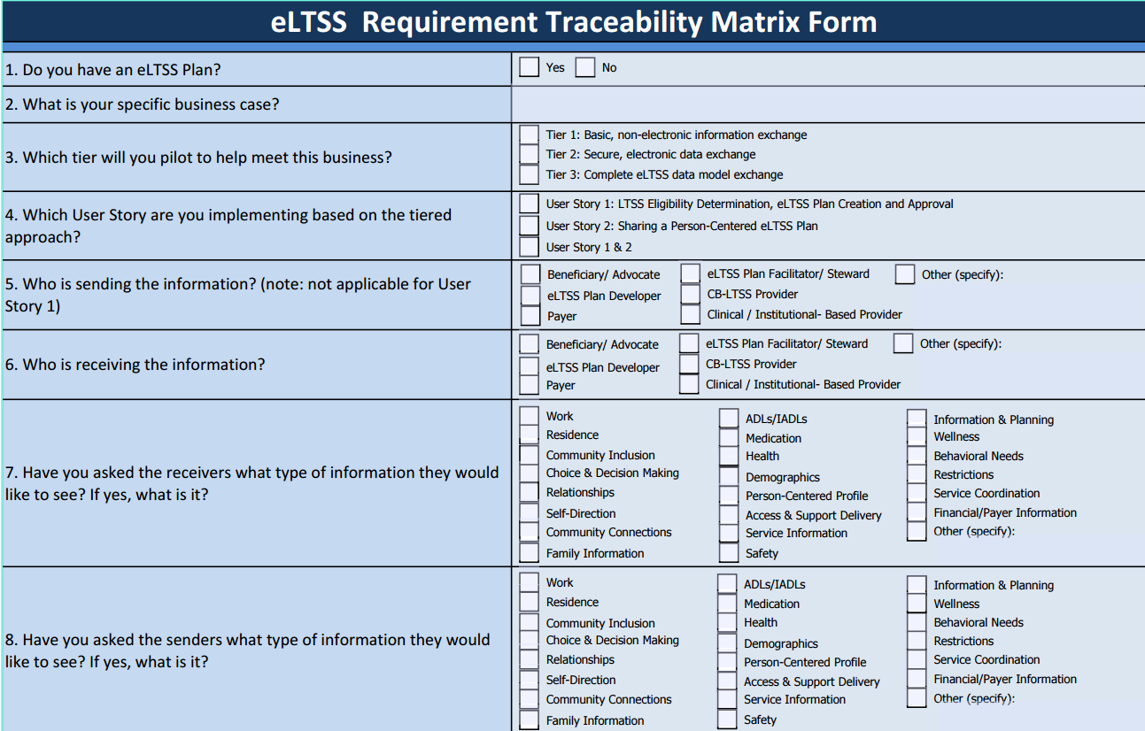
Requirement Traceability Matrix – At a Glance
Requirement Traceability Marix
Notes:
Things to verify you apply to the pilot as a whole

Slide 20
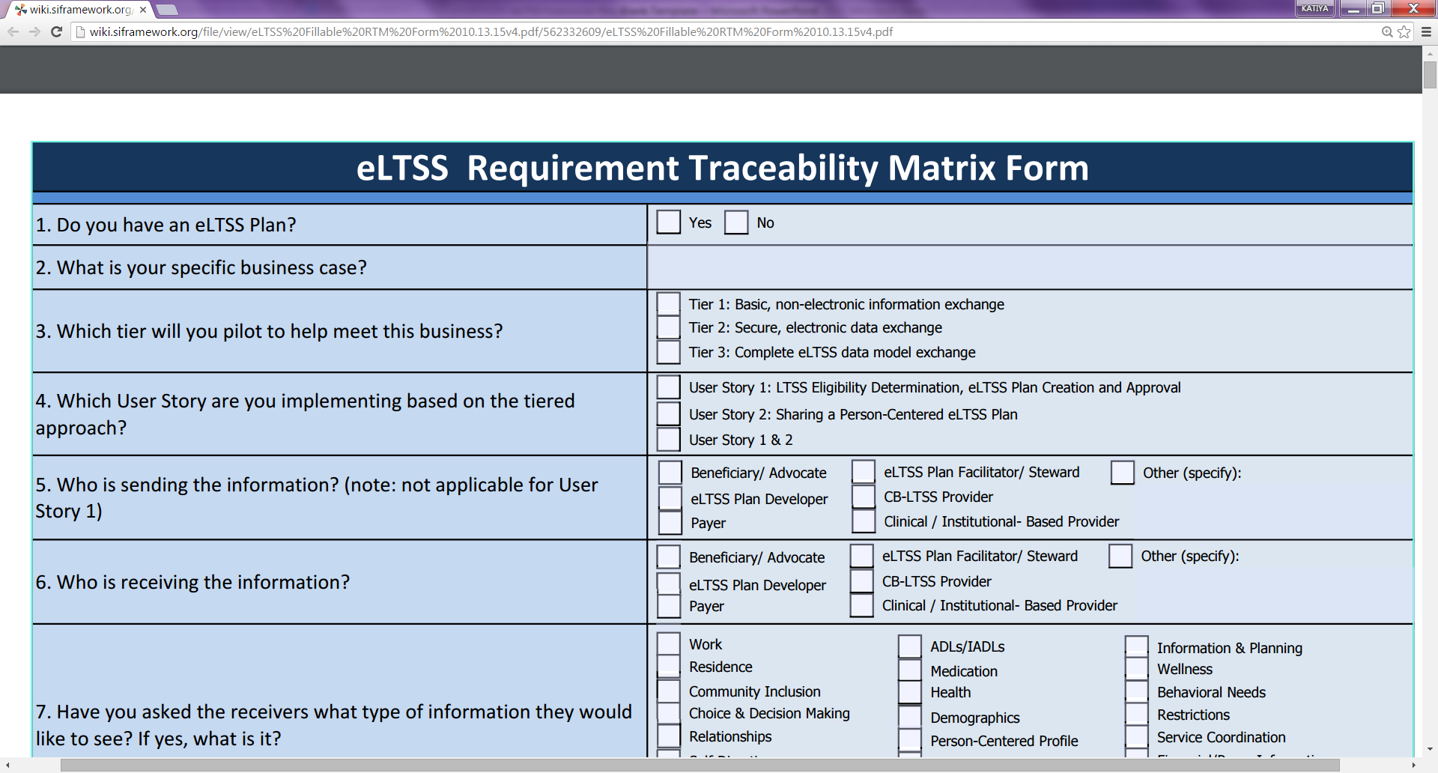
RTM Question 1
Note:
  If your Use Case Activity in this pilot is to create a plan, the answer to this question would be no.
  If you have already created a plan, the answer to this question would be yes.
    You would then need to identify your eLTSS Plan and complete the questions at the end of this form.

Slide 21
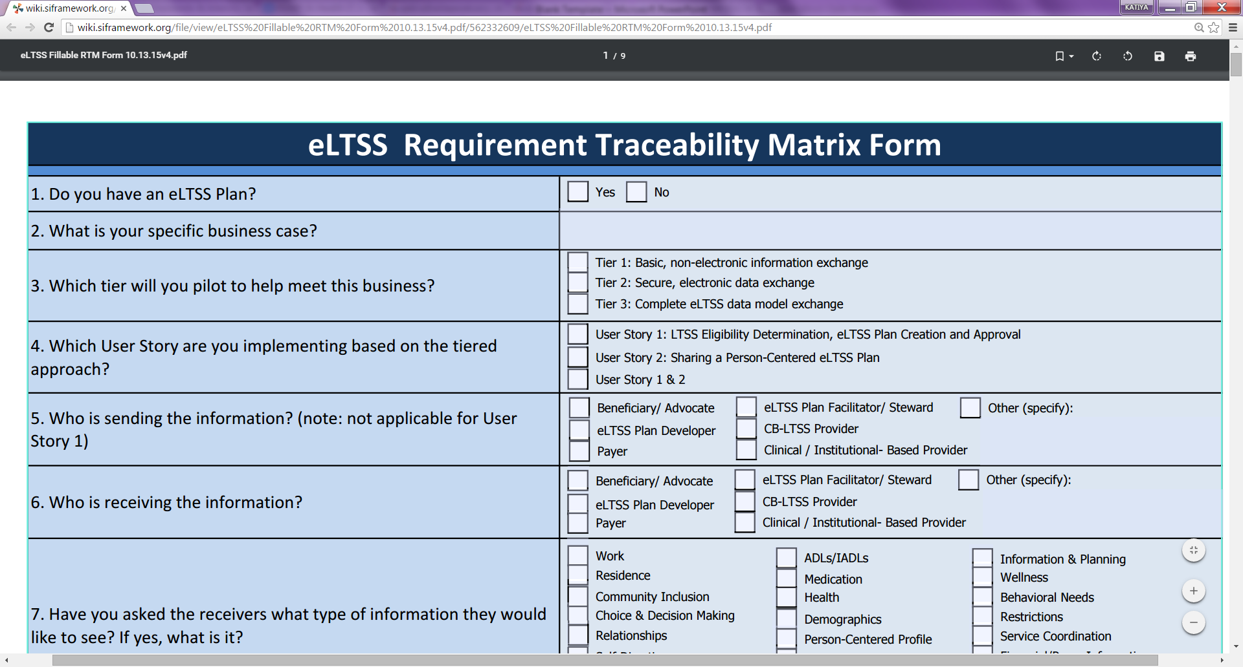
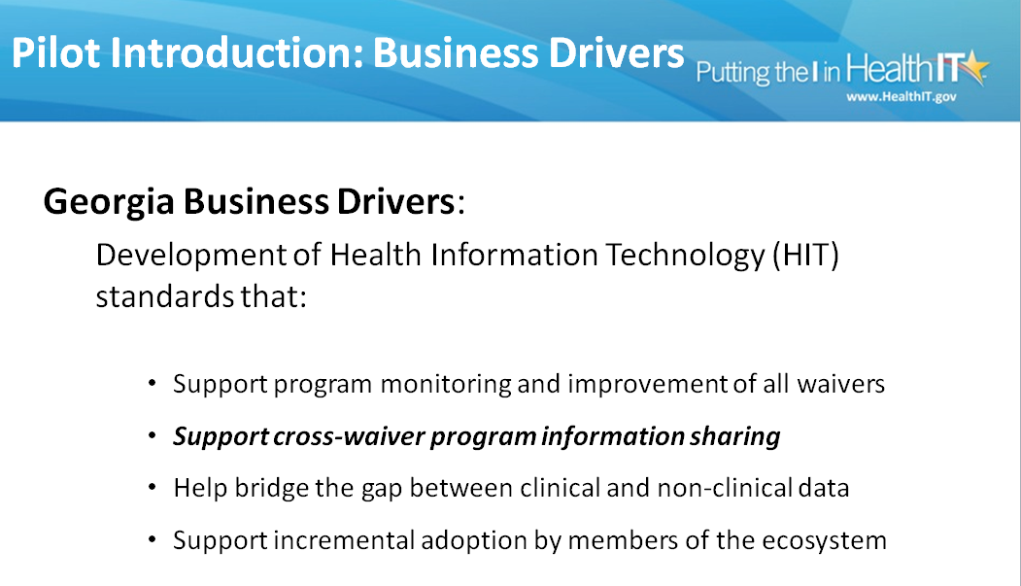
RTM Question 2
Example: Georgia State TEFT Grantee Business Drivers

Slide 22
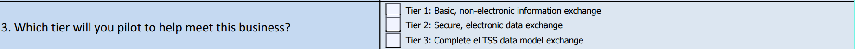
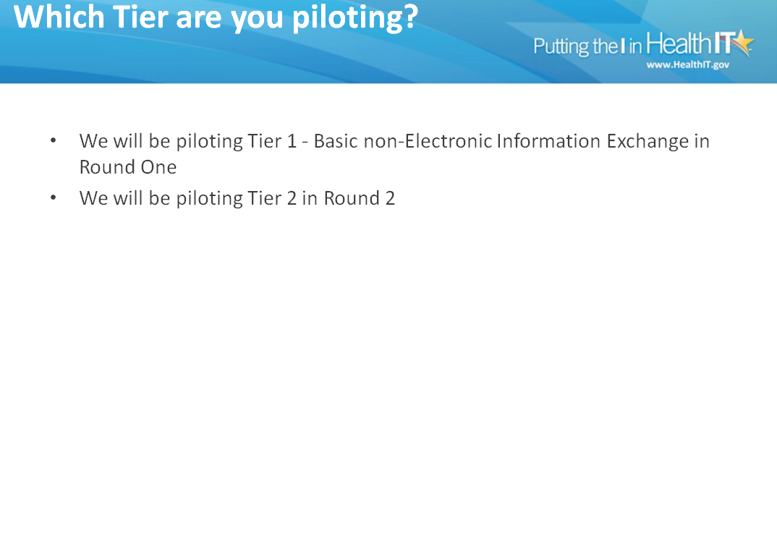
RTM Question 3
Example: Minnesota State TEFT Grantee will be piloting: tier 1

Slide 23
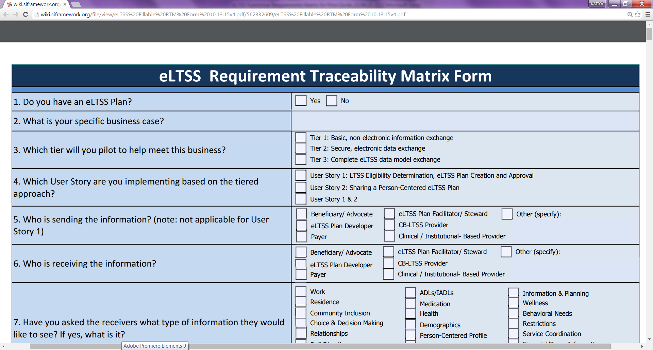
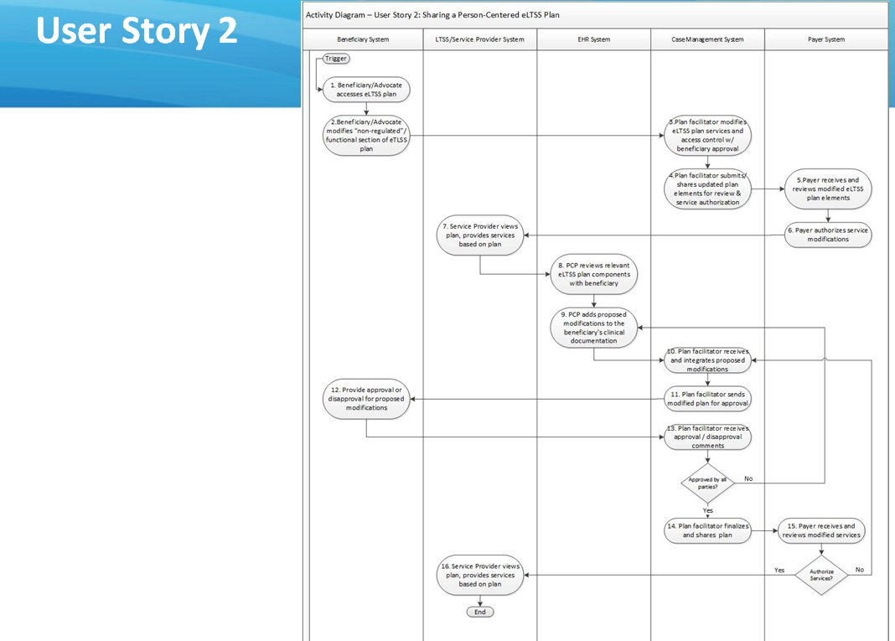
RTM Question 4
Example: Arizona State TEFT Grantee is piloting user story 2
Note:
  If you do not have an elTSS plan, it is best to pilot User story 1
  If you currently have an eltss plan it’s best to pilot User story 2

Slide 24
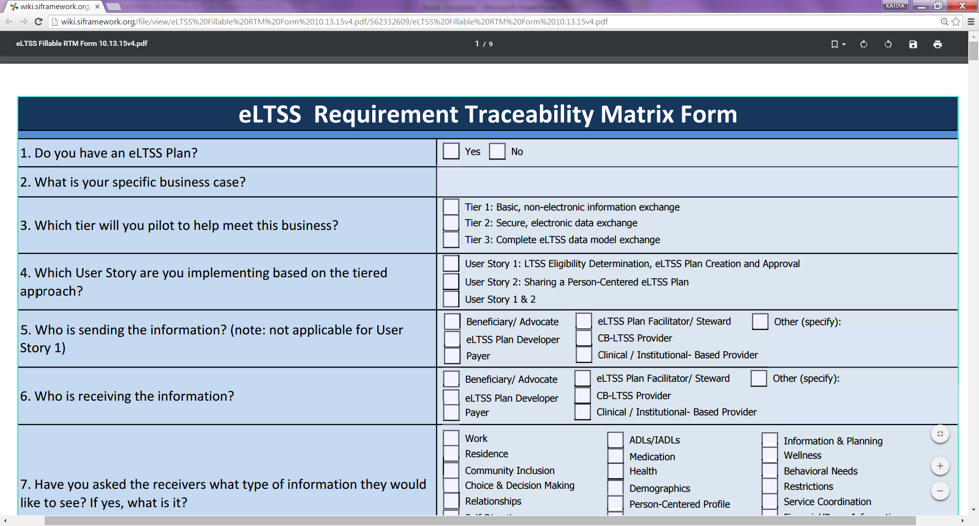
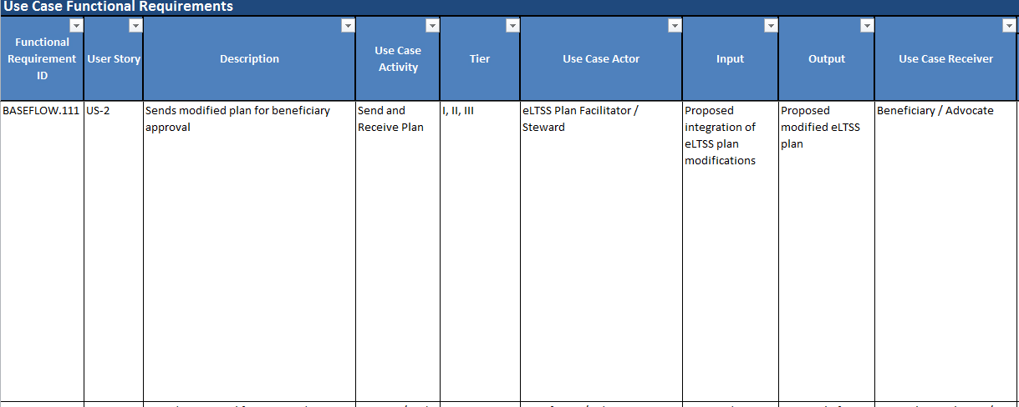
RTM Question 5
Example of an eLTSS Plan Facilitator/Steward (use case actor) sending a modified plan to the beneficiary for approval
(This example directly maps the RTM to the FRM)
http://Functional Requirements Matrix Link
Notes:
* People who decide to pilot user story 1 can put plan developer

Slide 25
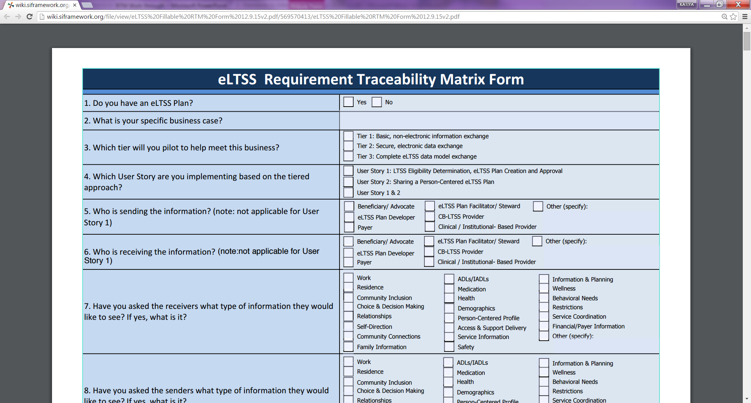
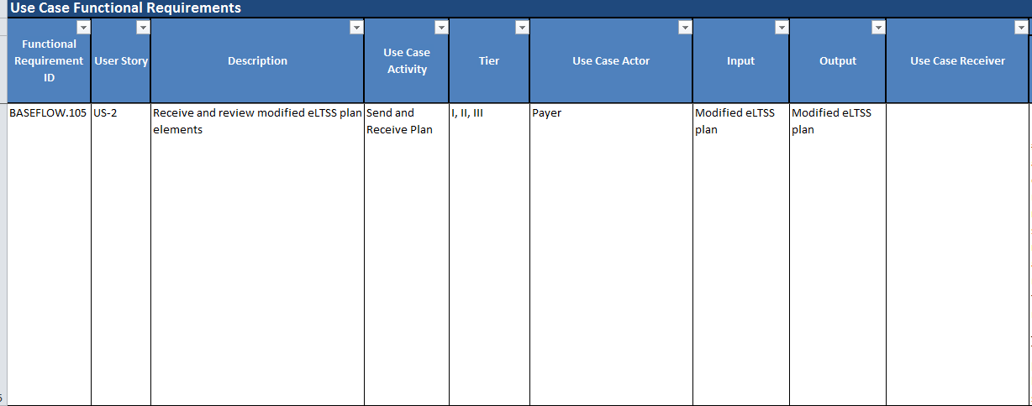
RTM Question 6
Example of a Payer (use case actor) receiving and reviewing modified eLTSS plan elements
(This example maps the RTM directly to the FRM)
http://Functional Requirements Matrix Link

Slide 26
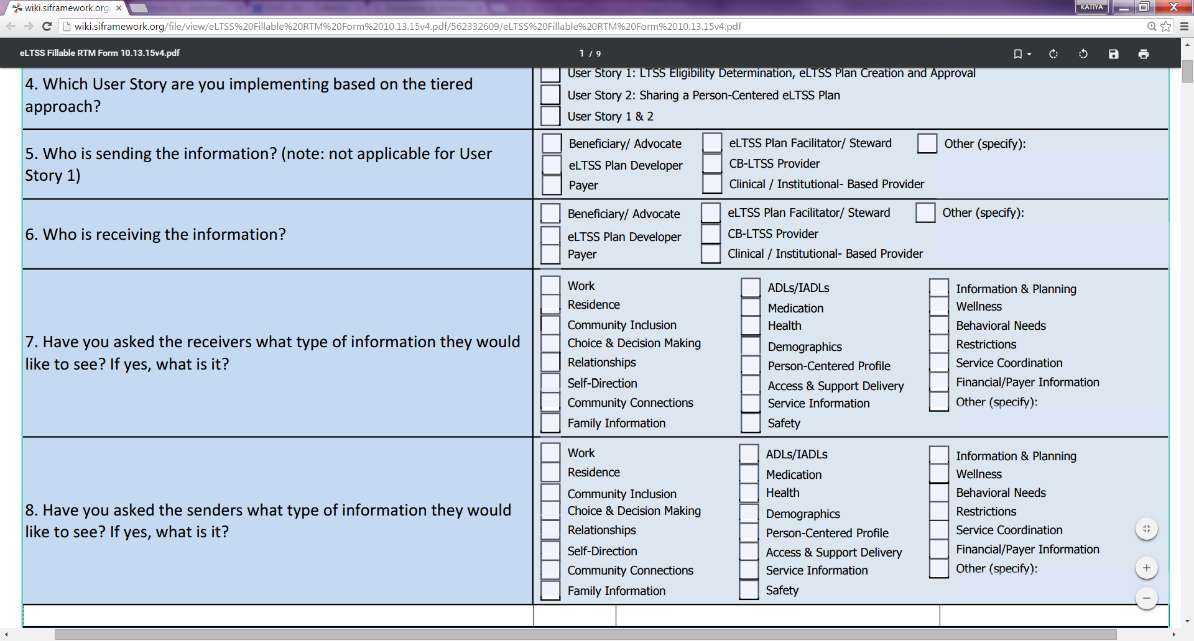
RTM Question 7& 8

Slide 27
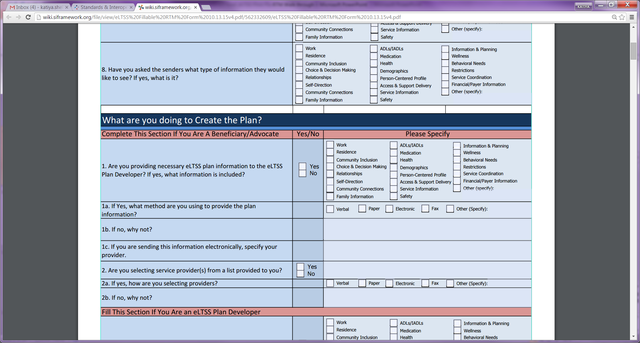
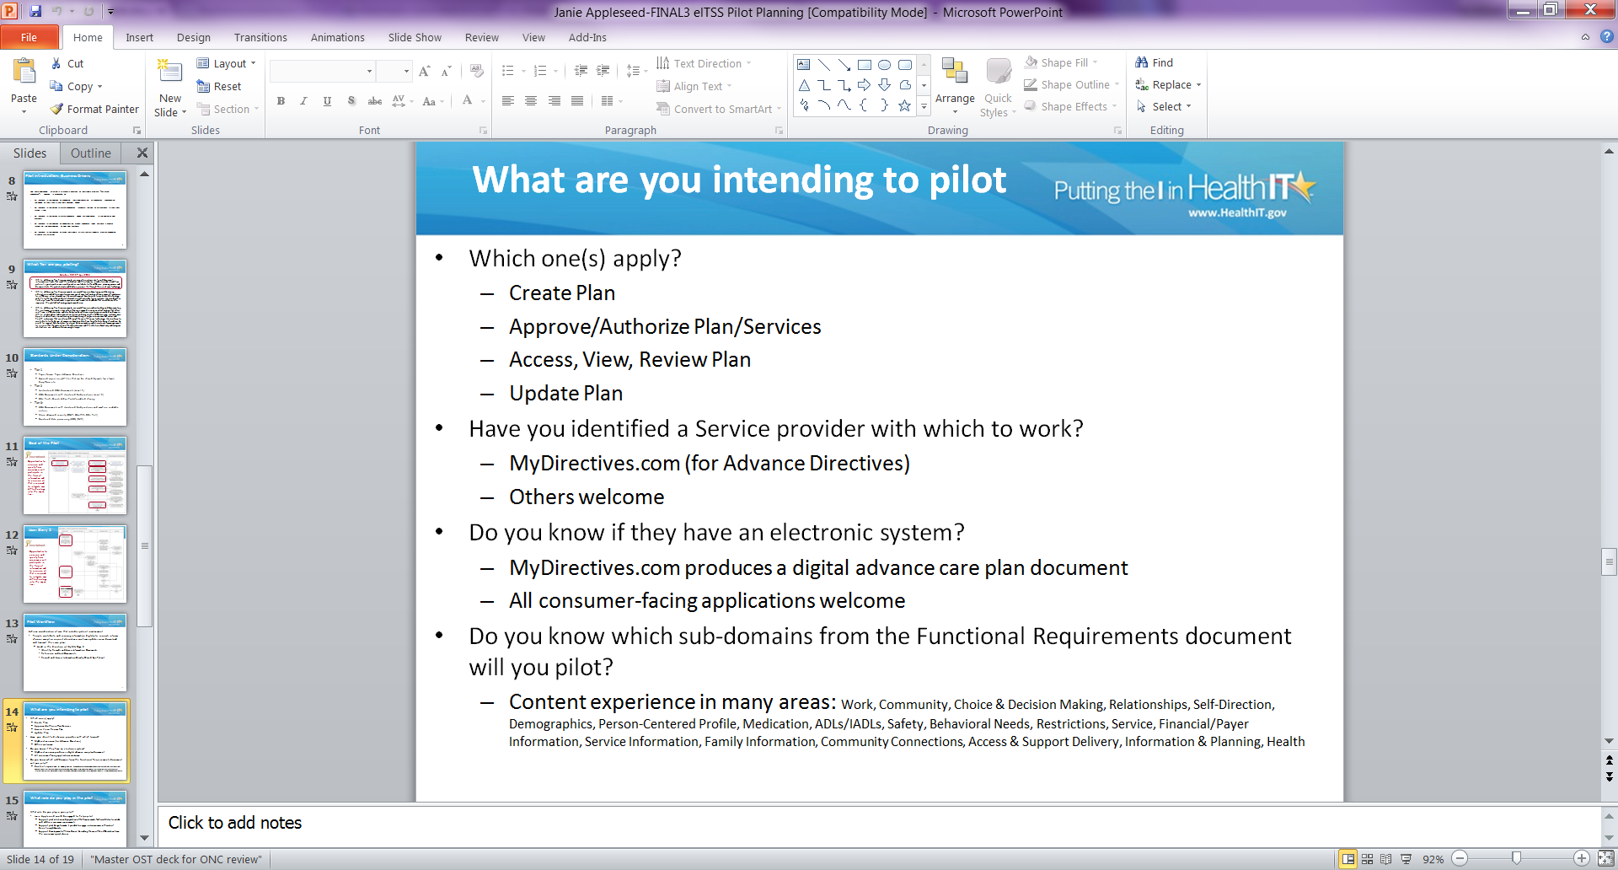
RTM: Create a Plan; Beneficiary/Advocate
Complete this section if your role is the beneficiary or advocate in the pilot
Example: Janie AppleSeed ( a Beneficiary/Advocate) would answer this question by referencing the pilot’s subdomains their selected from the FRM

Slide 28
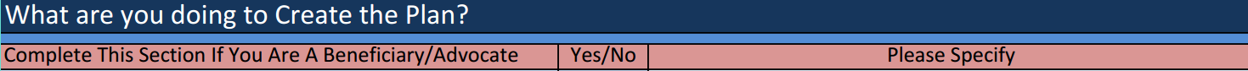

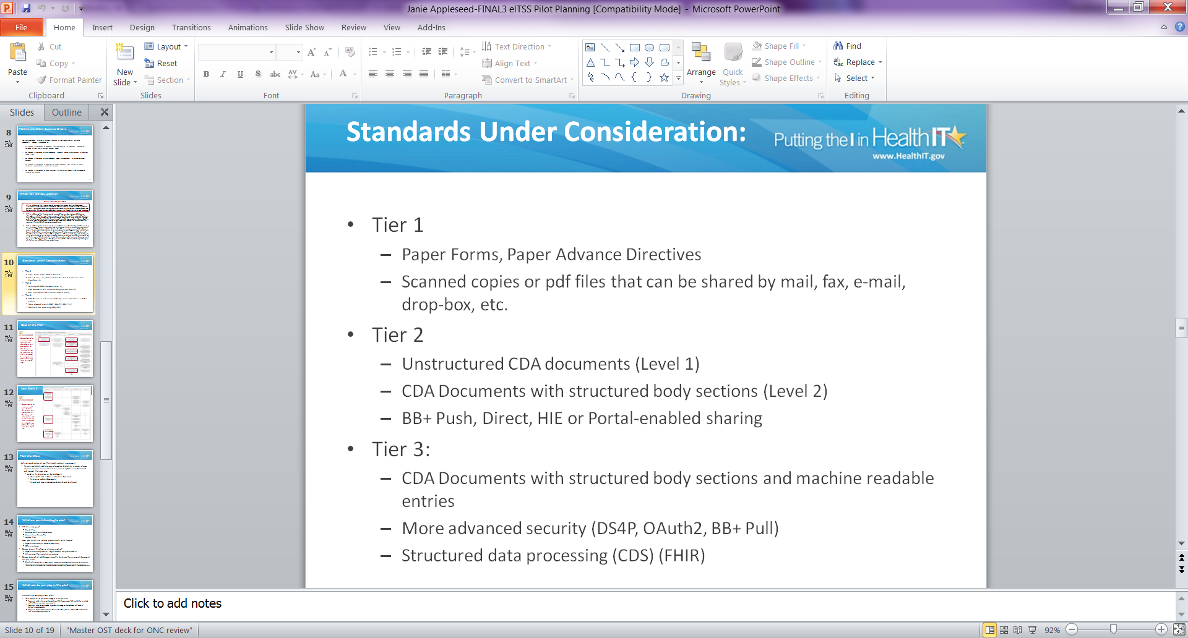
RTM: Create a Plan; Beneficiary/Advocate (con’t)
Example: Janie Appleseed will provide the plan information using Paper and fax

Slide 29
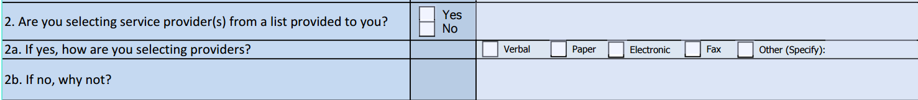
RTM: Create a Plan; Beneficiary/Advocate (con’t)
Example: Janie Appleseed has identified MyDirectives as their service provider

Slide 30
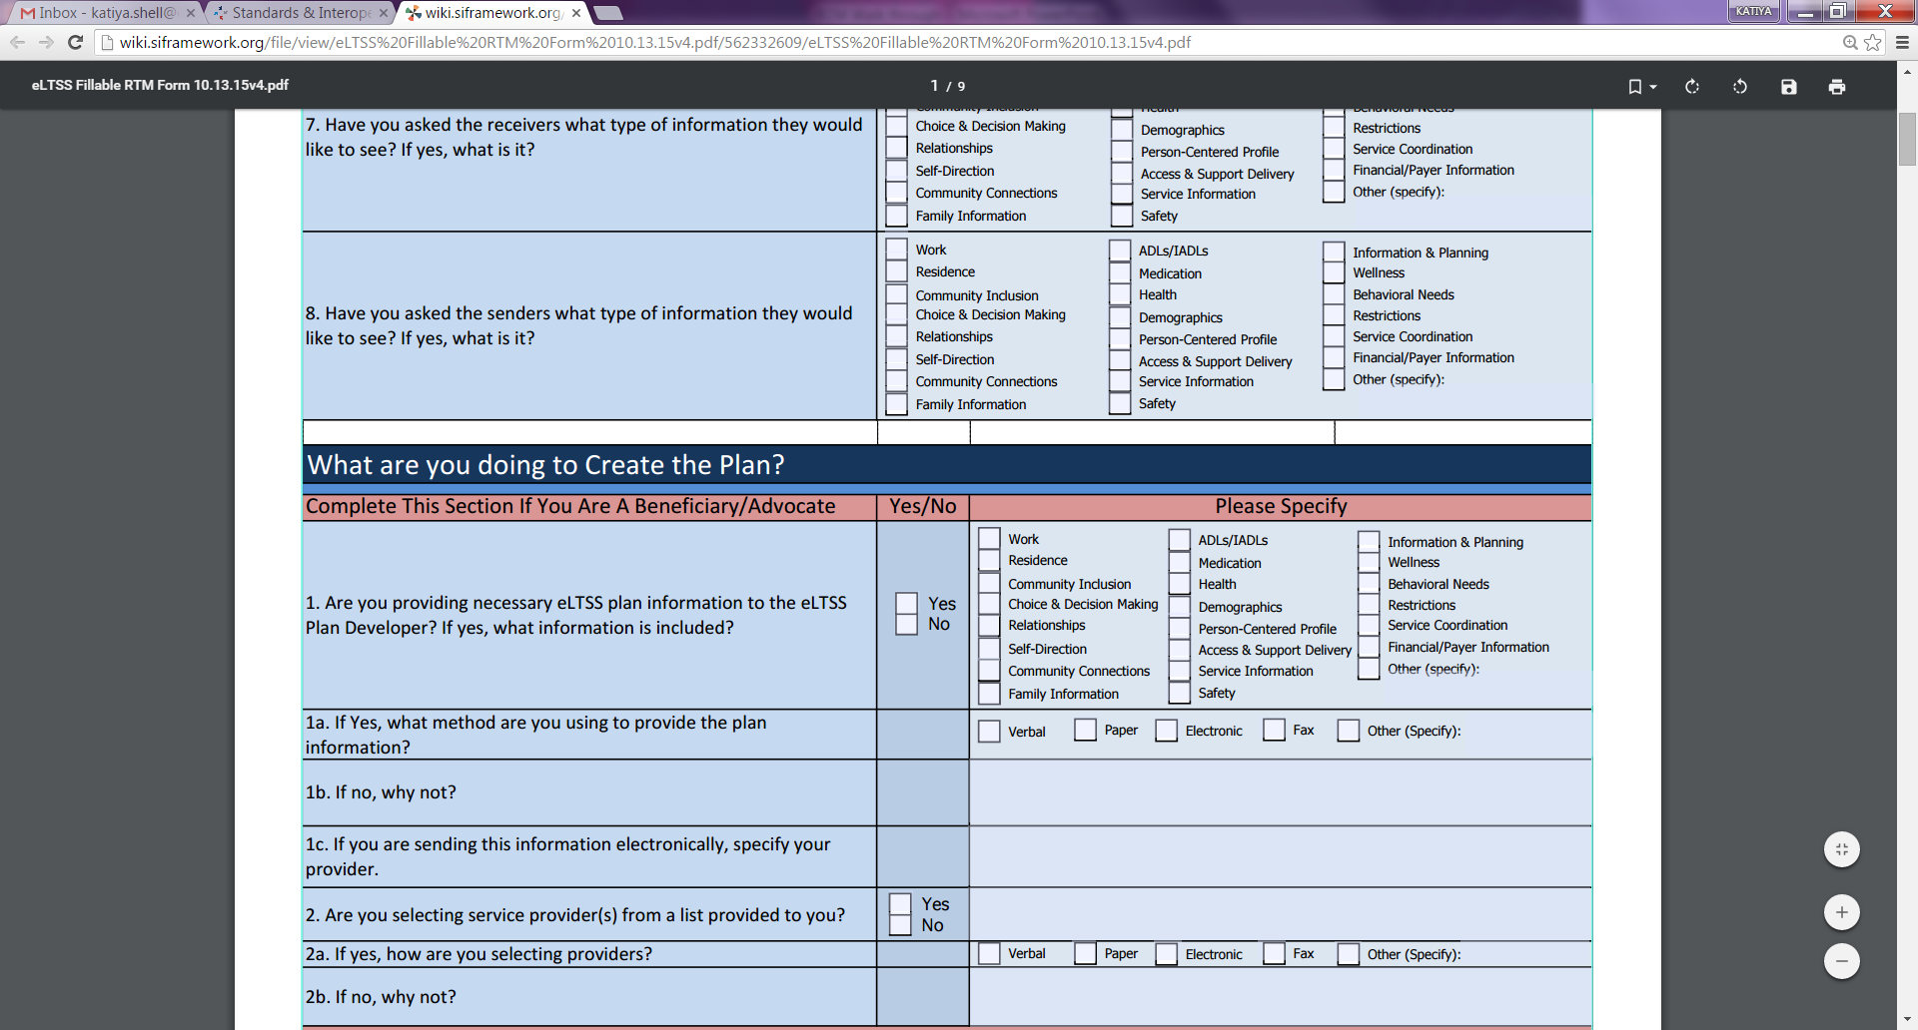
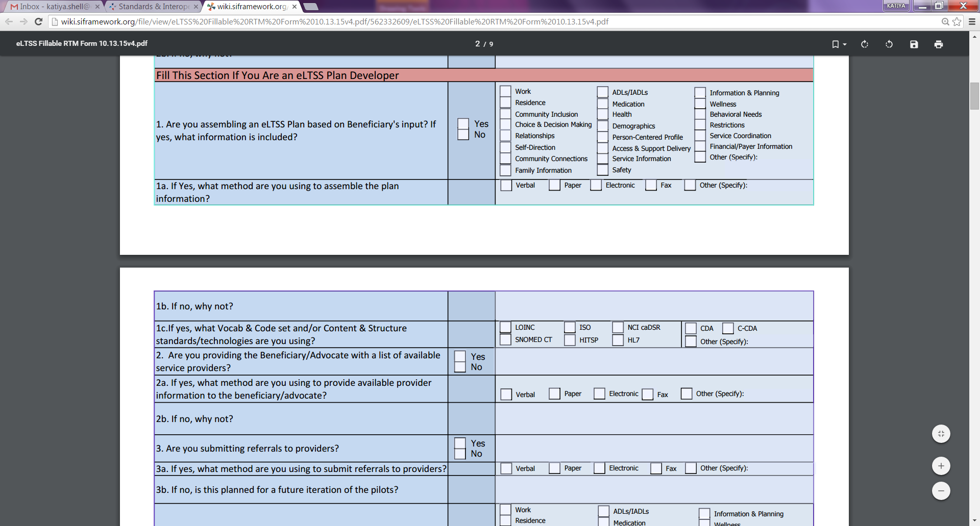
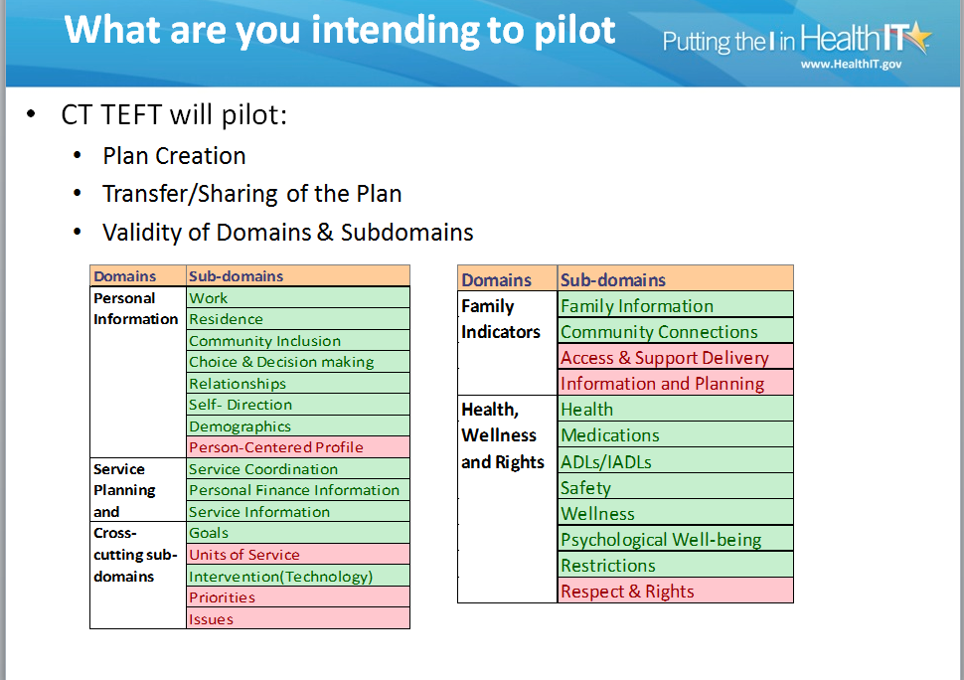
RTM: Create a Plan; Plan Developer
Complete this section if your role in the pilot is to develop the eLTSS plan
Example: The subdomains Connecticut State TEFT Grantee will be using to assemble an eLTSS Plan

Slide 31
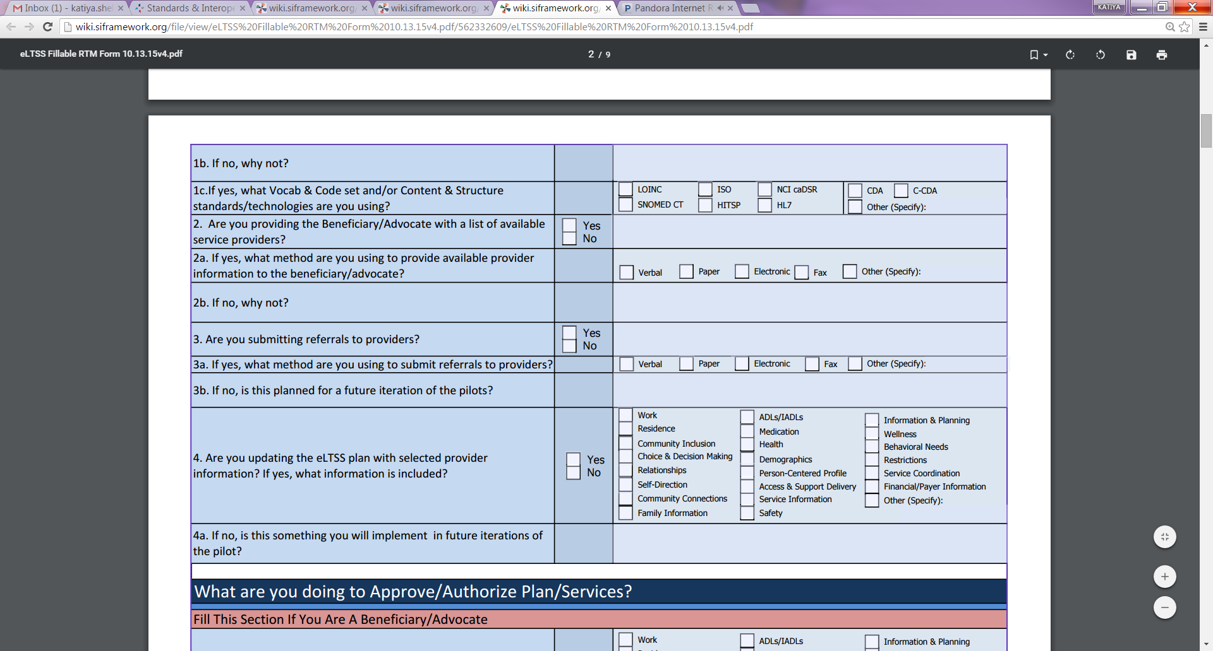
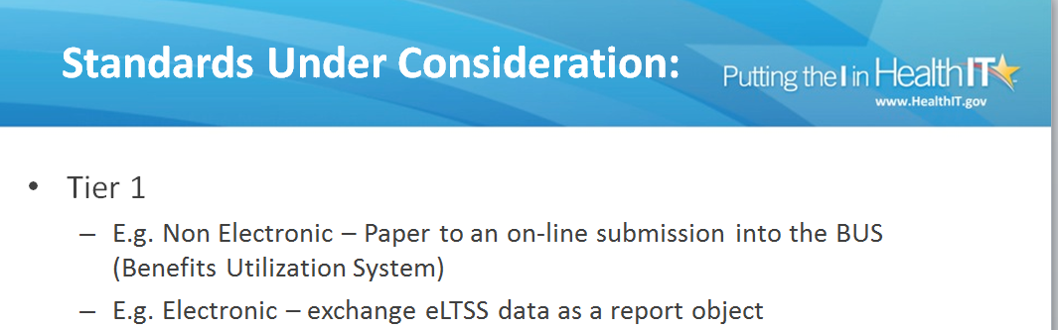
RTM: Create a Plan; Plan Developer
Example: Colorado State TEFT Grantee will use paper to assemble their eLTSS plan

Slide 32
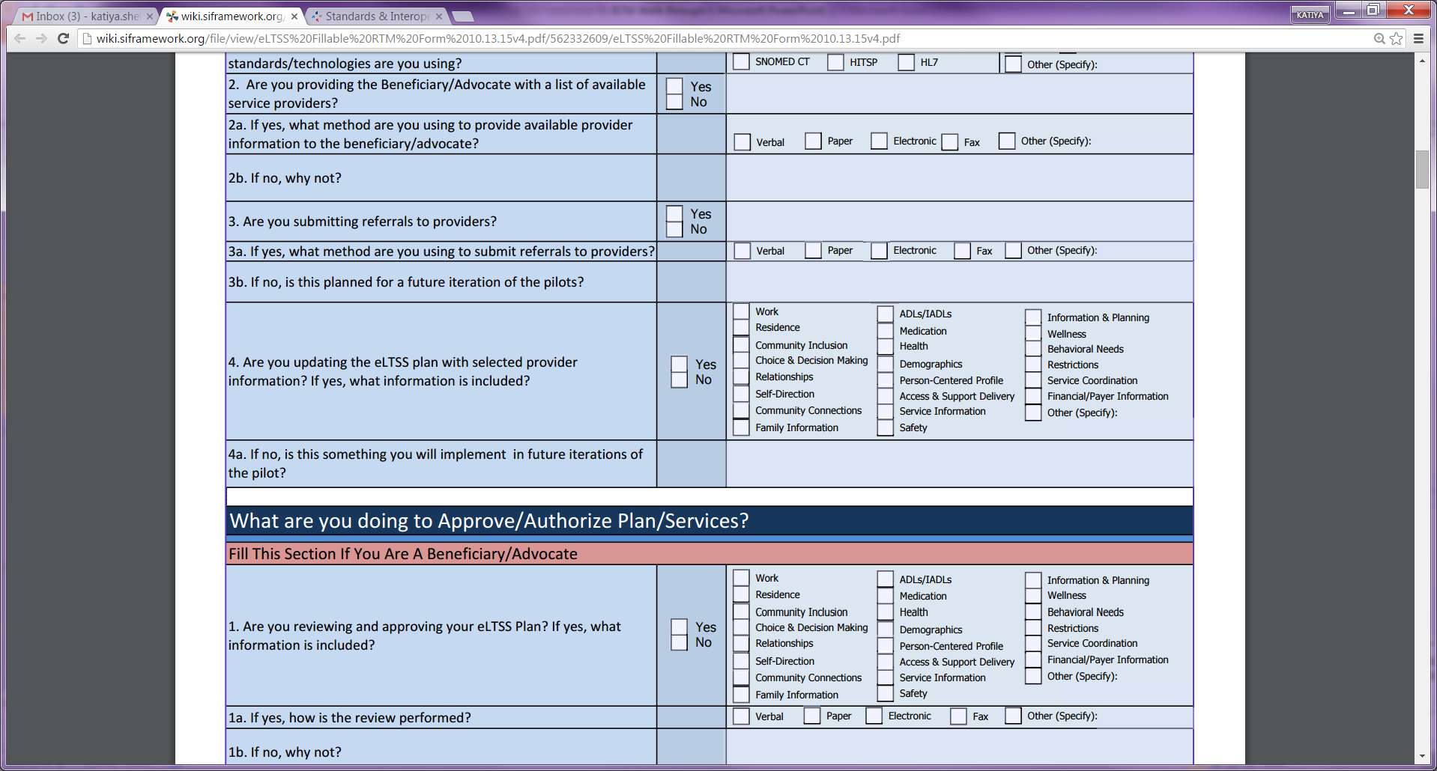
RTM: Create a Plan; Plan Developer… cont’d

Slide 33
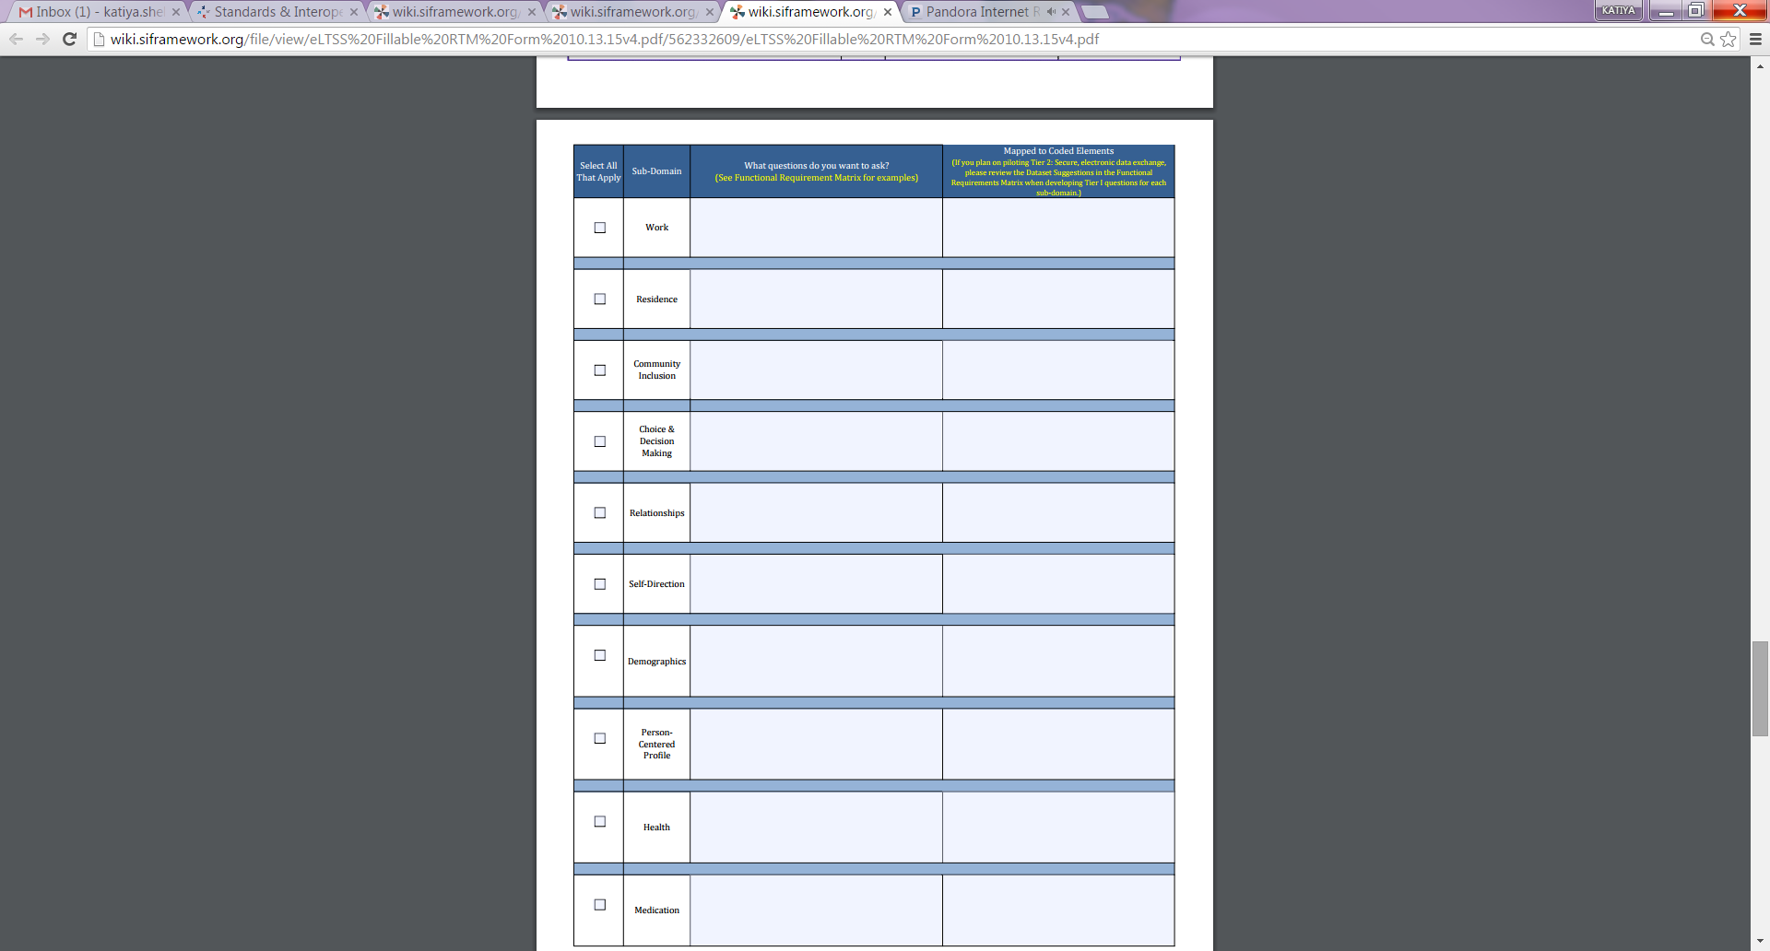
RTM Subdomains
The last 3 pages of the RTM contain questions that regard the sub domains used in the pilot.
Even if you are not piloting “create a plan” You would then need to identify your eLTSS Plan, this can be done by completing this section.
Notes:
Another question I want to ask Jamie

Slide 34
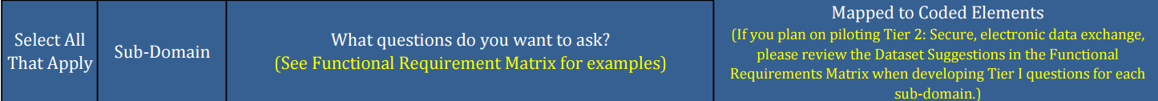
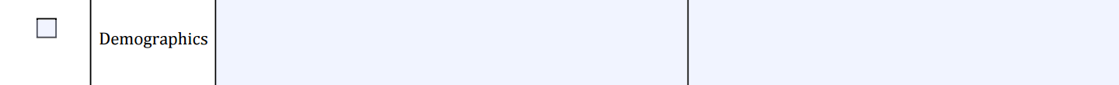
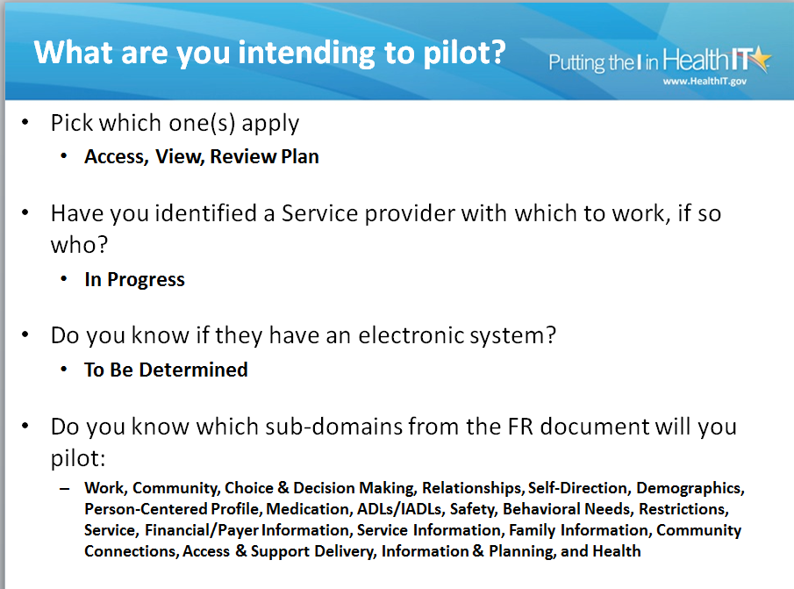
RTM Subdomains…cont’d
Example: Kentucky State TEFT Grantee has chosen demographics as one of the sub domains they will pilot.

Slide 35
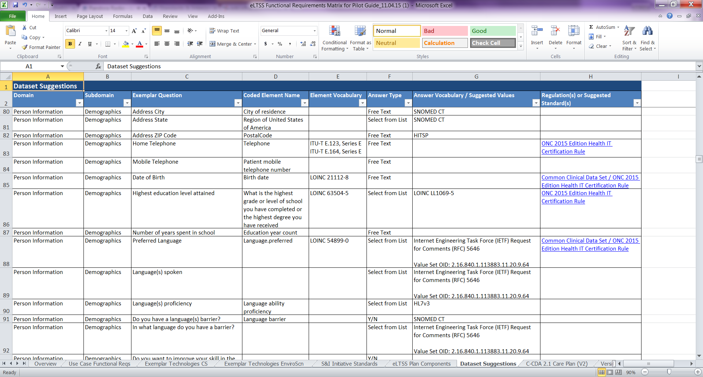
RTM Subdomains…cont’d
Functional Requirements Matrix (FRM) , Dataset Suggestion Tab
http://Functional Requirements Matrix Link

Slide 36
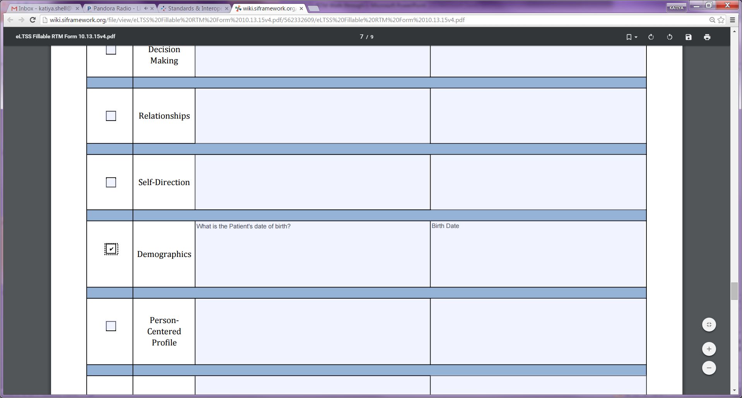
RTM Subdomains…cont’d
Example of a question Kentucky State TEFT Grantee can ask regarding this sub domains derived from the FRM
Functional Requirements Matrix (FRM)

Slide 37
Comments/Discussion
Questions?
Comments?

Slide 38

Winter 2015 Timeline
DATE | TOPIC | TEFT/NON | Point of Contact
11/19/2015 | Pilot Presentation Meetings: eCaring Pilot Updates and Work Session (Domains Supporting Activities and Roles) | Non TEFT | Robert Herzog
11/26/2015 | Cancelled Due to Holiday
12/03/2015 | Pilot Presentation Meetings: Arizona Health Care Cost Containment System (AHCCCS) Review of Pilot Logistics, Supporting Materials, and Next Steps | TEFT | Jekenna Lebsock
12/10/2015 | Pilot Updates and Working Session focusing on RTM
12/17/2015 | Pilot Updates and Working Session focusing on RTM
12/24/2015 | Will be cancelled due to Holiday
12/31/2015 | Will be cancelled due to Holiday

Slide 39
Pilot Working Sessions
Pilot timeline is aggressive and limited. All-Hands meetings will focus on pilot activities:
  10-15 minutes of pilot updates
  Remainder of each session will be used to work through issues, artifacts or questions pilots have
Non-pilot community members are invited and encouraged to stay on the call if they wish

Slide 40
“Rules of the Road”
This project is and will continue to be an ongoing dialogue.
Discussion and community comments are welcome and encouraged.
Because time is limited and pilots have much to accomplish, we ask that all members of the community follow these simple guidelines:
  Keep comments brief and on point
  Focus on providing constructive input that can help aid in solving the issue at hand
  Feel free to send follow up comments or suggestions

Slide 41
Next Steps
If you are interested in sharing what you have completed on your RTM during the RTM working session on December 17th 2015, please contact Jamie Parker at jamie.parker@esacinc.com
If you are interested in piloting, please express your interest using the Pilot Interest Survey form:
  http://wiki.siframework.org/electronic+Long+Term+Services+and+Supports+Pilot+Interest+Survey

Slide 42
FACA Meetings (Federal Advisory Committees)
Upcoming FACA Meetings for December 2015 & January 2016
  Transitional Vocabulary Task Force - December 16, 2015
  CTC Task Force Potential Virtual Hearing - January 7, 2016
  CTC Task Force Meeting - January 8, 2016
  API Task Force Meeting - January 12, 2016
  CTC Task Force Potential Virtual Hearing - January 15, 2016
  CTC Task Force Meeting - January 19, 2016
  Joint HIT Committee Meeting - January 20, 2016
  API Task Force Virtual Hearing - January 26, 2016
  API Task Force Virtual Hearing - January 28, 2016
Public attendance is encouraged
https://www.healthit.gov/facas/calendar/2016/1

Slide 43
Useful Links
eLTSS Pilot Starter Kit
    http://wiki.siframework.org/electronic+Long-Term+Services+and+Supports+%28eLTSS%29+Pilots#Pilot Starter Kit
eLTSS Glossary:
  http://wiki.siframework.org/eLTSS+Glossary
eLTSS Reference Materials
  http://wiki.siframework.org/electronic+Long-Term+Services+and+Supports+%28eLTSS%29+References

Slide 44
eLTSS Initiative: Project Team Leads
ONC Leadership
  Mera Choi (mera.choi@hhs.gov)
  Elizabeth Palena-Hall (elizabeth.palenahall@hhs.gov)
CMS Leadership
  Kerry Lida (Kerry.Lida@cms.hhs.gov)
Community Leadership
  Mary Sowers (msowers@nasddds.org)
  Terry O’Malley (tomalley@mgh.harvard.edu)
Initiative Coordinator
  Evelyn Gallego-Haag (evelyn.gallego@siframework.org)
Project Management
  Lynette Elliott (lynette.elliott@esacinc.com)
Use Case & Functional Requirements Development
  Becky Angeles (becky.angeles@esacinc.com)
Pilot Guide Development
  Grant Kovich (grant.kovich@accenture.com)
Pilots Management
  Jamie Parker (jamie.parker@esacinc.com)
Standards and Technologies Identification
  Angelique Cortez (angelique.j.cortez@accenture.com)

