Slide 1
Observation status in hospital eCQMs
Change Review Process Meeting
October 15, 2015
Rute Martins
Division of Healthcare Quality Evaluation
The Joint Commission

Slide 2
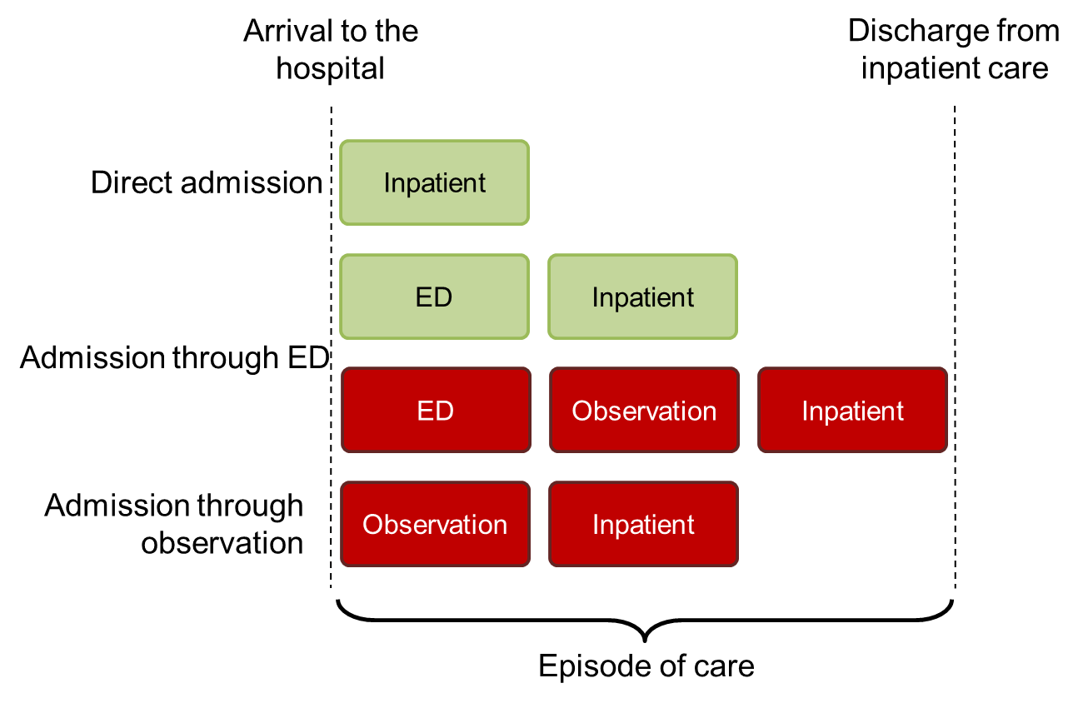
Implementation questions/issues
Logic does not account for observation status timeframe (CQM-1608)

Slide 3
Issue impact – CRP feedback
Issue is significant and perceived to affect measure calculation results
Variability in how ED  observation  inpatient is managed within an EHR
Issue relates/overlaps with ED visit ends <= 1 hour of inpatient admission
Observation vs. inpatient as administrative artifact
Policy implications of observation status
Implementers agree it’s a difficult issue to solve

Slide 4
Long term optimal solution
Use CQL to define hospital arrival unambiguously:
Earliest of:
ED visit start
Observation start
Inpatient admission
Current QDM logic framework does not support such a construct
Not viable for 2016 Annual Update

Slide 5
Possible interim “patches”
#1 Add guidance directing implementers to map observation to inpatient admission, when applicable
#2 Use a timing constraint only to cover both ED and observation implicitly (e.g. <= 3 day(s) SBS $EncounterInpatient)
#3 Model observation status explicitly in the logic (e.g. as encounter, location, ED disposition)

Slide 6
Weighing pros and cons
Unmanageably complex QDM logic
Model Obs Status Explicitly
Ability to solve the issue
Use a timing constraint
Lost ability to tie events to hospital arrival (if not through ED)
Add guidance
Lost ability to tie events to inpatient admission
Complexity/Unintended Consequences

Slide 7
Using a timing constraint
$MedicationX administered between arrival and discharge
BEFORE
OR: $MedicationX starts during Occurrence A of $EncounterInpatient
OR: $MedicationX starts during "Encounter, Performed: Emergency Department Visit" <= 1 hour(s) ends before or concurrent with start of Occurrence A of $EncounterInpatient
AFTER
OR: $MedicationX starts during Occurrence A of $EncounterInpatient
OR: $MedicationX <= 3 day(s) starts before start of Occurrence A of $EncounterInpatient

Slide 8
Using a timing constraint: effort vs. benefit
Can “pick up” on events prior to arrival
Can be confusing if applied only to some eCQMs (e.g. VTE, STK-5)
Cannot be applied to eCQMs dependent on arrival time (e.g. STK-2)
Does not resolve observation status issue when eCQM requires ED visit (e.g. STK-4)
May not meet measure requirements (e.g. STK-8, STK-10)

Slide 9
Time to decide
OPTION 1 (recommended): Wait and change logic once
No logic changes until CQL becomes available
Add guidance recognizing limitation of logic to capture observation status periods
OPTION 2: Implement partial solution now and optimal solution later
Replace ED timing constraint with <=3 days prior to inpatient admission threshold where possible

