Slide 1
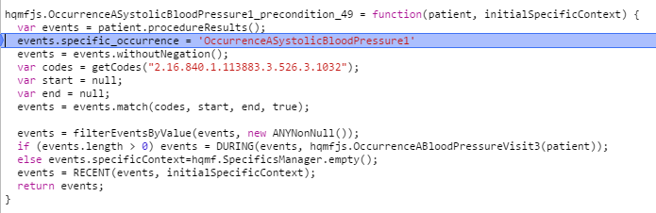
The specific occurrence key is assigned to the events array before any processing is done

Slide 2
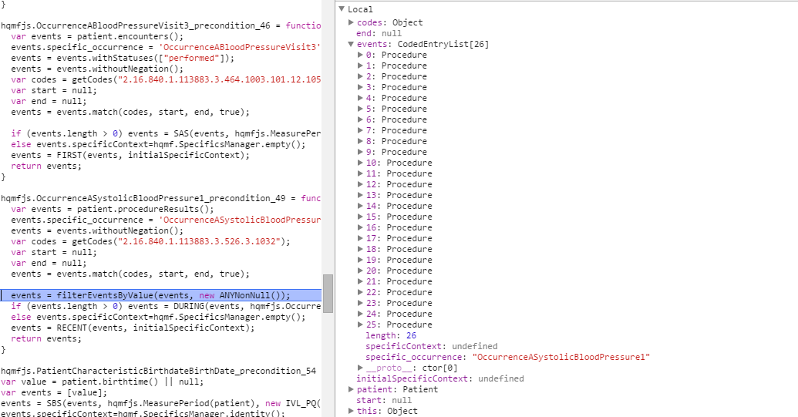
You can see here there are 26 events matching the code set. The specific occurrence is still set.

Slide 3
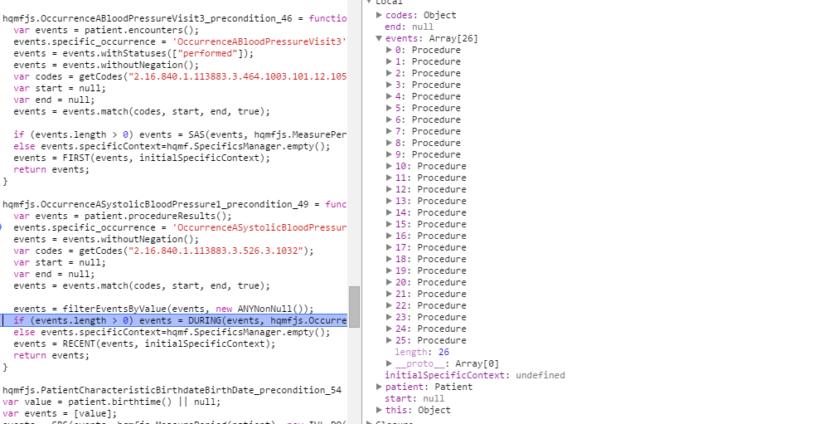
Stepping forward past the call to filterEventsByValue,
the specific occurrence key is lost.

Slide 4
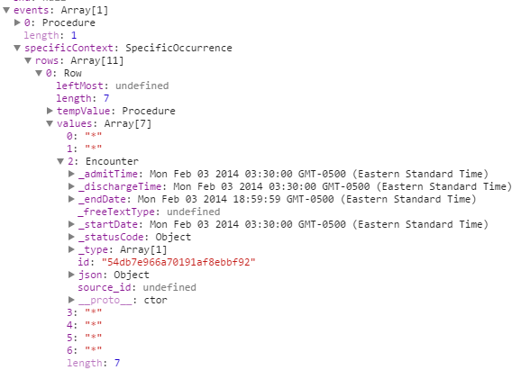
This results in a specificContext as such:
Notice there is a ‘*’ in position one
Indicating that any procedure is valid

Slide 5
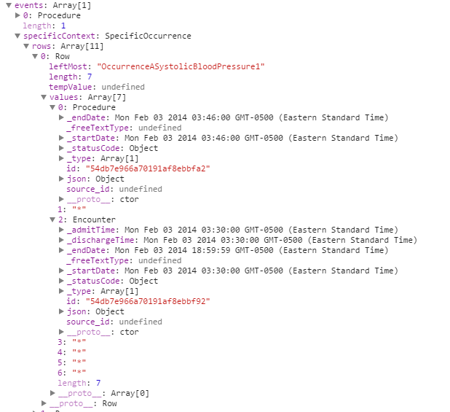
If we maintain specifics through the call to filterEventsByValue then the generated context is:
We now have an occurrence
In position 1 instead of ‘*’

