Slide 1
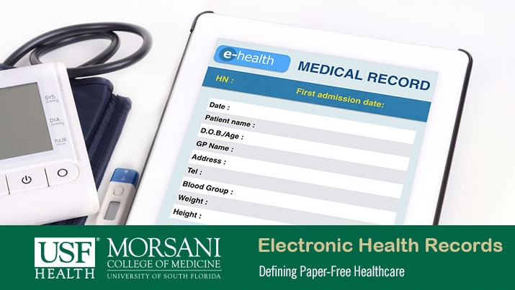
The value of capturing SDH data in clinical care
Caroline Fichtenberg, PhD
Managing Director, Social Interventions Research and Evaluation Network (SIREN), UCSF
Interoperability in Action Webinar Series #2
Advancing Interoperable SDH
July 26, 2017
Notes:
Hello, Thank you Al. I am Caroline Fichtenberg the managing director of the social interventions research and evaluation network, otherwise known as SIREN, an initiative housed at UCSF. I am going to talk to you over the next 15 minutes about the value of capturing patients’ social determinants of health data in clinical care to provide some background for the rest of the session.

Slide 2
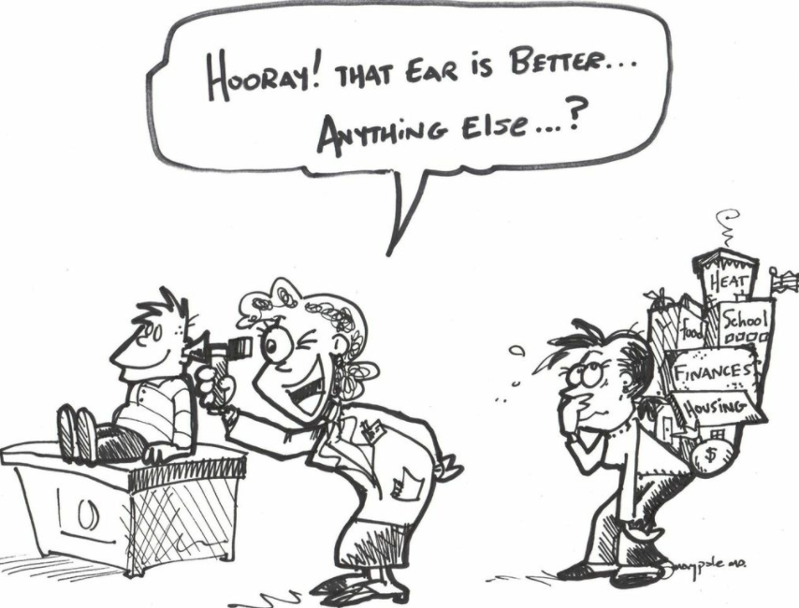
SIREN’s mission is to catalyze and disseminate high quality research that advances efforts to address patients’ social and economic needs in the context of health care delivery.
Used with permission from Jack Maypole, MD
Notes:
First I would like to give you a little bit of background by introducing SIREN. SIREN, the social interventions research and evaluation network, is an institute housed at UCSF whose mission is to catalyze and disseminate high quality research that advances efforts to address patients’ social and economic needs in the context of health care delivery. SIREN was basically created to help build the evidence about how to improve the care being provided in this cartoon and to recognize what physicians treating low income patients have recognized for a long time that all of the social and economic hardships experiences by families affects health outcomes and the effectiveness of medical care. However, in the fee-for service model of health care, they were unable to do much about this.

Slide 3
New incentives leading to new care models
Payment Reform
Pay for performance
ACO
Care Transformation
Multidisciplinary care teams
Care management/ coordination
Bundled payment
Capitation
Prevention
Addressing social determinants
Population health
Notes:
New incentives unleashed by payment reforms in the ACA are spurring health care transformation to improve health outcomes and care quality at reduced cost. The various payment reform efforts that are underway, including pay for performance, bundled payments, ACOs and capitation models, are incentivizing new activities and services including multidisciplinary care teams, care coordination and management, as well as an increased focus on population health, prevention, and efforts to address SDH. SHD are a focus because…

Slide 4
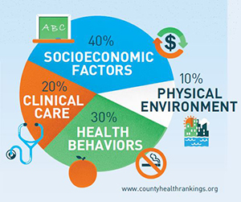
Determinants of health
Notes:
Because of the research, over the past several decades that has found that socioeconomic factors, also known as social determinants of health, have a substantial impact on health, in this model accounting for 40 percent of the variability in health outcomes. It is worth noting that since socioeconomic factors influence clinical care, health behaviors and physical environment, the total impact of SDH may be even larger.

Slide 5
Roles of health care sector around SDH
Modify care
Change medication dosing
Use generic or non-refrigerated medications
Include interpreters
Open evening and weekend clinics
Use phone and text instead of mail reminders
Modify patients’ SDH
Connect with food programs
Provide legal services to address landlord tenant dispute
Refer for supportive or low income housing
Connect with free diaper and parenting programs
Link to GED or ESL classes
Notes:
What role can health providers play in addressing SDH? There are two main ones:
One, they can modify care to improve its effectiveness. For instance, providers might dose medications around work schedules, open evening or weekend clinics, use non-refrigerated medications, or ensure interpreters are present at all clinic visits. These are all efforts to modify care to improve outcomes for people experiencing social and economic hardships.
The second approach, and this pushes the bounds of clinical health care a little more, focused on efforts to actually change patients’ SDH. This might involve helping patients connect with food programs to resolve food security, providing legal services, referring to supportive or low income housing. The thinking underlying this approach is that addressing social determinants could potentially be part of what improves health and reduces preventable health care utilization.

Slide 6



















Notes:
Although that second approach is a paradigm shift for medicine, there are a lot of organizations now working in this space—including some major medical providers and influential medical professional organizations and health care bellwethers like the National Academy of Medicine, the National Association of Community Health Centers, the American Academy of Pediatrics, many Primary Care Associations across the country. And as of earlier this year, CMS has funded 32 sites around the country as part of the Accountable Health Communities model to test how screening patients for SDH and referring them to services impacts health, care quality, utilization and costs.

Slide 7


‘Actionable’ social determinants of health
Food security
Housing security
Housing quality
Financial security
Education
Employment
Child care
Safety
Social support
Transportation
siren
Notes:
In general programs to address social determinants begin with providers screening patients for what we at SIREN like to call “actionable” social determinants (i.e. social determinants of health that can be improved through the action of clinical teams, for example by referring to community resources or by providing services directly.) These include things like food security, housing security and quality and other basic needs, as well as safety and social support. Most of the data is collected directly from patients but some sites also pull neighborhood data from local, state ad or federal databases to help characterize patients’ needs.

Slide 8
Screening Tool Examples
IOM domains and questions (11 domains, 24 questions)
PRAPARE tool (16 domains, 21 questions)
Accountable Health Communities (CMMI/CMS) tool (5 domains, 10 questions)
Heath Leads REACH (domains & questions vary)
Domain-specific: Hunger Vital Sign (2 questions)
Other tools: WE CARE, IHELP, SEEK, WellRX, HealthBegins, and more …
(https://sirenetwork.ucsf.edu)
Notes:
To facilitate patient level screening for social and economic needs, several screening tools have been developed over the past 5-10 years. Here are a few of the better known and most used. The domains and questions used vary. Some are domain-specific tools (like the Hunger Vital Sign for food insecurity) and some are multi-domain, comprehensive screening tools (like the PRAPARE tool or the CMMI tool). Some vary by the target populations—like those focused on pediatric versus adult patient populations. For more information about these tools you can visit the SIREN website (listed in the footer) where we have them all listed.

Slide 9
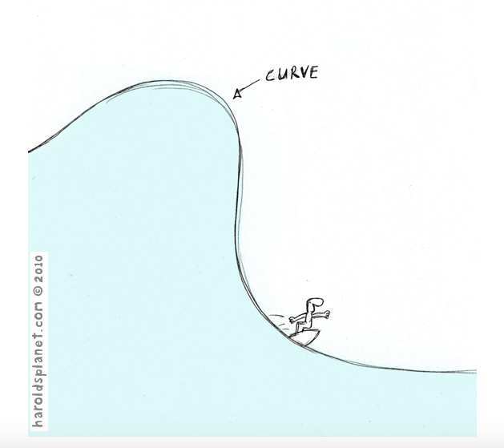
EVIDENCE
REST OF HEALTH CARE
EARLY ADOPTERS
Adapted and used with permission from Ralph Lazar. HaroldsPlanet.com ©2010.
Notes:
So there has been a fair amount of work on developing tools for screening. The problem comes with what happens next. How are these data being used in clinical settings? There’s been a lot of experimentation around that, but pretty limited evidence on the interventions that make a difference. Evidence is lagging pretty far behind the early adopters and even the rest of the health care field.

Slide 10
Social prescribing is being widely
advocated and implemented but current evidence fails to provide sufficient detail to judge either success or value for money. If social prescribing is to realize its potential, future evaluations must be comparative by
design and consider when, by whom, for whom, how well, and at what cost.
Bickerdike L, Booth A, Wilson PM, et al. Social prescribing: less rhetoric and more reality.
A systematic review of the evidence. BMJ Open 2017;7:e013384
(https://sirenetwork.ucsf.edu)
Notes:
A recent review of evidence in the UK, which has been experiencing the same surge in interest in this area, which they call social prescribing, stated:
Social prescribing is being widely advocated and implemented but current evidence fails to provide sufficient detail to judge either success or value for money. If social prescribing is to realize its potential, future evaluations must be comparative by design and consider when, by whom, for whom, how well, and at what cost.
Our research group recently published a review of the research in the US that found exactly the same thing. By the way, if you are interested in these papers you can find both of these papers in the Evidence Library on our website.

Slide 11
Uses of SDH data in clinical settings
Patient level:
  Modify care to better meet patient needs
  Modify patients’ social needs to improve health
System level:
  Population health
  Risk adjustment and payment reform
Notes:
What can be done with SDH data collected from patients? We already talked about how the data can be used to modify patient care and to modify patients’ social determinants of health . In addition to these patient level uses, there are several system level uses, including using SDH data to engage in community health efforts to address population health. Another key use is to carry out risk adjustment and payment reform so that providers and health systems that serve large numbers of patients with social needs aren’t penalized in a value-based care world. The NAM is is currently investigating risk adjustment options, as is NQF. All of these are active areas of research, with more research needed to determine the most effective strategies.

Slide 12

Uses of SDH data in clinical settings
Patient level:
  Modify care to better meet patient needs
  Modify patients’ social needs
System level:
  Population health
  Risk adjustment and payment reform
Inter-operable SDH data
Notes:
To facilitate that research as well as for the system level uses and often for patient level efforts to address social needs, it is key to have access to SDH data that is collected in a standard way and that is interoperable so that data can be either shared across systems in the case of patient care, or aggregate across systems for population health and risk adjustment purposes.

Slide 13
SDH data capture and interoperability technical needs
Full complement of codes reflecting SDH
Guidance about how to use codes
EHR functionality
Interoperability
Notes:
To achieve interoperable SDH data, there are currently several technical hurdles.
First, we do not yet have a full complement of medical terminology codes to use to capture SDH data in EHRs. As we’ll hear more about from other speakers today, we have a partial set but not for all SDH domains and not for all part of the SDH screening and interventions spectrum.
Second HIT specialists, EHR vendors, and data users need guidance about how to use these codes, which codes to use when etc..
Third, EHR systems need to include SDH data capture functionality. Many vendors are working on this so options in this space should be becoming much more common soon.
Fourth, we need technical specifications for interoperability through systems like HL-7, FHIR etc.

Slide 14
SDH Capture in EHRs Planning Group
Vivian Auld, NLM
Michael Cantor, New York University School of Medicine
Terry Cullen, Regenstrief
Sarah DeSilvey, Vermont
Lisa Lang, NLM
Samanthan Meklir, ONC
Michelle Proser, National Association of Community Health Centers
Al Taylor, ONC
Dan Vreeman, Regenstrief
Notes:
In order to help facilitate filling these gaps, SIREN is part of an effort with several key tool developers and medical codes standards development organizations to develop a complete SDH medical coding terminology set and guidance to use of these codes. One key element of that effort is to provide a collaborative mechanism for SDH screening tool developers to help ensure the development of a standardized way to collect these data. I want to thank all the folks on this list who are working with us to move this effort ahead.

Slide 15
SIREN Research Advisory Committee
Laura Gottlieb, UCSF/SIREN Director
Nancy Adler, UCSF/SIREN co-Director
Sara Ackerman, UCSF
Andrew Beck, Cincinnati Children’s Hospital
Jim Bellows, Kaiser Permanente
Seth Berkowitz, Mass. General Hospital
Elena Byhoff, Tufts Medical Center
Alicia Cohen, University of Michigan
Jeffrey D. Colvin, University of Missouri
Erika Cottrell, OCHIN
Eric Fleegler, Boston Children’s Hospital
Damon Francis, Health Leads
Arvin Garg, Boston University
Rachel Gold, OCHIN
Danielle Hessler Jones, UCSF
Clarissa Hsu, University of Washington
Robert Kahn, Cincinnati Children’s Hospital
Stacy Lindau, University of Chicago
Tricia McGinnis, CHCS
Andrew Pinto, University of Toronto
Maria Raven, UCSF
Megan Sandel, Boston University
Adam Schickedanz, UCLA
Sara Standish, Health Leads
John Steiner, Kaiser Permanente
Notes:
IN closing I want to acknowledge Laura Gottlieb and Nancy Adler who are SIREN Director and co-director and the RAC that advises us.

Slide 16

Questions?
Contact: caroline.fichtenberg@ucsf.edu
Website: http://sirenetwork.ucsf.edu
Twitter: @SIREN_UCSF
Notes:
Finally I would like to open it up for questions

