Slide 1

Decentralized Identifiers (DIDs):
Solving the Root Identity Problem
ONC Healthcare
Blockchain Challenge September 30, 2016
Drummond Reed
CEO, Respect Network

Slide 2
Why is blockchain identity a breakthrough?
Distributed ledgers (blockchains) are tremendously secure, scalable, and reliable
When applied to identity, a distributed ledger can solve the “root of trust” problem:
  How can there be a global source of identity that everyone trusts, but isn’t owned or controlled by any
  one company or government?
It enables true self-sovereign identity

Slide 3
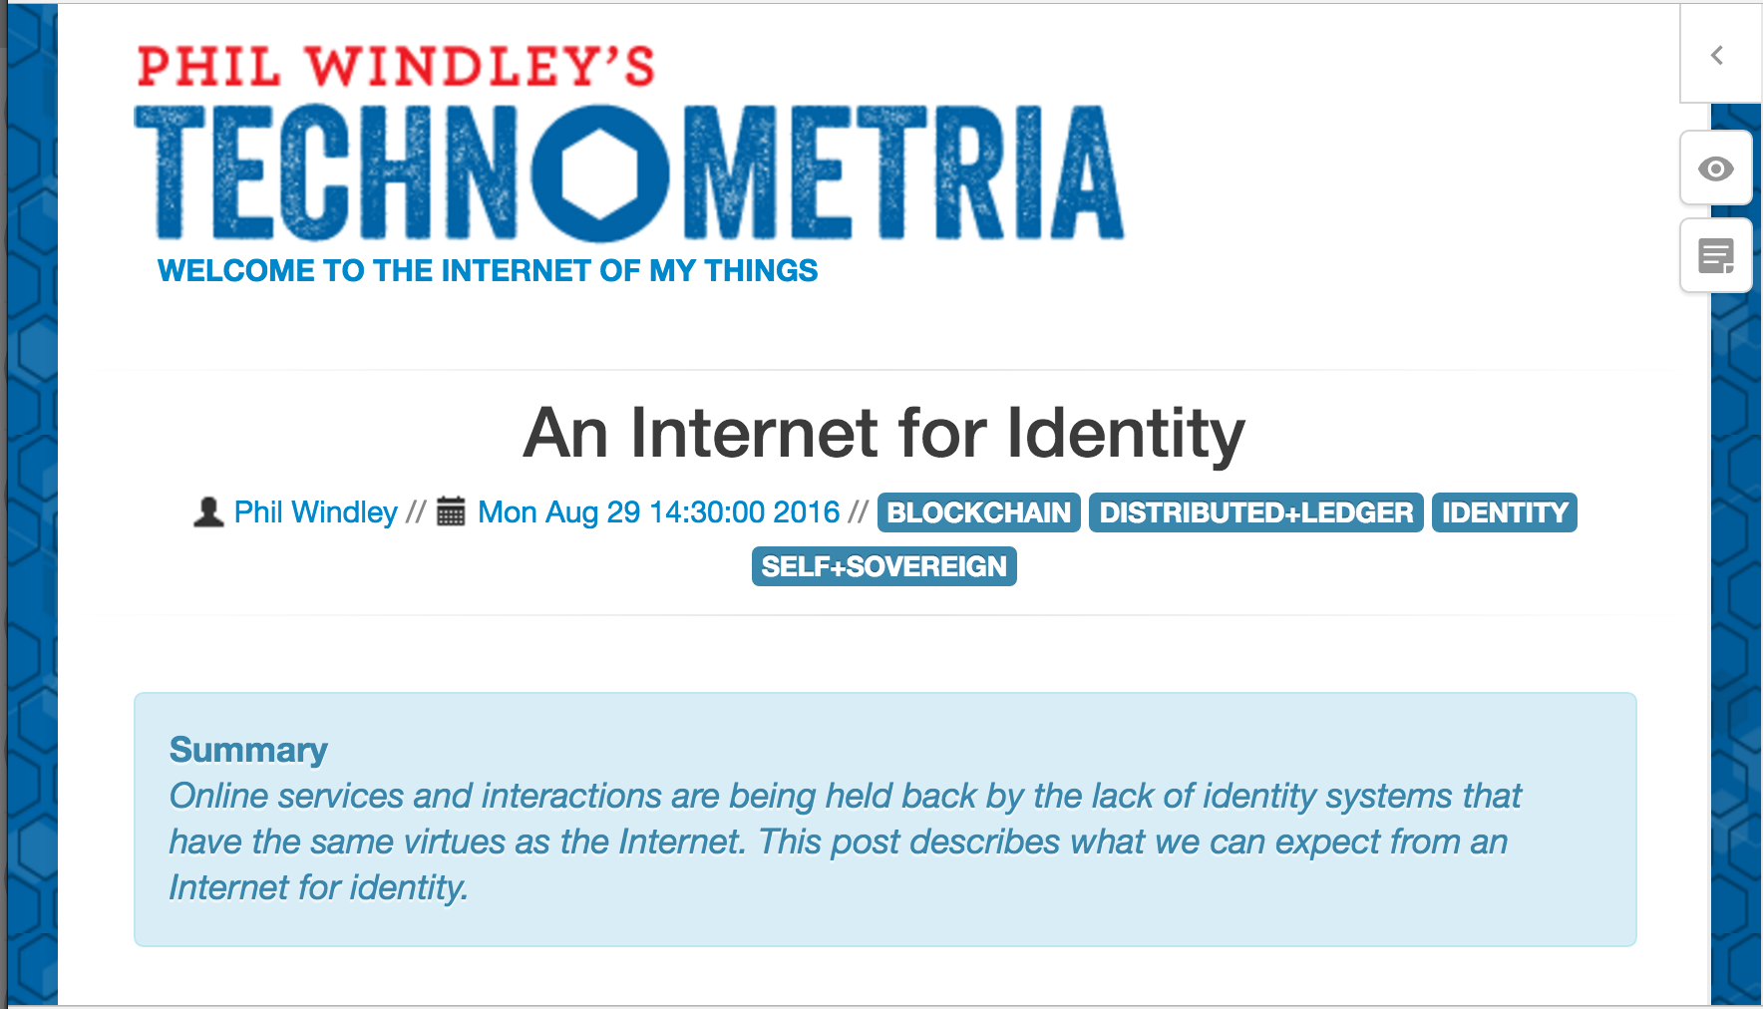

Slide 4
Blockchain Models
Validation
Permissionless
Permissioned
Bitcoin
Ethereum
Sovrin
Public
Access
N/A
Concord (R3)
CU Ledger
Private

Slide 5
So, on a “fit for purpose” identity ledger, what does a root identity record look like? And can it deliver both security AND privacy?

Slide 6
{ Key: “Value” }
{ DID: “DID Object” }

Slide 7
DIDs (Decentralized IDentifiers)
Term originally coined by W3C Verifiable Claims Task Force
Design goal: a globally unique identifier anyone can generate without a central authority
Default choice: a UUID
did:76d0cdb7-9c75-4be5-8e5a-e2d7a35ce907

Slide 8
CIDs (Cryptographic IDentifiers)
Term originally coined by OASIS XDI Technical Committee
Design goal: a globally unique identifier anyone can generate—but with specified cryptographic properties
Example: a base58 encoded Ed25519 key
cid-1:MIIBIjANBgkqhkiG9w0BAQEFAAOCAQ8AMIIBCgKCABMC

Slide 9
Bridging the DID and CID Worldviews
There are strong arguments for both
We are currently seeking a consensus across the two camps
But on this we all agree: there should be a single unified standard for the globally unique identifier of a DID object

Slide 10
{ Key: “Value” }
{ DID: “DID Object” }

Slide 11
DID Objects: The Fundamentals
JSON object
  Conformant with RFC 7159
Digitally signed
  JSON Web Signature (RFC 7515)
  JSON-LD signature
  JXD (JSON XDI Data) signature

Slide 12
DID Objects: The 4 Essential Elements
Identifier (reflexive)
Pointer(s) to sources of claims (attributes)
Cryptographic Proof of Ownership
Cryptographic Proof of Update

Slide 13
Proof of Ownership: Two Options
CID
  Easy if already supported by the DLT
  Extensible to different CID types
PEM (Privacy Enhanced Mail) format
  Popular public key encoding format
  RFCs 1421-1424

Slide 14
Proof of Update: Three Options
Self
M of N signatures (CID or PEM)
Smart signatures (Christopher Allen et al)

Slide 15
Binding DIDs to DLTs
A DID binding defines the CRUD (Create, Read, Update, Delete) operations on a DID record for a specific DLT
Can be defined for almost any DLT
  Sovrin, Bitcoin, Ethereum
Caution: storing DIDs on multiple DLTs introduces very complex source-of-authority problems

Slide 16
Four Rules for Respecting Privacy
Allow multiple DIDs for persona and pseudonym management
Avoid storing private attributes on a public ledger (even when encrypted)
Avoid correlation of off-ledger pointers
Use anonymous credentials (zero-knowledge proofs) whenever possible

Slide 17
Future Work: Please Join Us
Watch for publication of DID Identifers and Objects specification
Join us at one of the following events (all in San Francisco or Mountain View):
  Rebooting the Web of Trust—Oct 19-21
  Internet Identity Workshop—Oct 25-27
  Verifiable Claims Task Force—Oct 27-28

Slide 18
Thank You

